Slide 1
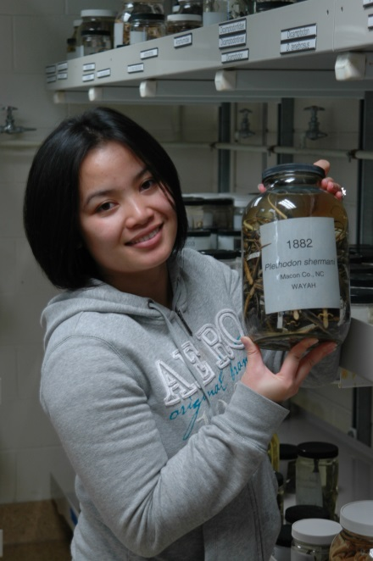
OSU Herpetological Research Collection: Past, Present, Future
video
Stevan J. Arnold
Curator of Amphibians & Reptiles
Department of Integrative Biology
Notes:
The Herpetological Research Collection (HRC) is separate and distinct from the smaller Herpetological Teaching Collection. This ppt is intended as help in planning the future of the HRC. Most of this presentation is devoted to describing the HRC and making the argument for hiring a curator. The last few slides explore just a few of the options for a curatorial hire. A video of this presentation is available at for the 18 October 2018 Faculty Meeting entry in the IB folder on the OSU Box = https://oregonstate.app.box.com/file/334132841243

Slide 2
Overview
The current curator is retiring on 1 Jan 2019 but will work pro bono for a couple of years.
Do we need a replacement curator?
What are the options for hiring a replacement?

Slide 3
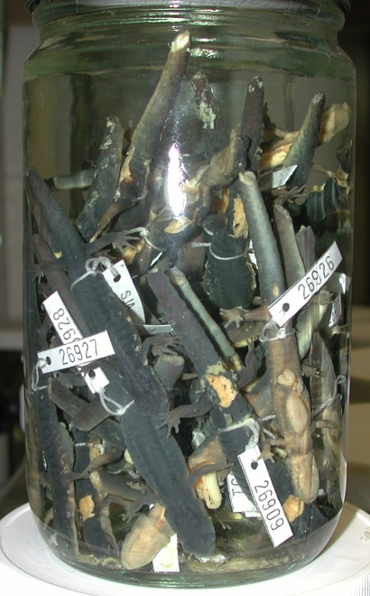
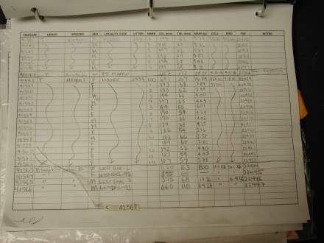
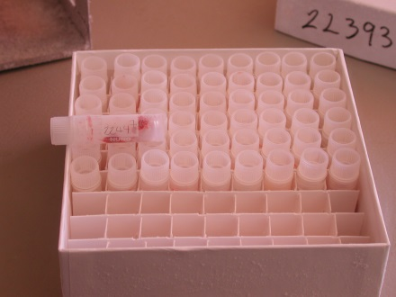
What is the collection?
Specimens (50,000+ amphibians and reptiles preserved in ethanol).
Records (60,000+ records of localities, pedigree, stomach contents, photos, habitat,
etc).
Frozen tissue (20,000+ samples of tissue frozen at -80 deg C).
Localities (4,800+ sampling stations documented with notes, photos, and videos).
more details
Notes:
The OSU Herpetological Research Collection (the subjects of this ppt) is distinct from the Vertebrate Teaching Collection in IB, click the link on the slide. Specimens.- In this collection, as in most herpetological research collections, individual specimens are tagged with a unique number.

Slide 4
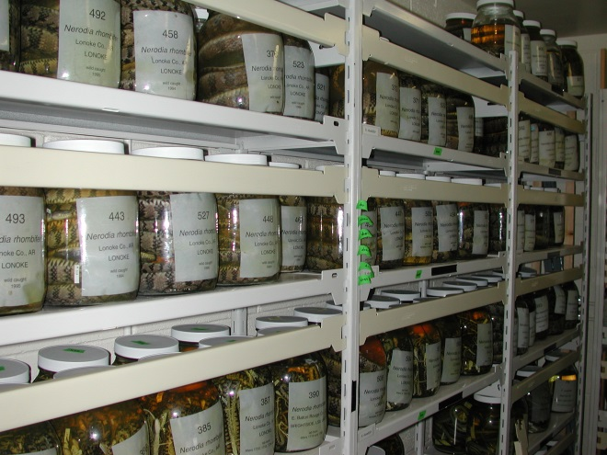
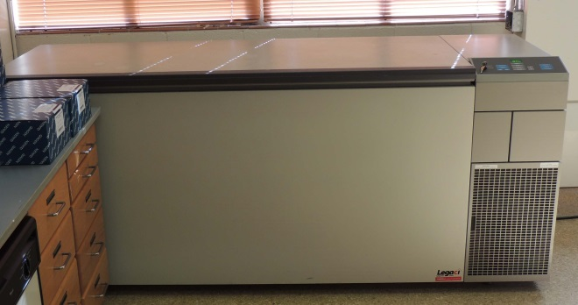
Where is the collection?
Physical presence of specimens.- was in Cordley →
now in Weniger → will return to Cordley
Physical presence of frozen tissue and hard copies of records.- Cordley
Local and online digital presence of records.-
T: drive, VertNet
link
Notes:
Crucial files for the Herpetological Research Collection are located at T:/Zoology/Cord5021/Catalog. The online, searchable version of the specimen catalog, on VertNet, is located at http://portal.vertnet.org/p/oregon-state-university.

Slide 5
Why can’t we put the collection
in storage?
It is being used.
It is growing.
Need access for routine curating (e.g., replacing fluid lost by evaporation, answering queries, etc).
It is flammable.
Notes:
Specimens are stored in 70% ethanol, which is classified as a Category 2 Flammable Liquid and regulated as such by the OSU Health and Environmental Safety and the Corvallis Fire Marshall.

Slide 6
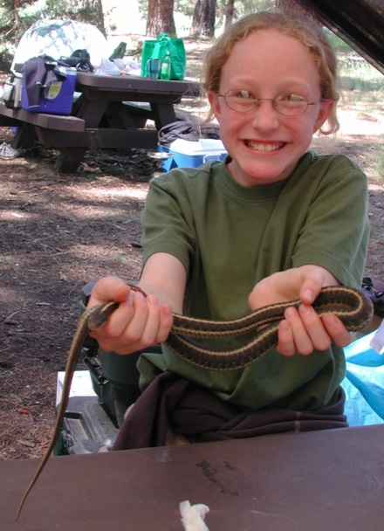
Who uses the specimen
collection?
Researchers (e.g., physical access to specimens, loans of specimens and tissue).
Students (e.g., research projects, dissertaton research, tours).
Public (e.g., individual and group tours).

Slide 7
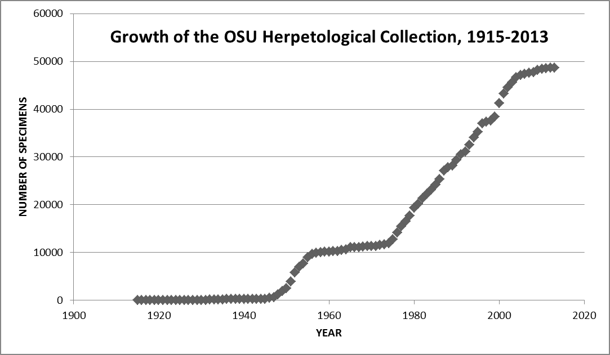
How fast is the specimen collection
growing?
Notes:
During the most active periods, the rate is about 1500 specimens/yr

Slide 8
Why is the collection important?
Documents the distribution of Oregon’s herpetofauna.
Significant national/international resource.
Important resource for specimen- based teaching, research, and outreach.
Notes:
Preserved specimen and DNA vouchers are important for locality records because they verify the true taxonomic identity of those records.

Slide 9
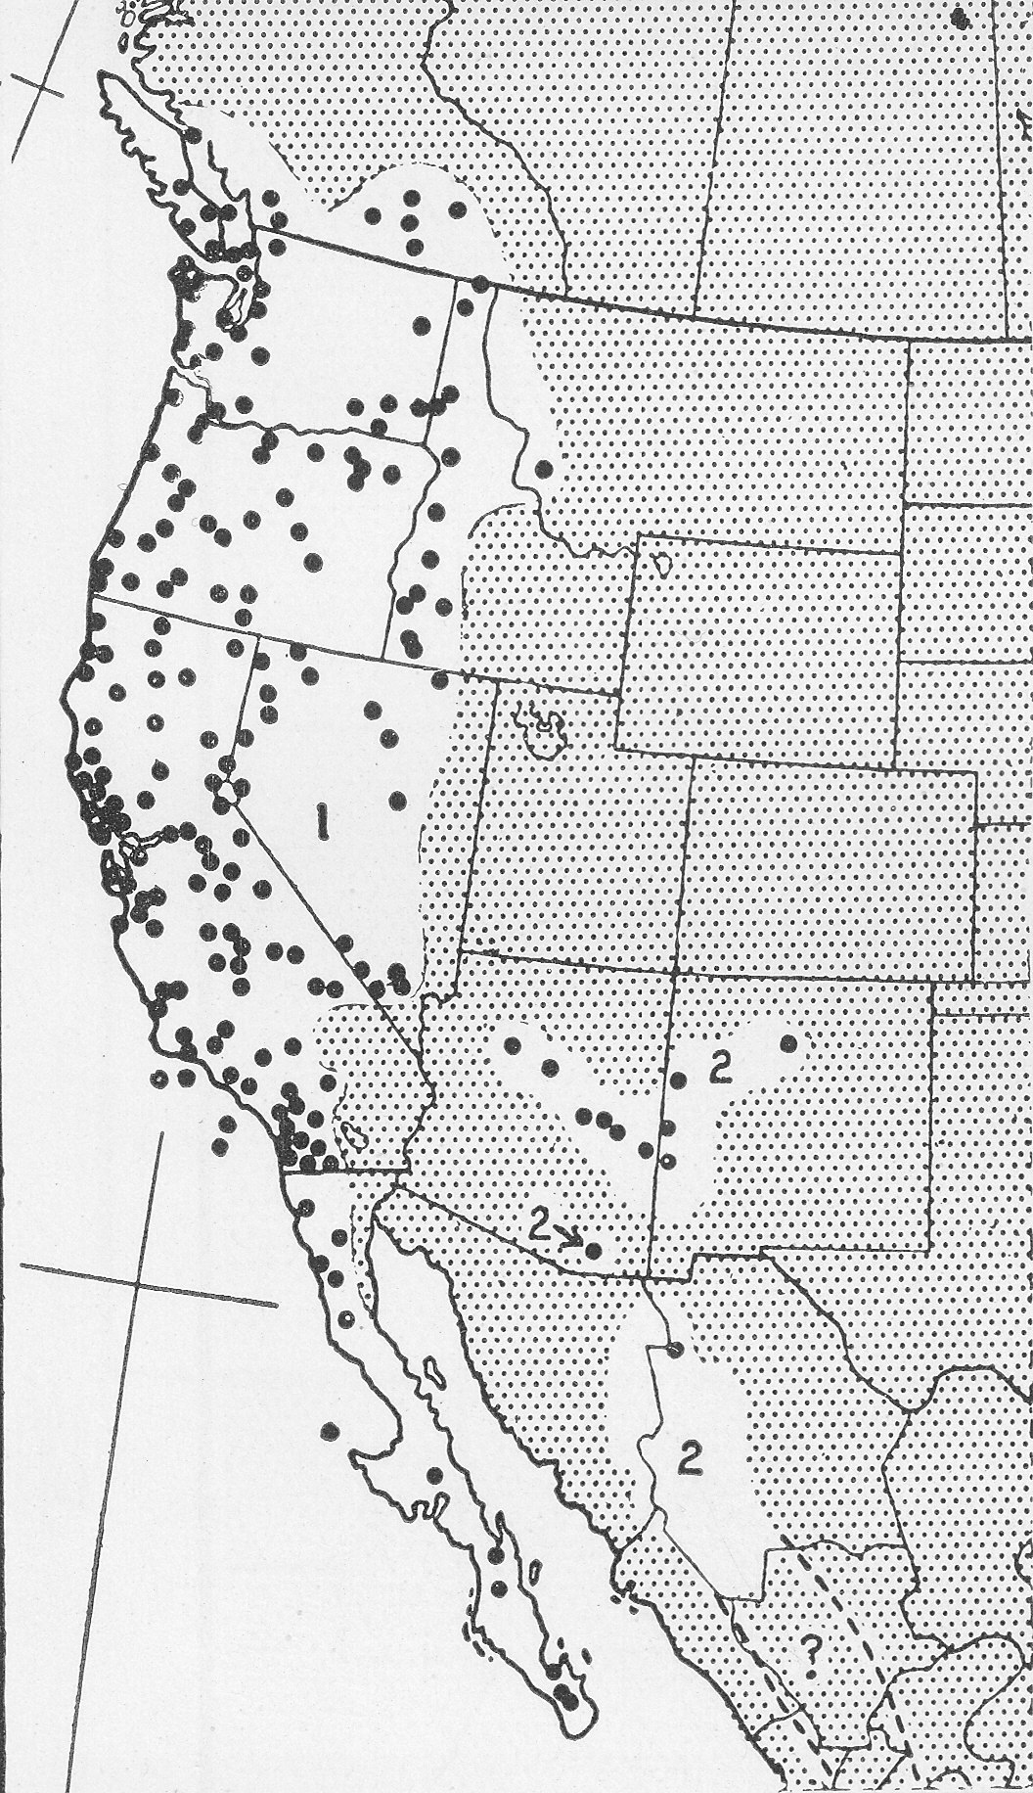
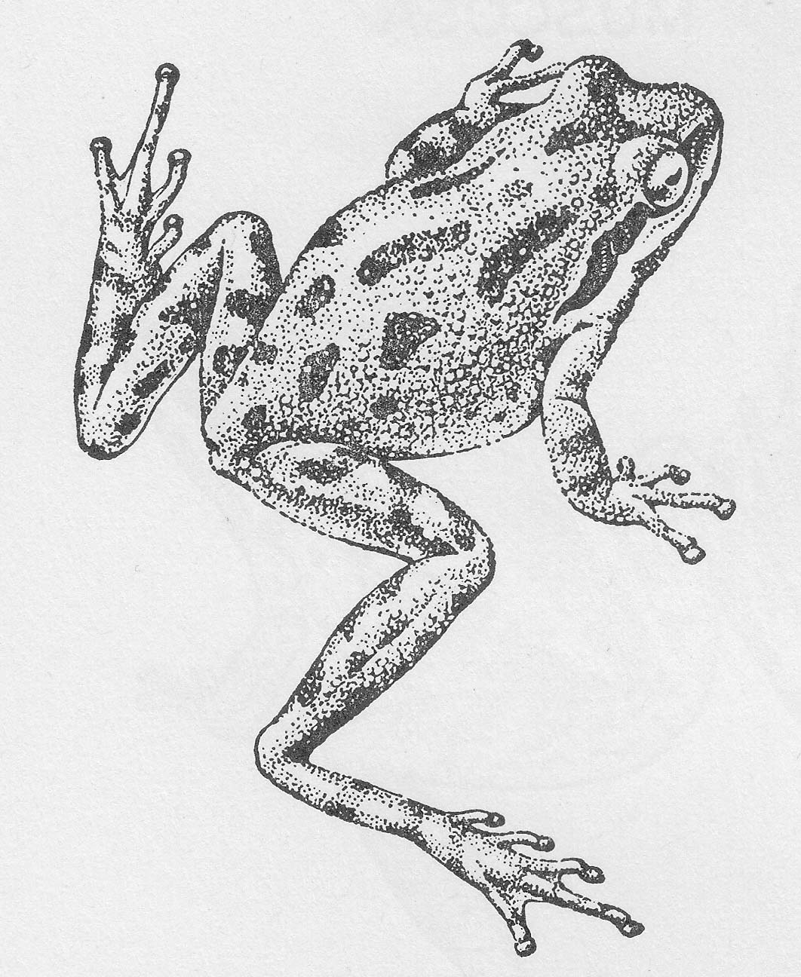
Distribution of the Pacific Chorus Frog
based on museum records
Pseudacris regilla
Stebbins 1951
Notes:
Figure and map from Stebbins 1951, Amphibians of Western North America. Records labeled 1 are P. regilla, records labeled 2 are P. wrightorum. Most of the records for Oregon are based on OSU specimens.

Slide 10
20 Largest Herpetological Specimen Collections
in the USA (thousands of specimens)
Rank | # specimens | name | State
1 | 572 | National Mus Nat Hist | DC
2 | 349 | Amer Mus Nat Hist | NY
3 | 347 | Univ Kansas Biodiv Instit | KS
4 | 316 | Cal Acad Sci | CA
5 | 285 | Field Mus Nat Hist | IL
6 | 272 | Museum of Vert Zool | CA
7 | 197 | Univ Michigan Mus Zool | MI
8 | 173 | Florida Mus Nat Hist | FL
9 | 170 | Carnegie Mus Nat Hist | PA
10 | 114 | Univ Texas Arlington A&R Div Res Ctr | TX
11 | 99 | Louisiana State Mus Nat Sci | LA
12 | 94 | Texas Nat Hist Collections, Austin | TX
13 | 76 | San Diego Nat Hist Mus | CA
14 | 66 | Univ Colorado Mus Nat Hist | CO
15 | 63 | James R. Slater Mus Nat Hist | WA
16 | 59 | Sam Noble Oklahoma Mus Nat Hist | OK
17 | 58 | Oregon State University | OR
18 | 57 | Univ Arizona Mus Nat Hist | AZ
19 | 49 | North Carolina Mus Nat Sci | NC
20 | 43 | Yale Peabody Mus | CT
Notes:
Based the sizes of collections that are members of VertNet. Some institutions list the entire size of their vertebrate holdings without breaking down the total by taxon (e.g., the MCZ at Harvard University). Those institutions are not included in this table.

Slide 11
Who owns/controls the collection?
Individual researchers.
Department of Integrative Biology.
Deans of the Colleges of Science & Agricultural Science.
Notes:
You might think that ownership and control falls into three categories, but that is NOT the case.

Slide 12
Who owns/controls the collection?
Individual researchers.
Department of Integrative Biology.
Deans of the Colleges of Science & Agricultural Science.
Notes:
A statement by the Deans of CoS and CoAS that they, not departments or individual researchers, control research collections in their departments was made in the aftermath of dissolving the Department of Entomology (sometime before 20060. In the DoE some researchers had claimed that they owned the insect collections that they had built while on the faculty of OSU. The Deans refuted that view. Because OSAC was jointly administered by CoS and CoAS, the Deans also asserted a controlling role over the OSAC collections, and by extrapolation that assertion applies to other research collections.

Slide 13
Implications of College-level control of
the Herpetological Collection?
IB cannot give the Collection away or sell it on Ebay.
If IB does not exercise its responsibility to maintain the collection, it could be transferred to another department.
Along with such a transfer, IB would lose the opportunity to hire a curator and teach two herpetology courses (IB 573 Herpetology, IB 574 Systematic Herpetology)

Slide 14
Who pays for collection operations
and other expenses?
NSF research grants.- Arnold & Houck grants for work on snakes and salamanders.
Department of IB.- funds allocated on item-by- item basis.
Natural History Fund.- endowment generates ca $16K/yr, shared by several collections.
Braly Fund.- endowment generates ca $12K/yr, used for IB faculty research setups.
NSF infrastructure program.- for special needs, not day-to-day operations.
Notes:
The operating expenses for the Collection are about $5-10K per year (excluding salary for a curator). The Herpetological Research Collection does not have a sustainable budget model. In other words, the HRC budget is not a line item in the IB or CoS budget. Instead, the budget is an ad hoc patchwork of funds from several sources.

Slide 15
What does a curator do?
Answer questions (e.g., from the public, researchers, students, administrators, Fire Marshall).
Identify specimens (including photographs of specimens).
Supervise the maintenance and growth of the collection and its databases (including writing collection improvement grants).

Slide 16
Who will curate the collection?
The R. Storm/ S. Arnold model.- tenure track with research, curatorial, and teaching duties; systematics training.
The Peter Konstantinidis model.- instructor with curatorial and e-campus teaching duties; systematics training.
The Chris Marshall model.- non-tenure track faculty with curatorial and teaching duties; systematics training.
Notes:
Peter Konstantinidis has an appointment in OSU Fisheries and Wildlife and curates three collections in that department: fishes, mammals, and birds.
Training in systematics (the study of phylogenetic relationships) is an important requirement for a curatorial hire for a couple of reasons. First, research collections worldwide are organized according to the Linnaean hierarchy (class, order, family, genus, species). Consequently, a curator needs to be familiar to that hierarchy as it applies to amphibians and reptiles. Second, a curator needs to be able to evaluate current systematic literature on amphibians and reptiles both to organize the collection and communicate with its largest clientele (systematists).

Slide 17
Summary
The collection consists of specimens, tissue, and data of several kinds.
The collection supports collection-based teaching, research, and outreach.
The collection has local, regional, and national users.
The collection needs a curator trained in herpetology and systematics.
The curator might be a tenure track or instructor faculty appointment.

