Slide 1

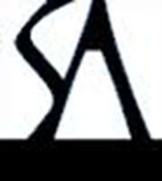
Phenotypic evolution: the emergence of a new synthesis
Stevan J. Arnold
Oregon State University
Notes:
This talk consists of a story within a story. The outer story poses the question ‘If we were in the midst of one of the great synthetic periods in evolutionary biology, how would we know it?’ The inner story asks the question ‘What is the best model for phenotypic evolution?’ and illustrates my contention that we are in the midst of a great synthetic period by comparing a vignette of synthesis from my own work with G G Simpson’s (1944) synthesis. This presentation, the American Society of Naturalists Presidential Address, was given at the First Joint Congress on Evolutionary Biology, in Ottawa, Canada on 9 July 2012. The logos are reminders that a manuscript with a similar title will be submitted for publication in the American Naturalist in the next year and, in book form, for publication by Sinauer Associates in the next couple of years.

Slide 2
If we were in the midst of one of the great synthetic periods in evolutionary biology, how would we know it?
Synthesis in evolutionary biology then and now
Simpson (1944) & the ongoing synthesis in evolutionary quantitative genetics
Two examples of the ongoing synthesis (Estes & Arnold 2007, Uyeda et al. 2011)
Conclusions & perspectives from the two studies
Some general lessons about synthesis in evolutionary biology
Notes:
The outer story (points 1, 2, 5), the inner story (points 3, 4).

Slide 3
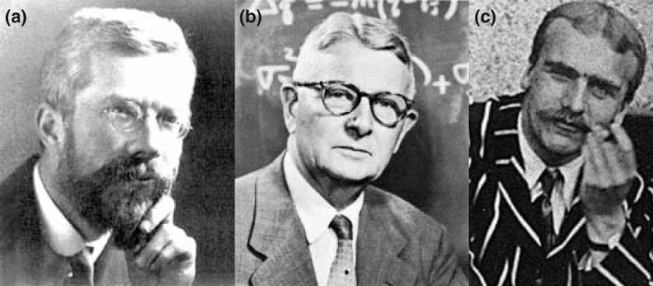
Synthesis 1930-32
R A Fisher 1930 The genetical theory of natural selection..12,618 citations
S Wright 1931 Evolution in Mendelian populations…………... 5,493
J B S Haldane 1932 The causes of evolution………………………. 1,463
Notes:
Fisher, Wright and Haldane’s publications are capstones for the blossoming of population genetic theory that they cultivated in the 1920s. The three publications mentioned here are dramatically different in style, just as the authors differed stunningly in personality (and attire). Although they contributed to this same synthetic period, Fisher and Wright held contrasting views about evolutionary process. Adherents to their respective positions continue to argue to the present time. Wright (1931) is a major paper rather than a book, but it is an important and timely summary of his views.

Slide 4
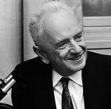
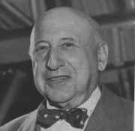
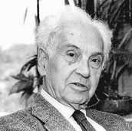
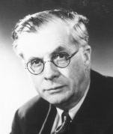
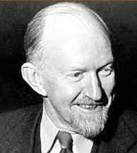
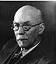
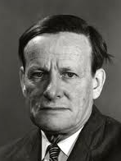
Synthesis 1937-50
T Dobzhansky 1937 Genetics and the origin of species…….. 4,591 citations
R Goldschmidt 1940 The material basis of evolution…….…. 1,009
E Mayr 1942 Systematics and the origin of species …………. 4,380
J Huxley 1942 Evolution, the modern synthesis………………. 1,891
G G Simpson 1944 Tempo and mode in evolution…………… 1,684
I I Schmalhausen 1949 Factors of evolution …………..…..…… 841
G L Stebbins 1950 Variation and evolution in plants………… 3,506
Dobzhansky Goldschmidt Mayr Huxley Simpson Schmalhausen Stebbins
Notes:
The period 1937-50 is sometimes known as ‘The Modern Synthesis’, a moniker that seems increasingly outdated. This synthesis is sometimes attributed more narrowly to Dobzhansky, Mayr, Simpson, and Stebbins, all of whom published books in a series edited by L C Dunn for Columbia University Press. These authors did not always see eye-to-eye. Even the smaller set of three or four (the Big Three or Four) held contrasting views. For example, Mayr reports that he was so infuriated by Goldschmidt’s book that he set to work on his own account of geographic variation and speciation. Mayr chastised Simpson for his brief treatment of speciation. Simpson responded that he did in fact devote considerable space to speciation, but in any case his focus was on the major features of evolution, not on minor features such as speciation. The Modern Synthesis was far from harmonious.

Slide 5
Synthesis in evolutionary biology
An ongoing process since 1859, especially now!
Cumulative number of citations of 57 influential books
as a function of time
17,902
19,574
Notes:
Stepping back from the specifics of past synthetic periods, we see a continuous and accelerating graph of synthetic activity. Synthesis in our time? Schluter’s (2000) book on the ecology of adaptive radiations is a case in point. With 2,000 citations in just the last dozen years, this book compares favorably to the major books of the Modern Synthesis on many counts in addition to citation. To continue the comparison of past and contemporary synthesis, I now turn to my inner story, comparing Simpson’s synthesis, and in particular his account of quantum evolution with my own recent research that bears on phenotypic evolution in deep evolutionary time.

Slide 6
Simpson’s 1944 synthesis
Population genetics meets paleontology … evolution in deep evolutionary time
Reliance on case studies
Qualitative use of theory
Use of graphical models (e.g., adaptive landscape for phenotypic traits)
Notes:
Simpson’s 1944 book, Tempo and Mode, is often cited as the first reconciliation of paleontology with population genetics. Simpson’s own assessment was that alone among the contributors to the Modern Synthesis he steadfastly explored the time dimension, and especially deep evolutionary time. Simpson’s book strikes the modern eye as lacking in data tables, compilations, and graphs. In this sense, his argument is much closer to Darwin than to, say, Schluter. Like Darwin, Simpson digests case studies out of sight and presents us with distilled principles. His use of theory is largely qualitative. He sketches arguments of logic and consistency using population genetic theory, cast in term of the short term dynamics of allelic fixation. The actual gist of Simpson’s theoretical arguments is presented in graphical models of the type illustrated in the next slide.

Slide 7
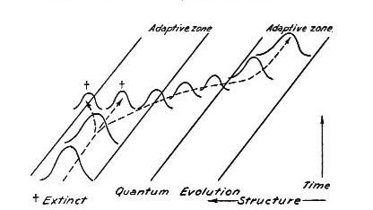
Simpson’s concept of quantum evolution
Notes:
Simpson’s (1944) use of the adaptive landscape concept is explicit in his book and implicit in this figure, in which the frequency curves for a quantitative trait evolve within and transit between adaptive zones.

Slide 8
Simpson’s concept of quantum evolution
Notes:
The connection of Simpson’s model to contemporary evolutionary quantitative genetics becomes clear when we superimpose a stabilizing selection function, that could account for the stability of the frequency curves that Simpson graphs. We let the optimum of that function anticipate the path of the evolving trait mean as it transits to a new adaptive zone, as in Lande’s (1976) displaced optimum model. Simpson called rapid and substantial evolution of this kind ‘quantum evolution’ and considered it his most controversial innovation in 1944. He used horse evolution as a possible example of quantum evolution, arguing that especially rapid and substantial evolution occurred as the horses moved from a browsing to a grazing adaptive zone. But Simpson also argued that such quantum evolution was exceptional and that most evolution occurred within adaptive zones. Such ‘phyletic evolution’ was characterized by extinction and modest diversification, as well as by literal stasis.

Slide 9
Ongoing synthesis in evolutionary quantitative genetics
Quantitative genetics provides a theoretical framework with direct connections to data
Key concepts rendered in statistical terms
Mega-data sets reveal evolutionary patterns
Test alternative models in ML framework
Notes:
Continuing with my inner story, I now take up the issue of how we might explore and test Simpson’s concept of quantum evolution. By way of contrast, the key points are that in contemporary synthetic studies we have: (1) a better conceptual framework, (2) much more data, and (3) better ways of testing our models (e.g., maximum likelihood = ML). For these reasons we shouldn’t be intimidated by the Modern Synthesis.

Slide 10
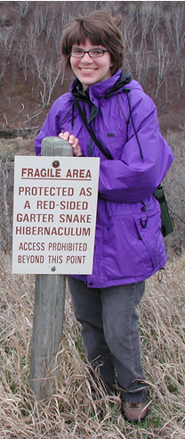
Two examples of ongoing synthesis
Suzanne Estes & S J Arnold
2007
Resolving the paradox of stasis: models with stabilizing selection explain evolutionary divergence on all timescales.
American Naturalist
Suzanne Estes
Notes:
The first element in my synthesis vignette is a study I did with Suzanne Estes of Portland State University.

Slide 11

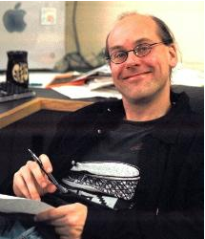

Two examples of ongoing synthesis
Josef C Uyeda, Thomas F Hansen, S J Arnold & Jason Pienaar
2011
The million-year wait for macroevolutionary bursts.
PNAS USA
Josef Uyeda
Thomas Hansen
Jason Pienaar
Notes:
The second element is a study with Josef Uyeda (then my PhD student at Oregon State University), Thomas Hansen (my colleague at the University of Oslo), and Jason Pienaar (then a postdoc with Hansen at Oslo).

Slide 12
The approach
Make data and theory communicate (Plot your data!)
Compile abundant, high quality data (necessarily univariate)
Compile a priori estimates of key parameters: population size, inheritance, selection
Use the most powerful stochastic models of phenotypic evolution, cast in terms of key parameters
Confront the models with data (cross-check with parameter estimates)
Notes:
The study with Suzanne Estes, self-consciously applied five principles. In the process, we departed from a couple of unfortunate positions that had become entrenched in the literature. For example, instead of using generic models of process (e.g., unparameterized OU and Brownian motion models), we used models that were parameterized in terms of effective population size, inheritance and selection. This improvement allowed us to test models at critical junctures by asking whether a model fit required parameter values that were biologically unrealistic. Secondly, we departed from the tradition of focusing on evolutionary rates. Let x be the amount of phenotypic divergence during an time interval of length y. Much of the literature prior to Estes & Arnold (2007), graphed and analyzed evolutionary rates (x/y) as a function of time (y). This parameterization is fraught with a ratio problem, long familiar in statistics. One escapes from this problem by graphing and analyzing divergence (x) as a function of time (y).

Slide 13

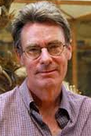
A priori estimates of key parameters
Heritability
Stabilizing selection
Distance to optimum
n=580
n=355
n=197
D Roff, pers com
Kingsolver et al. 2001
Kingsolver et al. 2001
Joel
Kingsolver
Derek Roff
Notes:
Another aspect of our approach was to use compilations of key parameters that were available in the literature. Three examples are shown here. Calculations of the measures of stabilizing selection and distance to an intermediate optimum are based on the data compiled by Kingsolver et al. 2001 and are described in Estes & Arnold 2007. The data for the heritability histogram were supplied by Derek Roff, but the original paper that used them was Mousseau & Roff 1987.

Slide 14
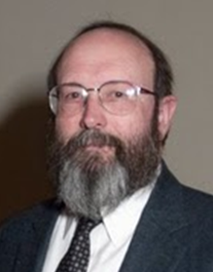
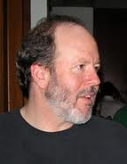
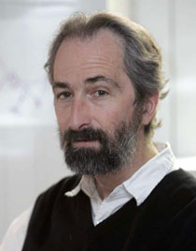
A short digression to talk about stochastic models of phenotypic evolution
If replicate lineages obey the same stochastic rules, we can statistically characterize the distribution of trait means of those replicates at any generation in the future.
Joe Felsenstein
Russ Lande
Mike Lynch
Notes:
The use of stochastic models of evolutionary process is central to the discussion that follows. Felsenstein, Lande, and Lynch are responsible for most of the non-generic, parameterized models of phenotypic evolution that are used in Estes & Arnold 2007. The essence of these models can be grasped by imagining a set of replicate populations, all derived from the same ancestral population with a trait mean of zero at generation zero. We specify a set of stochastic rules for the evolution of that trait mean and suppose that all of the independent replicate lineages derived from those populations obey those same rules. With the right specification, we can characterize the distribution of lineage means at any point in the future! The case of genetic drift supplies a concrete, simple example.

Slide 15
A short digression to talk about stochastic models of phenotypic evolution
For example, in the case of drift with no selection, the mean at a particular generation is the sum of two parts:
the mean in the preceding generation
deviation due to parental sampling, a normally distributed variable with zero mean and a variance equal to G/N_{e} ,
  where G is genetic variance and N_{e} is effective population size
Notes:
The example of genetic drift is easy to follow, so perhaps this is a good place to describe connections to two other models that figure prominently in the discussions that follow. In a model in which the position of a intermediate optimum undergoes Brownian motion, the (a) term is the position of the optimum in the preceeding generation, and the (b) term is a different but constant variance of a normal distribution, which describes the sampling of departures in optimum position. In a model of simple, pure white noise, the (a) term takes a constant value of zero, and the (b) term different but constant variance of a normal distribution, which describes the sampling of departures in optimum position.

Slide 16
A short digression to talk about stochastic models of phenotypic evolution
If drifting replicate lineages obey the same stochastic rules, we can statistically characterize the distribution of lineage trait means at any generation, t, in the future.
In this particular case, the replicate trait means will be normally distributed with zero mean and a variance equal to tG/N_{e}.
Notes:
Results of this kind are the statistical equivalent of ‘replaying the tape of evolution’, to use Stephen Jay Gould’s metaphor. Of course this statistical statement of future generations is much more powerful than the metaphor because we can use it as a foundation for testing our model with data.

Slide 17
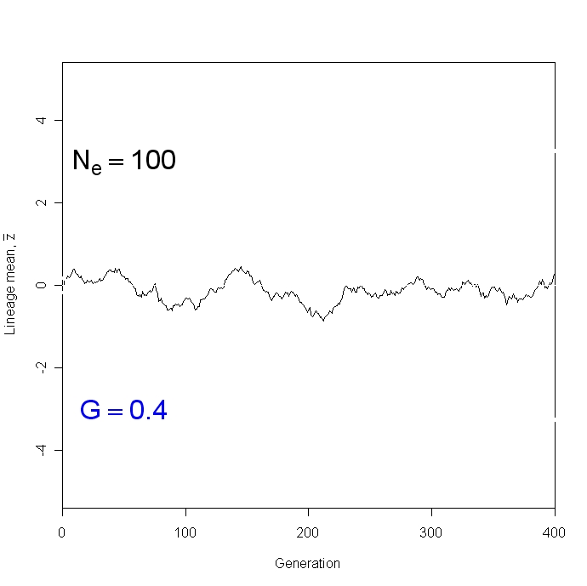
A simulation of a single lineage evolving by drift
Lineage mean
Time (generations)
Notes:
In this example, within-population phenotypic variance is standardized at one. Consequently genetic variance = heritability, which in this example is set at a constant, empirically-established modal value of 0.4. For purposes of illustration, Ne is set at an unrealistically low value of 100.

Slide 18
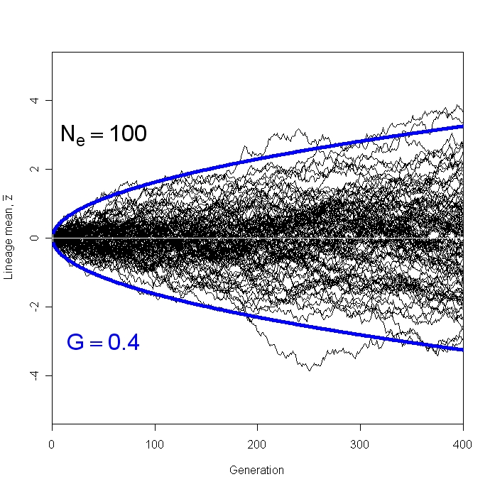

A simulation of 100 lineages evolving by drift
± 99% confidence limits
Lineage mean
Time (generations)
Notes:
Because the lineage means are normally distributed at any given generation in this and in many other models, we can easily solve for and graph the 99% confidence limits for the model, shown here in blue. Everything we need to know about the model’s predictions are encapsulated in those confidence limits. For example, if we graph data on these same axes, we can do a quick visual model fit by overlaying the confidence limits on that data plot. See Estes & Arnold 2007 for examples.

Slide 19
Testing models with the Gingerich data
The data (sources, pattern)
The models (drift, models with a stationary optimum, models with a moving optimum)
Conclusions
Estes & Arnold 2007

Slide 20

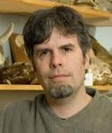

Testing models with the Gingerich data
The data (sources, pattern)
The models (drift, models with a stationary optimum, models with a moving optimum)
Conclusion
Andrew Hendry
Philip Gingerich
Michael Kinnison
Estes & Arnold 2007
Notes:
Although I will refer to the ‘Gingerich data’, much of the data on a microevolutionary timescale as assembled by Hendry (shown on the right in the middle image) and Kinnison. Gingerich began compiling data from paleontological time series in the 1980s and combined his data with Henry and Kinnison’s in Gingerich (2001), which may be consulted for details. Gingerich graciously made the data set available to us so that we could back calculate divergence values from rates.

Slide 21
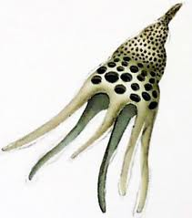
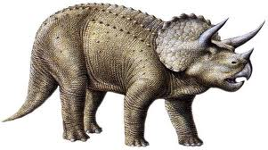
Testing models with the Gingerich data
The data (sources)
Longitudinal data: 2639 values for change in trait mean over intervals ranging from one to ten million generations; 44 sources, time series.
Traits: size and counts; dimensions and shapes of shells, teeth, etc.; standardized to a common scale of within-population, phenotypic standard deviation.
Taxa: foraminiferans … ceratopsid dinosaurs.
…
Estes & Arnold 2007
Notes:
The features of standardization in the Gingerich data mean that we combine data from diverse studies in a meaningful way. The resulting, bulked picture of divergence tells us what is often observed and what is virtually never observed in phenotypic evolution.

Slide 22
A short digression to talk about the data plots
Mean body size at generation 0 = 100 mm
Mean body size at generation 100 = 150 mm
Average within-population std dev in body size = 10 mm
Divergence = 150 mm - 100 mm = 50 mm or 5 sd
Interval = 200 = 10² generations
Notes:
Consider a single data point, drawn from a particular time series (a set of estimated traits means, each separated by an estimated interval of elapsed time).

Slide 23
A short digression to talk about the data plots
Mean body size at generation 0 = 100 mm
Mean body size at generation 100 = 150 mm
Average within-population std dev in body size = 10 mm
Divergence = 150 mm - 100 mm = 50 mm or 5 sd
Interval = 200 = 10² generations
Notes:
Plotting our single point on axes for divergence and time interval, we obtain this picture. In the plots that follow, we add points, each time anchoring each point as if both divergence and time begin at the origin. Note that divergence, as we have scaled it, is equivalent to a contrast ala Felsenstein (1985), but our contrasts are not independent because some pairs of points share the measurement error associated with a common mean.

Slide 24
Testing models with the Gingerich data
The data (pattern): 99% confidence ellipse
Estes & Arnold 2007
Notes:
Divergence as a function of elapsed time for the bulked ‘Gingerich’ data. The 99% confidence ellipse is shown in grey. The good fit of this very slightly, positively inclined, narrow ellipse illustrates the remarkable fact that the overall regression of divergence on time is barely different from zero. In other words, the overall trend in the data is stasis, no change in mean regardless of timescale. Furthermore, the fossil time series data appear to continue the trend of the microevolutionary time series data, a result that argues for continuity of process.

Slide 25
Testing models with the Gingerich data (Estes & Arnold 2007)
The data (pattern): ± 6 within-pop pheno sd
Estes & Arnold 2007
Notes:
In this plot I’ve added purple lines at +6 and -6 within-population phenotypic standard deviations, on either side of zero divergence point. This pair of lines generously approximates the 99% confidence ellipse. In other words, more than 99% of the divergence data (n=2639) fall between these lines.

Slide 26
When models confront the data, they can fail in three ways
1. Under-prediction: no points here
Estes & Arnold 2007
Notes:
Before turning to the details of model fitting, which are in any case described in Estes & Arnold 2007, let’s consider the three major ways in which models failed when we confronted them with these data. In the first way (under-prediction), the model fails to predict observed levels of divergence at short timescales (i.e., fails to account for the data inside the red ellipses). For example, models of genetic drift, with realistic values of heritability and effective population size, fail to predict enough divergence on short timescales.

Slide 27
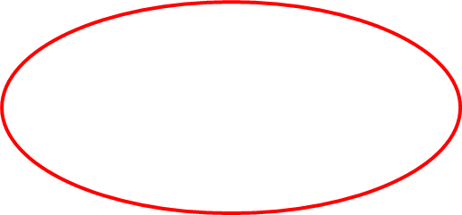
When models confront the data, they can fail in three ways
2. Blowout: lots of points here
Estes & Arnold 2007
Notes:
In the second, more common mode of failure (blowout), the model predicts too much divergence on long timescales. In other words, the model predicts an abundance of data inside the red ellipses shown here. Again, genetic drift suffers from this problem.

Slide 28
When models confront the data, they can fail in three ways
3. Fails parameter cross-check: requires unrealistic values
Estes & Arnold 2007
Notes:
In the third kind of failure, the model does predict data inside the purple boundaries but only if we invoke unrealistic values for key parameters. For example, peak shift models (in which the trait mean shifts between two adaptive peaks) require unrealistically small values for effective population size (<250), while an Ornstein-Uhlenbeck (OU) model with a single peak requires a value for stabilizing selection that is several orders of magnitude weaker than values commonly observed in nature.

Slide 29
Testing models with the Gingerich data
Conclusion: When representatives of the entire family of existing stochastic process models confront the data, only a single model is left standing.
Drift (Brownian motion)
Stationary optimum (OU)
Fluctuating optimum (Brownian motion or white noise)
Moving optimum (with white noise)
Peak shift (drift from one optimum to another)
Genetic constraints with any of the above
Displaced optimum model
Estes & Arnold 2007
Notes:
Most of the models we tested failed to predict the Gingerich data for one or more of the three reasons just discussed. In nearly all cases failure was dramatic rather than subtle. The basic problem for the models is that the data fall within a relatively narrow band of values (described by the purple lines) and most models blow out of those boundaries. One model*, however, the displaced optimum model proposed by Lande (1976), could account for the data, if just one of its parameters were varied.
_________________
* As we shall see when we assemble more data (Uyeda et al. 2011), this assertion is a bit of an overstatement! In light of that addition data, we will need to resurrect the models with fluctuating optima (Brownian motion and white noise).

Slide 30
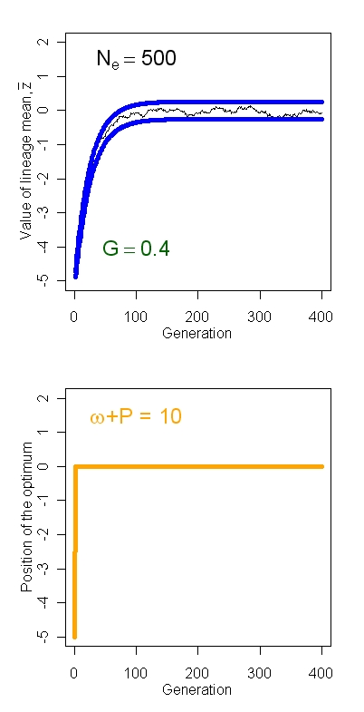

Displaced optimum model
Response of one lineage
mean
Model of peak movement
Lande 1976
Notes:
In Lande’s (1976) displaced optimum model, the position of an intermediate optimum suddenly shifts to a new position in a single generation and thereafter resides at that position (lower panel). This model of peak movement represents a relatively sudden in situ change in environmental conditions or the invasion of a new environment. In the simulation shown in upper panel, we see the lineage mean tracking the displaced optimum, a process that requires about 100 generations, and thereafter fluctuating about the optimum in drift-stabilizing selection balance. The blue lines show the 99% confidence limits for the model (with heritability =0.4, Ne=500, and the parameter describing the strength of stabilizing selection, ω² , set at 10).

Slide 31
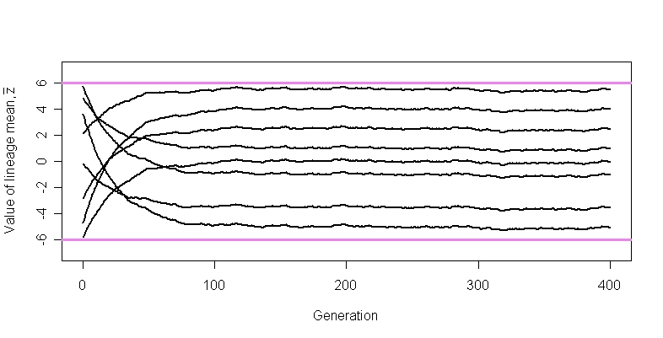
Displaced optimum model
Multiple lineages chasing displaced optima
could easily fill an adaptive zone
Lineage mean
Time (generations)
Lande 1976
Notes:
In this figure, by invoking displacements of the optimum that range from -6 to +6 within-population phenotypic standard deviations, we account for the full range of divergence within the purple boundaries, but do not go outside them. This success, however, has been achieved in the face of some obvious simplifications. First, we have contrived the sample of displacements to achieve the desired result. Second, all of the displacements occur in the first generation and none happen thereafter. Recognizing these restrictions, we can easily imagine a model that relaxes them. For example, the displacements might occur at random according to some stochastic process (e.g., a Poisson process). Furthermore, the magnitude of the displacement once it occurs might be drawn from some probability distribution (e.g., a normal distribution centered about zero). We will explore both of these avenues of improvement in the section that follows.

Slide 32
Testing models with the Uyeda et al data
The data (sources, pattern)
The models: white noise fluctuation of the trait mean combined with three models of moving optima (Brownian motion, single-burst, multiple-burst)
Conclusions
Uyeda et al 2011
Notes:
We now turn to the second element in our vignette that compares Simpson’s synthesis with one in our time. In this second element, a study by Uyeda et al. 2011, I will first discuss the data and then the models, before drawing conclusions from the model fits.

Slide 33
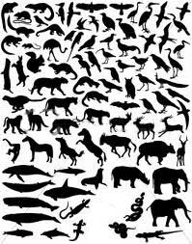
Testing models with the Uyeda et al. data
The data (sources)
Size-related traits: over 8,000
data points from 206 studies.
Three sources:
(i) microevolutionary time series,
(ii) fossil time series,
(iii) data from time-calibrated
trees.
Vertebrate taxa: mammals, birds,
squamates.
Uyeda et al 2011
Notes:
In this study our first goal was to improve the dataset in a couple of ways. First, we restricted the focus to size-related traits so that we might realistically strive for a homogeneous process. Second, we more than doubled the amount of the data. Most of the increase in sample size was achieved by adding data on body size from time-calibrated evolutionary trees. Early in our collaboration, Hansen noted that although the Gingerich data support an overall model of stasis, it is common in comparative studies to find that sister taxa have similar body sizes. With this apparent contradiction in mind, we decided to add tree-based data to our study. Thirdly, we restricted our focus to vertebrates, again in the spirit of improving the prospects for a single, homogeneous process.

Slide 34
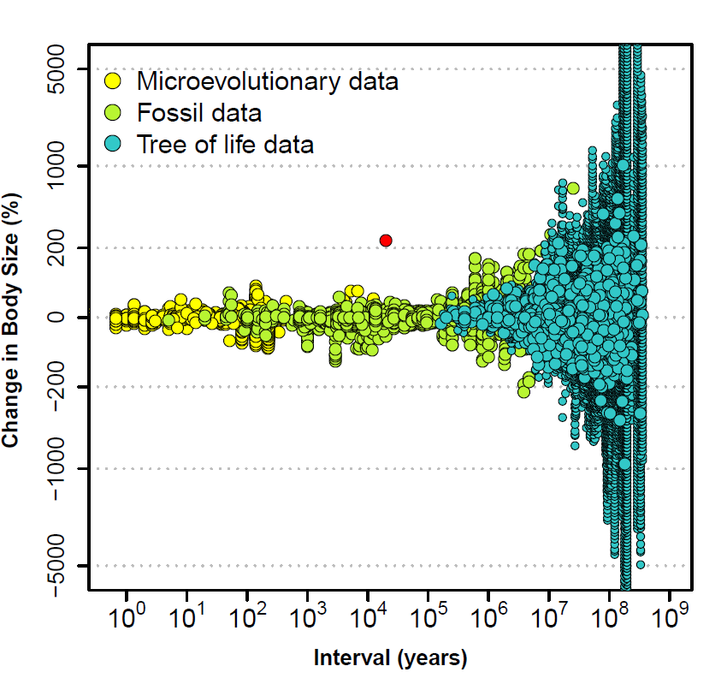
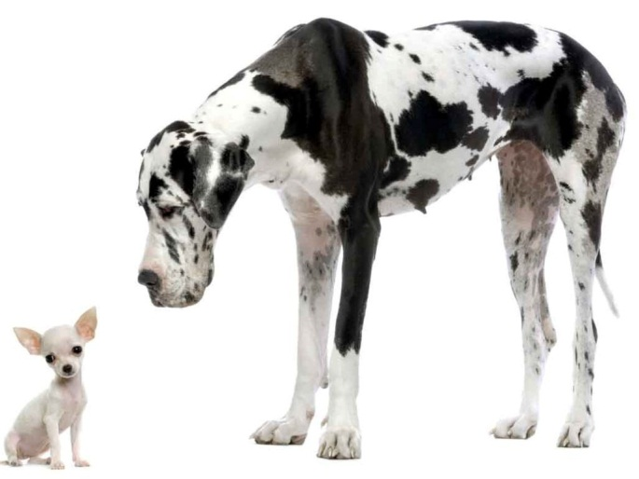
A hypothetical data point on the new
plotting axes
Notes:
In the plots that follow we will use different axes than the ones employed by Estes & Arnold (2007). Why? In the first place, as we shall see, by adding tree-based data we greatly expand the magnitude of divergence that we observe. To accommodate this expansion we now use a log scale that is equivalent to the proportional change in body size. The second change occurs on the x-axis. Before we measured time in generations, now we measure it in years. Although the same patterns are evident on both timescales, the pattern appears blurred on the generational scale, perhaps because of error in the estimates of generation time (see Uyeda et al. 2011 for comparison plots).

Slide 35
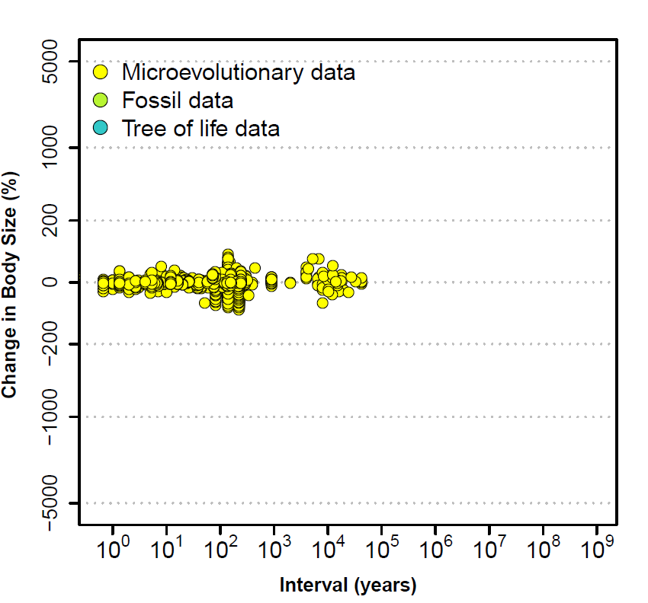
Notes:
In this plot and the next two, we add data to the plot in the order: microevolutionary, fossil, and finally tree-based. Notice that the pattern merges smoothly as the data types are added, again suggesting homogeneity of pattern and perhaps of process.

Slide 36
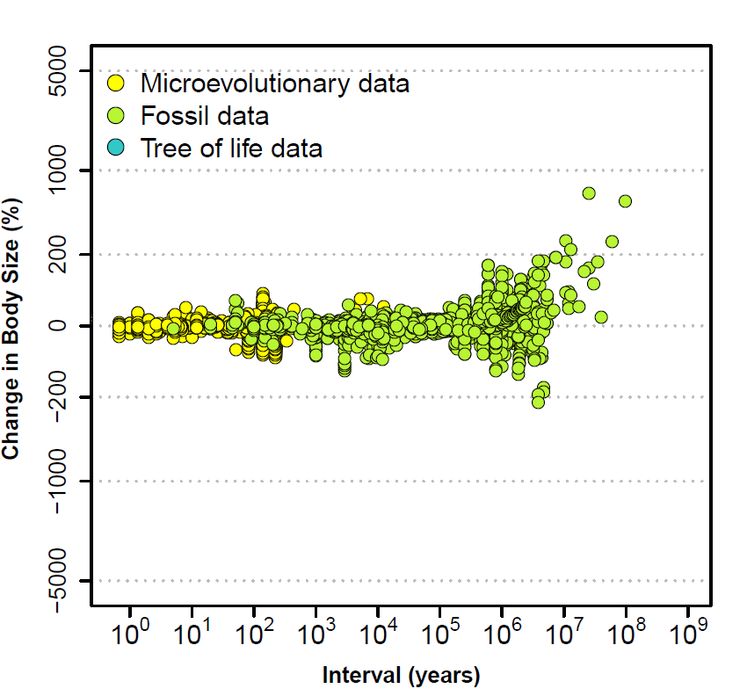
Notes:
With the addition of fossil time-series data in this plot, we see an inkling that at long timescales the pattern is a different one from that seen in the microevolutionary data. In particular, we see an abundance of fossil data in which divergence exceeds a 100% change in body size.

Slide 37

Notes:
Adding in the tree-based data, we see many more examples in which divergence in body size exceeds 200%. Two kinds of tree-based data points are shown in blue. The larger blue circles show values of divergence that are average about a node on a tree. The smaller blue circles show divergence values for individual pairs of divergence values on a tree. Note that when data (contrasts) are drawn from a tree, they have no sign. For the purposes of merging the tree-based data with the microevolutionary and fossil data (which have signs), we assigned signs at random to the tree-based contrasts.

Slide 38
±65% change in body size
Notes:
We can gain perspective on the pattern before us if we ask for the position of the purple boundary lines that we drew on the Gingerich data. The equivalent boundaries for this divergence scale, also shown in purple, are ±65% change in body size. In other words, the vast majority of size evolution in vertebrates appears to be limited to a ±65% change in body size, regardless of timescale. Divergence in body size greater than 100% is common only on timescales greater than 1 million years. Note that the magnitude of body size evolution seen in domestic dogs over a period of about 30,000 years appears to be unprecedented in the natural world.

Slide 39


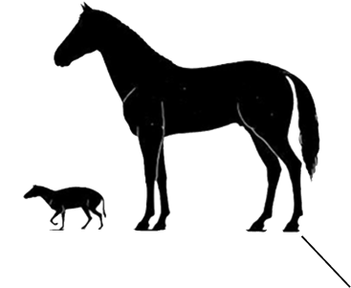
“The Blunderbuss Pattern”
Notes:
Another perspective on the data is gained by comparing the pattern to the barrel of a blunderbuss*, a muzzle-loading firearm of the 17th and 18th centuries. On a timescale less than a million years, size divergence is restricted to a narrow range that resembles the slender base of the barrel. On longer timescales, divergence values flare out much like the flared end of the barrel. How can we account for this blunderbuss pattern? But, before we leave our data plot, notice the data point representing divergence from Eohippus to modern horses. These and similar data points describing size evolution in horses are well outside the purple lines denoting bounded evolution, suggesting that the flared end of the blunderbuss captures Simpson’s concept of quantum evolution.
_______________
The flared end of the blunderbuss in this cartoon faithfully captures our data pattern, but in real blunderbusses, the end of the barrel was much less flared (http://en.wikipedia.org/wiki/Blunderbuss)

Slide 40
Modeling strategy
Account for the long barrel of the blunderbuss with a surrogate process (white noise fluctuation of the lineage mean about the trait optimum)
Compare 3 alternative models to account for the flared end of the blunderbuss (Brownian motion and two descendants of the displaced optimum model).
The 2 descendants: single- and multiple burst-models.
Uyeda et al 2011
Notes:
While the model comparisons in Estes & Arnold (2007) do not account for the flared end of the blunderbuss, the conclusions about the long barrel of the blunderbuss remain valid. With that perspective in mind, the Uyeda et al. collaborators decided to focus on models that might account for the flared end of the blunderbuss and to let a surrogate, place-keeping process account for the slender base of the barrel. That surrogate process is white noise fluctuation of the lineage mean about trait optimum. We employ this process in full knowledge of the fact that tracking an optimum that fluctuates across the full width of the central band of data will place an evolving lineage in hazardous demographic territory. The compensating advantage of a white noise model is that it requires a single variance term which can be easily combined with more complicated models that might account for the flared end of the barrel. In particular, we used white noise (WN) alone, as well as WN combined with Brownian motion and WN combined with two descendants of the displaced optimum model (the single- and multiple burst models), which we will now describe.

Slide 41
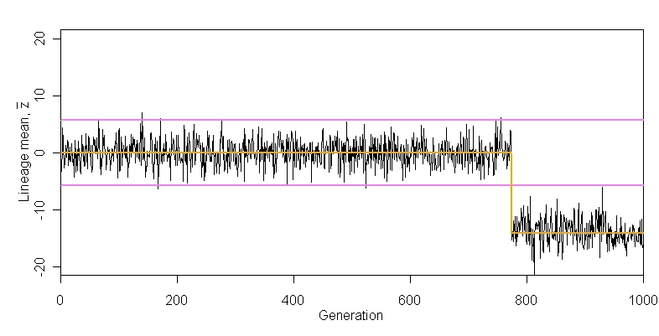
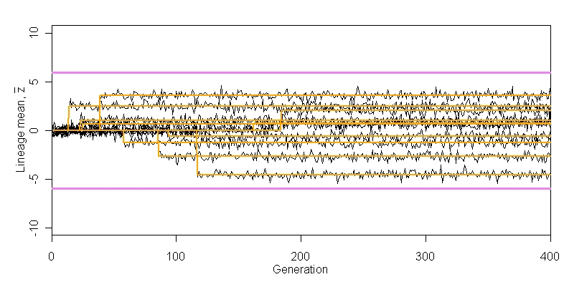
Simulations of the single-burst model
(peak movement, evolution of the lineage mean)
A single lineage
Lineage mean
Time (generations)
Multiple lineages
Lineage mean
Time (generations)
Uyeda et al. 2011
Notes:
These two panels illustrate the two key features of the single-burst model. In these simulations I’ve chosen parameter values so that those key features are revealed in just a few hundred generations. In these illustrations, the orange lines shows the time courses for the trait optimum, while the black lines show the evolving trait mean. The first key feature of the model is that optimum can move away from its initial position at zero in a single burst. The timing of this single burst is dictated by a Poisson process. Once that single burst occurs, the optimum retains its new position ever after. The second key feature of the model is that magnitude of the burst (the displacement of the optimum) is a draw from a normal distribution with a mean of zero. For example, in the top panel, we see that the single burst occurs at about generation 780 and amounts to a displacement of about -15 within-populations standard deviations (sd) away from the starting position, a displacment that would carry the lineage mean far outside the ± 6 sd boundary lines shown in purple. In the lower panel, we see multiple lineages evolving according to the same parameter values for the single-burst process, but those values are different from those in the upper panel. In particular, the waiting time to the single burst is much shorter, so that all the lineages appear to experience a single burst within about 110 generations. Furthermore, the magnitudes of the bursts are smaller, so that none of the lineages are carried outside the empirically-established purple boundary lines.

Slide 42
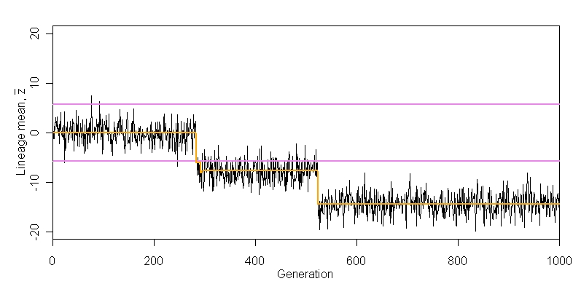
Simulation of the multiple-burst model
(peak movement, evolution of the lineage mean)
A single lineage
Lineage mean
Time (generations)
Uyeda et al. 2011
Notes:
This panel illustrates the multiple burst feature of the model that distinguishes it from the single-burst model. In this simulation run, bursts occurred at about generations 250 and 550. As in the single-burst model, the timing of bursts is dictated by a Poisson process, and the magnitudes of the bursts are draws from a normal distribution with zero mean.

Slide 43
Model comparisons
Model | White noise parameter estimate ( σ ) | AIC*
White noise (WN) only | 0.20 | −2940.53
Brownian motion + WN | 0.11 | −7877.97
Single-burst + WN | 0.10 | −9018.0
Multiple-burst + WN | 0.10 | −9142.54
Notes:
This slide summarizes and compares the fits of the four models to the Uyeda et al. data. For each model we can characterize the expected distribution of data at any given point in time (the first three models yield relatively simple normal distributions, but in the fourth, the distribution is more complicated). Using those expressions, we can calculate the likelihood of the data for any given choice of parameter values. For each model, we proceed by finding the choice of parameter values that maximizes the likelihood of the data. In the middle column of the table, we show the maximum likelihood estimates for the white noise parameter, expressed as a standard deviation. Notice that for all three of the combined models, the estimates of this white noise standard deviation are very similar (we will return to this point in a few slides). The column on the far right shows the Akaike Information Criterion (AIC) values, which represent best fits for each model, corrected for differences in numbers of parameters. The asterisk on the AIC label reminds us that we have treated the data points as independent observations in calculating AIC (i.e., we have ignored the covariance structure of the data), so our conclusions in comparing the models are necessarily tentative. The blue lines in the top panel shows the 95% confidence limits (CLs) for the best fit for each model. The best fit CLs for the white noise model are not shown. They would be parallel blue lines, slightly further apart than those shown, but without the flaring on the far right. We see from the AIC* column that the white noise only model appears to fare appreciably worse than the other models. The AIC* also suggests that the multiple-burst model fits best, followed by single-burst and then by Brownian motion. This order seems to be contradicted by the plots of best CLs in the top panel. In particular the Brownian motion fit appears to be as good as the multiple-burst fit. The Brownian motion model predicts a normal distribution of data at any given point in time, but a close examination of the data reveals a non-normal overabundance of divergence data near the zero point, especially at the far right end of the plot. The single- and multiple-burst models do a better job of accounting for this aspect of the data distribution, and those better jobs are reflected in their AIC* scores.

Slide 44
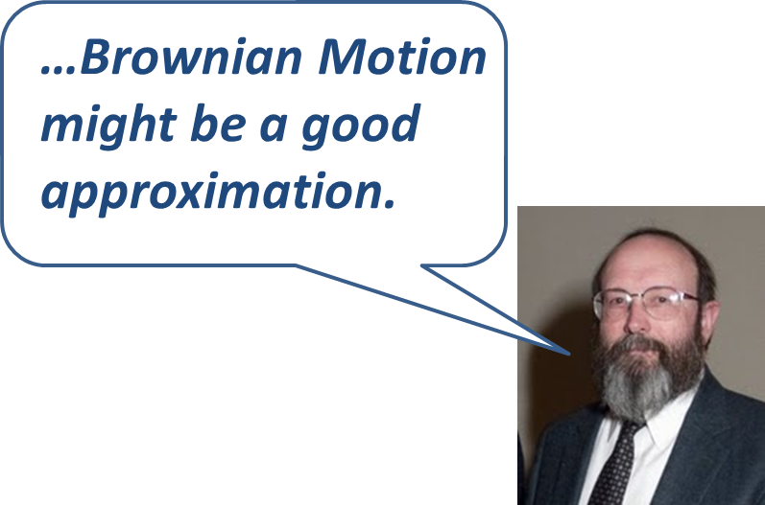
Model comparisons
Model | White noise parameter estimate ( σ ) | AIC*
White noise (WN) only | 0.20 | −2940.53
Brownian motion + WN | 0.11 | −7877.97
Single-burst + WN | 0.10 | −9018.0
Multiple-burst + WN | 0.10 | −9142.54
Notes:
At this point I would like to retract an conclusion that I reached with Suzanne Estes in Estes & Arnold (2007). In that paper we concluded that both versions of the Brownian motion model could be discarded because both models predicted more and greater values of divergence on long timescales than we observed in the Gingerich data. The implication, which we elaborated on in our 2007 discussion, is that Felsenstein’s (1985) independent contrasts foundation for comparative studies, which relied on a Brownian motion model of evolution, might be built on sand. However, as we observed in slides 38-40, comparative studies supply the very values of large divergence that Brownian motion predicts. Consequently, Felsenstein appears to be completely correct in saying that Brownian motion might be a good approximation to phenotypic evolution. We can, however, add a caveat. Brownian motion of the adaptive peak may be a good approximation, but Brownian motion of the trait mean about a stationary peak (i.e., genetic drift) is not. We can reach this conclusion by asking how large must effective population size be to account for blunderbuss picture of CLs shown in the picture on the far right in the top panel. The answer is hundreds of millions, if heritability takes the empirically observed modal value of 0.4. The problem for the genetic drift version of Brownian motion is that unrealistically large population size is required to stop the lineage from drifting outside the bounds of slender base of the blunderbuss and delaying substantial divergence until tens or hundreds of millions of years have elapsed.

Slide 45
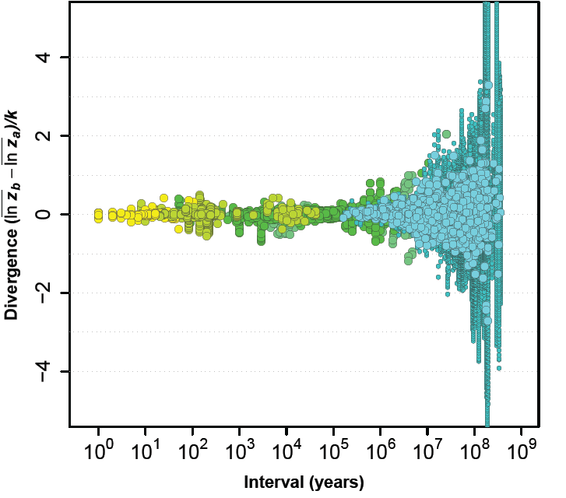
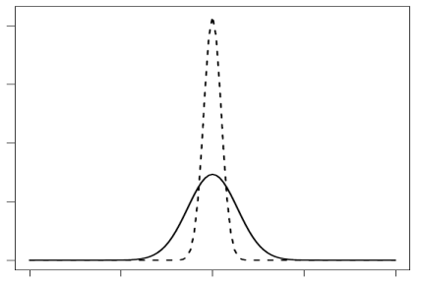
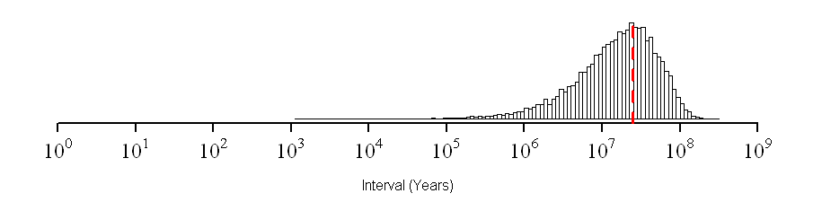
Multiple-burst model:
parameter estimates
White noise distribution
(dashed)
Burst size
distribution
(solid)
Probability
Burst timing distribution
(mean time between bursts = 25 my)
Probability
Notes:
This slides summarizes what we learn from the maximum likelihood estimates of parameters for the best-fitting multiple-burst model. Consider first the normal distribution of white noise deviations from zero on the y-axis, the initial position of the optimum. The best estimate of the standard deviation of this distribution (shown with a dashed line on the upper left) is abut 0.10. In contrast, the normal distribution of burst sizes (shown with a solid line) has a standard deviation of 0.27, about three times larger. Turning finally to the distribution of burst waiting times (bottom right), we see that on a log scale the distribution is skewed towards ‘short’ waiting times, but the mean time is 25 million years and bursts are very uncommon in intervals shorter than 1 million years. In other words, evolutionary bursts that might carry the lineage out of an adaptive zones are very rare. Furthermore, the large divergence values observed in some fossil time series and more commonly in comparative data would require a succession of several to many bursts.

Slide 46
Conclusions & perspectives from the two studies
Micro- and meso-evolution is bounded.
What is the best model of that bounded evolution?
Evolutionary bursts are rare but increasingly inevitable in deep evolutionary time.
Is the blunderbuss pattern general?
Are invasions of new adaptive zones responsible for evolutionary bursts and hence the flared barrel of the blunderbuss?
What triggers those bursts/invasions?
Notes:
Summing up our inner story (‘What is the best model for phenotypic evolution?’):
Micro- and meso-evolution (Simpson’s phyletic evolution) is bounded with most divergence in the range of ± 6 within population standard deviations or, for size-related traits, in the range of ± 65% change. Remarkably, most evolution occurs within these boundaries at all timescales.
The best model for that bounded evolution (i.e., evolution within a Simpson adaptive zone) undoubtedly involves long-maintained stabilizing selection but probably other restraining processes as well.
Most evolutionary bursts are modest in size and do not carry a lineage outside its adaptive zone. Irrespective of size, bursts are rare with an average waiting time of 25 million years. Despite this rarity, on timescales of 100 million years or more, bursts are increasingly inevitable. A succession of these stochastic but inevitable bursts can carry a lineage far beyond the boundaries of its original adaptive zone (Simpson’s quantum evolution).
We will need additional studies on additional kinds of traits and other kinds of organisms to determine whether the blunderbuss pattern, documented here for size-related traits in vertebrates, is a general pattern.
One interpretation of evolutionary bursts is that they coincide with the invasion of new adaptive zones, but other interpretations are possible and need to be tested.
The ecological context for evolutionary bursts is also an open question.

Slide 47
Synthesis in evolutionary biology
An ongoing activity since 1859
Contention and bickering is normal
To synthesize, we need to bridge between fields
Data should talk to theory & vice versa
An extraordinary burst of synthesis is happening right now!
Notes:
Returning to our outer story (‘If we were in the midst of one of the great synthetic periods in evolutionary biology, how would we know it?’ ), we can reach the following conclusions:
Synthesis is not something that we should anxiously await. In particular, analysis of citation patterns in evolutionary biology suggests that, despite surges and lulls, synthesis has been a continuous activity since 1859 and is accelerating in our time.
We should not expect harmony during periods of synthesis. During long-recognized periods of great synthesis in evolutionary biology (e.g., 1930-32, 1937-50) participants often disagreed, sometimes strenuously, about minor and major topics. Likewise, in our own time, dissension and discord are all about us.
To synthesize we need diverse perspectives and bridges between them. In the vignette from my own research, we discovered the blunderbuss pattern by combining data from three types of studies (microevolutionary, paleontological, comparative).
We pioneered a new approach for evaluating and testing stochastic models by breaking with tradition and plotting the data so that they communicated with the models. The general point is theory needs to be tested with the best available data. Conversely, we need to use the most powerful versions of theory, as we strive to move beyond metaphors.
The vitality of the Congress that surrounds us is testimony to an ongoing synthesis in evolutionary biology. I’ve illustrated my talk with one vignette, two papers, but even restricting our focus to phenotypic evolution one could choose among many important, ongoing efforts at synthesis. When I think about the ongoing synthesis in this field, a number of people come to mind (next slide). I hope you will join me in encouraging them to work on their syntheses, and I hope that you will continue to work on yours!

Slide 48







Acknowledgements
Research collaborators: Suzanne Estes, Josef Uyeda, Thomas Hansen, Jason Pienaar, Phil Gingerich, Andrew Hendry, Michael Kinnison, Russell Lande, Adam Jones, Reinhard Bürger
NESCent course collaborators: Joe Felsenstein, Trudy Mackay, Adam Jones, Jonathan Losos, Luke Harmon, Liam Revell, Marguerite Butler, Josef Uyeda, Matt Pennell
NSF OPUS program: Mark Courtney
Editor/publisher: Trish Morse, Andy Sinauer

