Slide 1
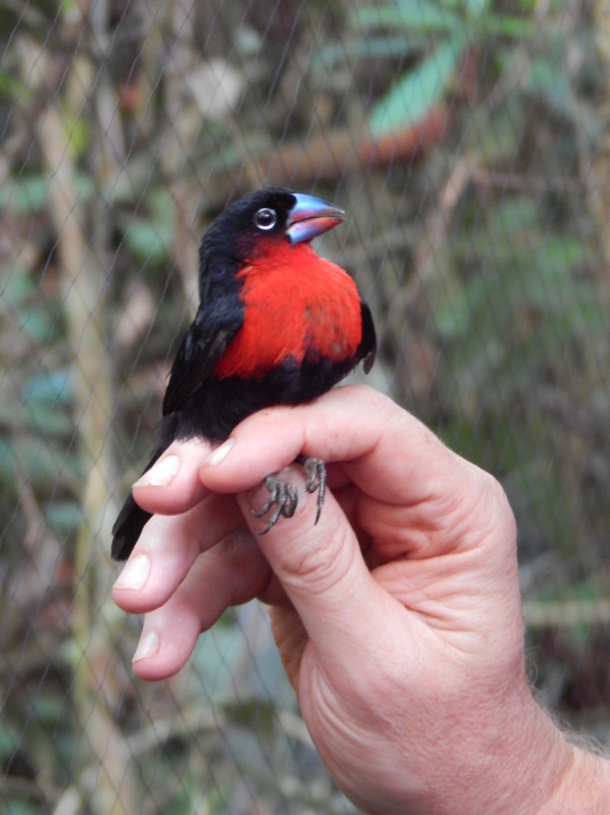
2.2 Selection on a Single & Multiple Traits
Stevan J. Arnold
Department of Integrative Biology
Oregon State University
Notes:
A Blue-billed Malimbe, just captured in a mist nest in Cameroon by Prof. Tom Smith

Slide 2
Thesis
Selection changes trait distributions.
The contrast between distributions before and after selection provides a powerful description of the force of selection.
Multivariate measures of selection can correct for the effects of correlations between traits.

Slide 3
Outline
Selection changes the univariate trait distribution.
Shift in the trait mean, s, the linear selection differential.
Change in the trait variance, C, the nonlinear selection differential
Examples and surveys of selection differentials
Selection changes the multivariate trait distribution.
The directional selection gradient, β, a vector.
The nonlinear selection gradient, γ, a matrix.
Examples and surveys of selection gradients.

Slide 4
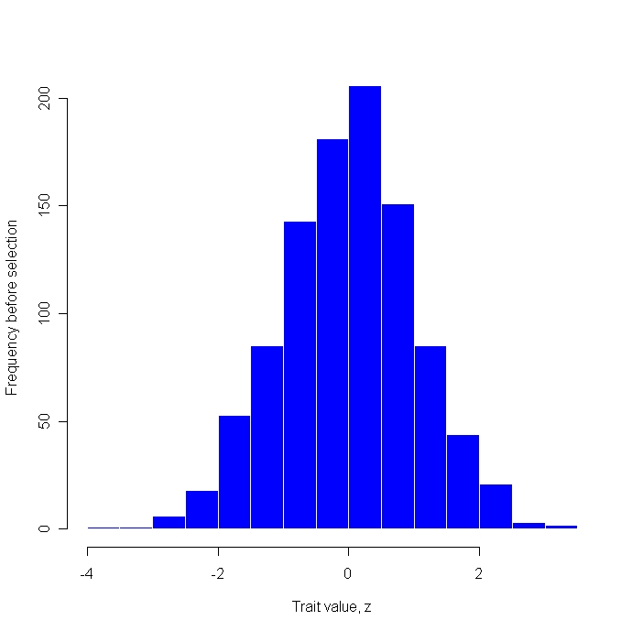
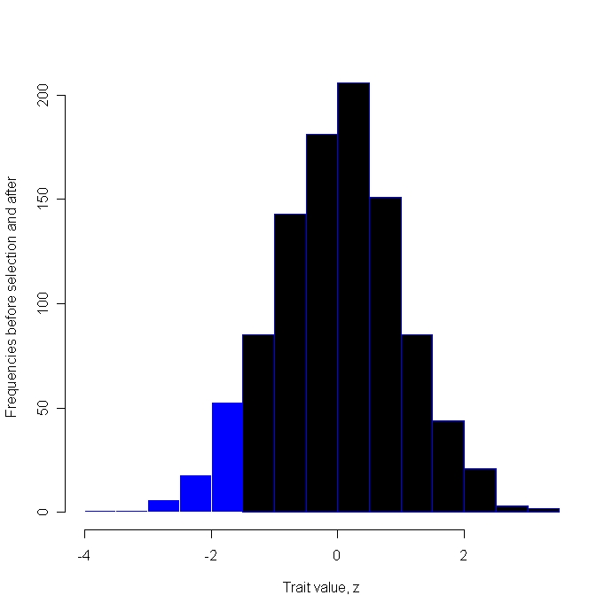
1. Selection changes the univariate trait distribution
The contrast between distributions before
and after selection is particularly revealing
Before selection
After selection
Frequency
Frequency
Trait value, z
Trait value, z
Notes:
A single hypothetical trait in a sample of 1000 individuals is subjected to truncation selection. (a) The histogram of trait values for these individuals before selection is shown in blue (mean = -0.01, variance = 1.04). (b) Only individuals with trait values greater than -1.5 (n=921) survived selection. The trait distribution after selection is shown in black. Selection has shifted the trait mean and contracted its variance (mean = 0.16, variance = 0.76). (P*-P)/P = -0.27; (P*-P+s²)/P = -0.24

Slide 5



2. Shift in the trait mean, the linear selection differential, s
a. A particular example
$$s={\overline{z}}^{∗}−\overline{z}=0.16−(−0.01)=0.17$$
b. The general case
where p(z) is trait frequency before selection
where p(z)* is trait frequency after selection
$${p(z)}^{∗}=w\left(z\right)p\left(z\right)$$
where w(z) is relative fitness of the z trait class
Notes:
The selection differential, s, has a long tradition in the quantitative genetic literature (Lush 1939). This general expression is from Lande & Arnold (1983).

Slide 6


2. Shift in the trait mean, the linear selection differential
c. The selection differential is a covariance
The standard expression for the covariance of variables x and y
The standard expression applied to case of w(z) and z
Notes:
Robertson (1966).

Slide 7

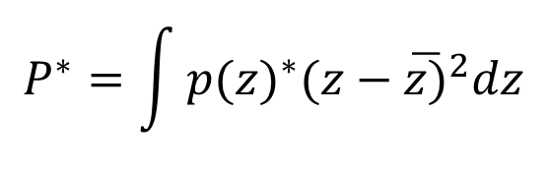

3. Change in the trait variance, the nonlinear selection differential, C
a. Returning to our example
$$C=P^{∗}−P+s^{2}=0.76−1.04+{0.17}^{2}=−0.24$$
b. The general case
where p(z) is trait frequency before selection
$$P^{∗}=\int{{p(z)}^{∗}{(z−\overline{z)}}^{2}dz}$$
where p(z)* is trait frequency after selection
The amount variance is contracted by
linear selection of magnitude s
$$s^{2}$$
Notes:
Lande & Arnold (1983).

Slide 8


3. Change in the trait variance, the nonlinear selection differential, C
c. C is a covariance, but P*-P is not.
By the same algebraic steps given earlier
where
$$\tilde{z}=z− \overline{z}$$
Notes:
Lande & Arnold (1983)

Slide 9
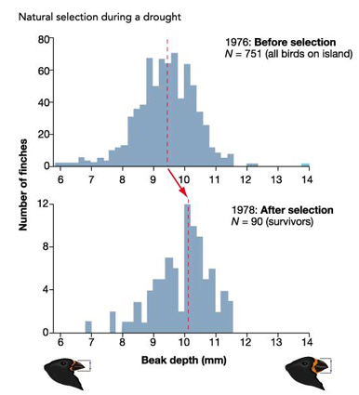
4. Examples and Surveys of selection differentials
a. Selection on beak depth in Galapagos finches
Notes:
Grant (1986)

Slide 10
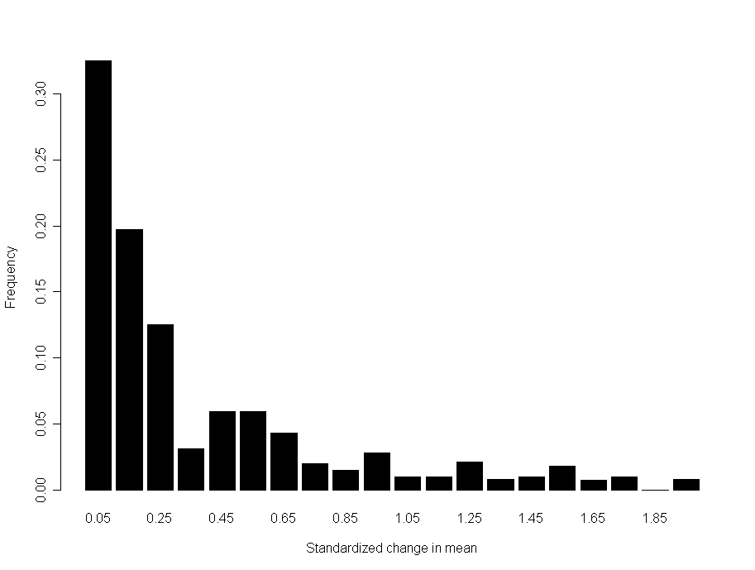
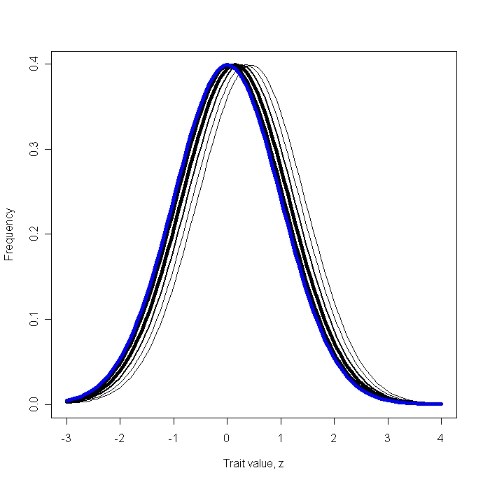

4. Examples and Surveys of selection differentials
a. The standardized linear selection differential, s’
$$s^{′}=({\overline{z}}^{∗}−\overline{z})/\sqrt{P}$$
n=262
Frequency
Frequency
Standardized linear selection differential
Trait value, z
Notes:
Histogram based on data in Endler (1986). In the panel on right, selection differentials, s , are illustrated as normal distributions after selection with mean shifted towards higher values. Line widths represent frequency in Endler’s histogram; before selection = blue, after selection = black

Slide 11
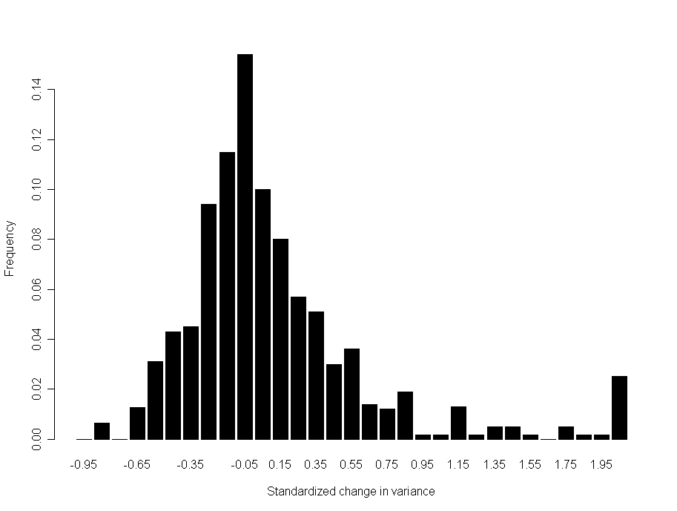
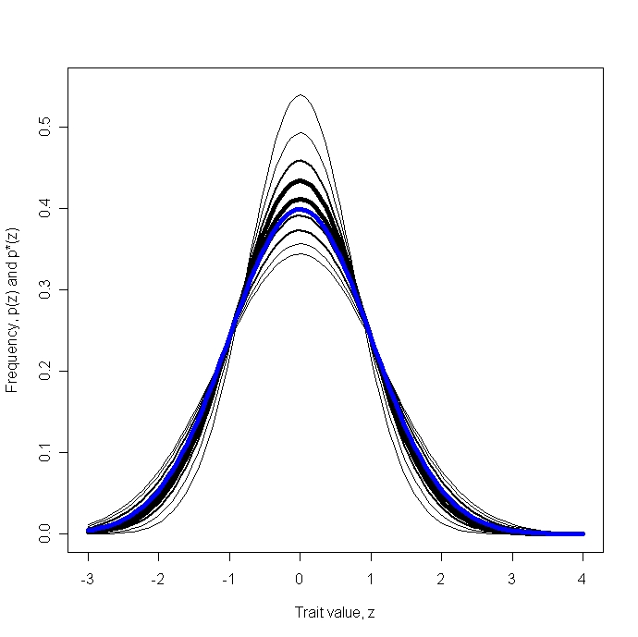
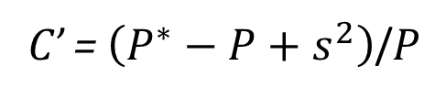
4. Examples andSurveys of selection differentials
b. The standardized nonlinear selection differential, C’
C’ = $\left(P^{∗}−P+s^{2}\right)$/P
Frequency
Frequency
Standardized nonlinear selection differential
Trait value, z
Notes:
Histogram on left from Endler (1986). In the diagram on the right, standardized change in variance, C’, is illustrated as normal distributions after selection with variance contracted or expanded. Line widths represent frequency in Endler’s histogram; before selection = blue, after selection = black.

Slide 12
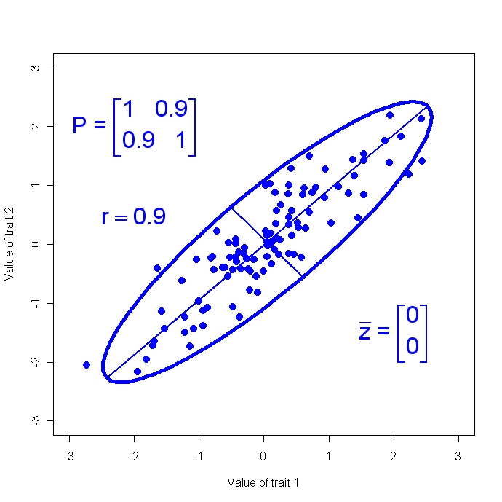
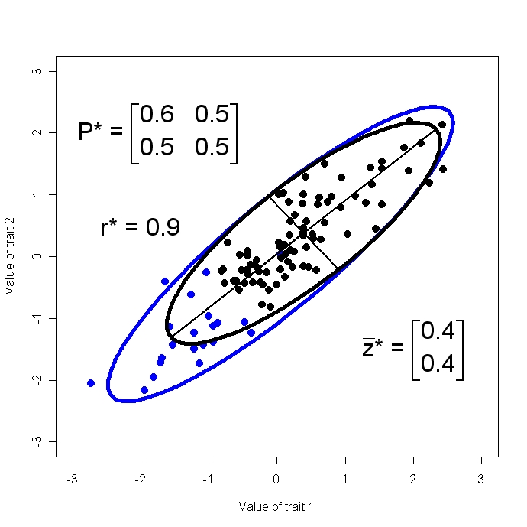
5. Selection changes the multivariate trait distribution
The contrast between distributions
before and after selection
Before selection
After selection
Frequency
Frequency
Trait value, z
Trait value, z
Notes:
In this hypothetical example, two traits in a sample of 100 individuals are subjected to truncation selection. (a) A scatter plot trait values for these individuals before selection is shown in blue, along with the sample’s 95% confidence ellipse. (b) Only individuals with trait values greater than -1.0 for both traits survived selection (n=81). The scatter plot of the sample after selection is shown in black along with its confidence ellipse. Selection has shifted the trait means upwards and contracted both trait variances, and the trait covariance.

Slide 13

5. Selection changes the multivariate trait distribution
b. The directional selection differential, s, is a vector
Notes:
Lande & Arnold (1983)

Slide 14




6. The directional selection gradient, β, a vector
a. The general and bivariate cases
b. Easier to understand if we rearrange terms
Direct effect of selection on trait 1 on trait 1
$$P_{11}β_{1}$$
Indirect effect of selection on trait 2 on trait 1
$$P_{12}β_{2}$$
Notes:
The directional selection gradient measures the direct force of selection on a trait, accounting for correlations with other traits (if all correlated traits under selection are included in the expression) (Lande & Arnold 1983).

Slide 15
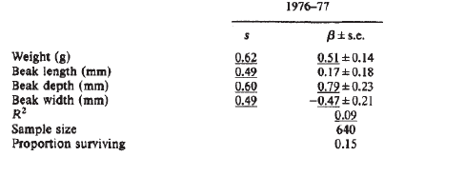
6. The directional selection gradient, β, a vector
c. Does the distinction between s and β matter?
In the case of Galapagos finches, the selection differential
and gradient on beak width have opposite signs.
Notes:
Price et al. (1984).

Slide 16



7. The nonlinear selection gradient, γ, a matrix
The general and bivariate cases of C,
the nonlinear selection differential
Notes:
The nonlinear selection gradient measures the direct force stabilizing, disruptive and other kinds of nonlinear selection, accounting for correlations among traits (Lande & Arnold 1983).

Slide 17



7. The nonlinear selection gradient, γ, a matrix
b. The general and bivariate cases of γ,
the nonlinear selection gradient
c. Rearranging to see direct and indirect terms,
Notes:
Lande & Arnold (1983)

Slide 18
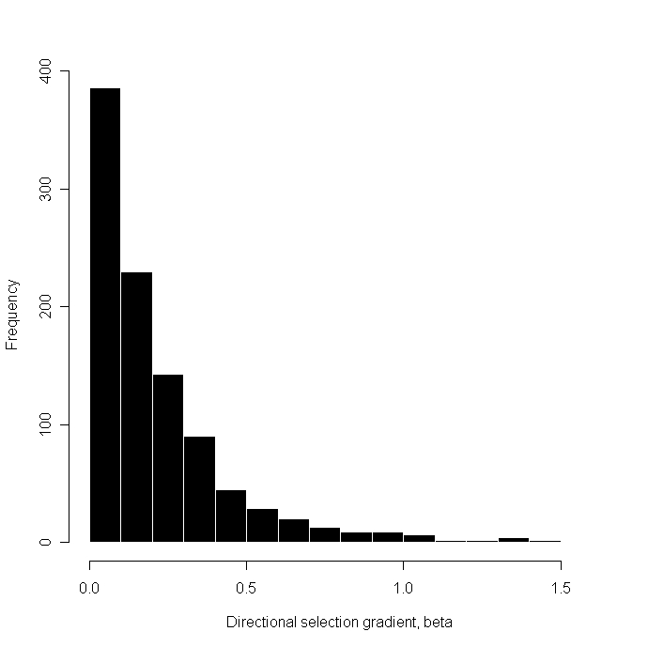
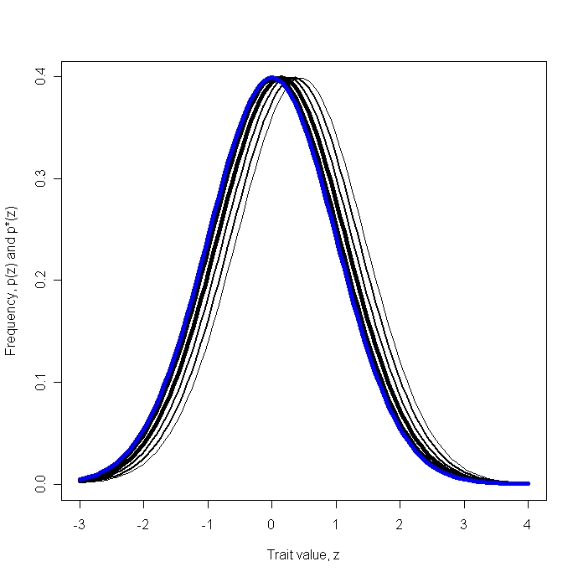
8. Survey
Standardized directional selection gradients, β
n=992
Frequency
Frequency
Standardized directional selection gradient
Trait value, z
Notes:
Histogram on left is based on data in Kingsolver et al. 2001. The diagram on right shows shifts in mean corresponding to the directional selection gradients in the histogram with line width proportional to frequency. Shifts corresponding to the five bins on the left-most side of the distribution (0.05-0.45) are shown in black and account for 90% of the observations.

Slide 19
What have we learned?
The additive genetic variance-covariance matrix, G, is the key to understanding multivariate resemblance between parents and offspring.
Consequently, the G-matrix is also the key to modeling multivariate responses to selection.
G induces correlated responses to selection that may be non-intuitive.

Slide 20
References
Lush, J. L. 1939. Animal Breeding Plans. Iowa State University Press.
Lande, R. and S. J. Arnold 1983. The measurement of selection on correlated characters. Evolution 37: 1210-1226.
Robertson, A. 1966. A mathematical model of the culling process in dairy cattle. Animal Production 8: 93-108.
Grant, P. R. 1986. Ecology and Evolution of Darwin’s Finches. Princeton Univ. Press.
Endler, J. 1986. Selection in the Wild. Princeton Univ. Press.
Price, T., P. R. Grant, H. L. Gibbs, and P. T. Boag. 1984. Recurrent patterns of natural selection in a population of Darwin’s finches. Nature 309: 787-789.
Kingsolver, J. G. et al. 2001. The strength of phenotypic selection in natural populations. American Naturalist 157: 245-261.

