Slide 1
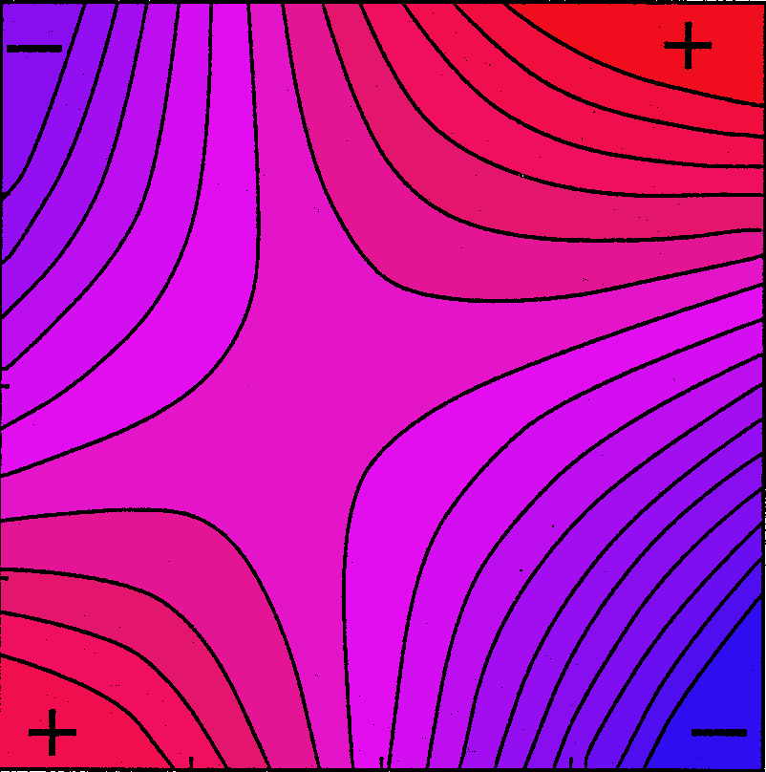
3.1 Selection as a Surface
Stevan J. Arnold
Department of Integrative Biology
Oregon State University

Slide 2
Thesis
We can think of selection as a surface.
Selection surfaces allow us to estimate selection parameters, as well as visualize selection.
To visualize and estimate, we need to keep track of three kinds of surfaces:
  the individual selection surface
  2. our approximation of that surface
  3. the adaptive landscape.

Slide 3
Outline
The individual selection surface, ISS.
Approximations to the ISS.
The adaptive landscape, AL.
Examples and surveys.
The multivariate ISS.
Approximations to the multivariate ISS.
The multivariate AL.
Examples and surveys.

Slide 4
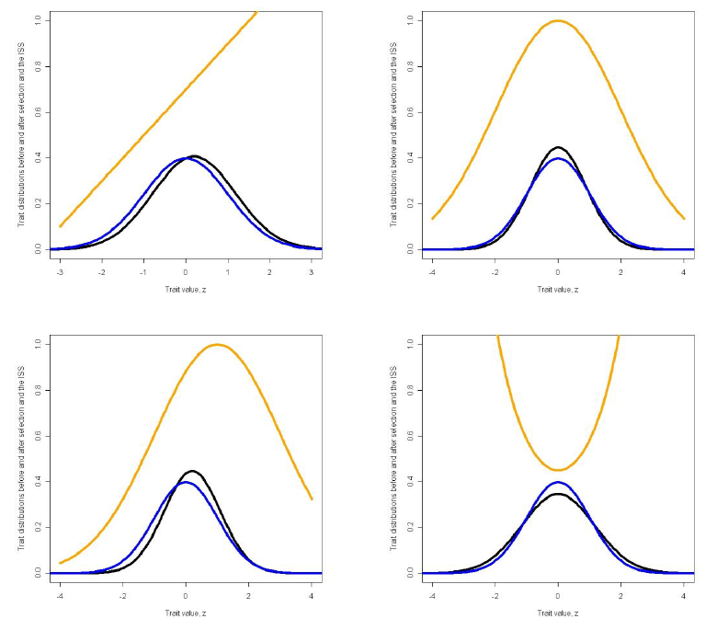

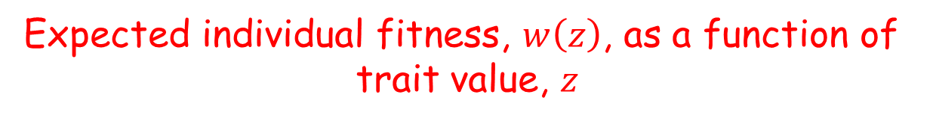
1. The Individual Selection Surface
Expected individual fitness, $w\left(z\right)$, as a function of
trait value, $z$
A model for how selection that changes trait
means and variances
p(z), p(z)*, and w(z)
Trait value, z, and mean, $\overline{z}$
Notes:
Examples of individual selection surfaces, ISSs, showing their effects on trait distributions.
The statistics of the trait distributions before selection (blue), p(z), and after (black) selection, p(z)*, are given in Lecture 2.2. The ISS is shown as an orange curve. (a) Directional selection. The ISS is a linear function, , α = 1, β = 0.2. Fitness is shown on a different scale than p(z) and p(z)*. (b) Stabilizing selection. The ISS is a Gaussian function with θ = 0, ω = 4. (c) Directional and stabilizing selection. The ISS is a Gaussian function with θ = 1 , ω = 4. (d) Disruptive selection. The ISS is a Gaussian function with θ = 0, ω = -4. Fitness is shown on a different scale than p(z) and p(z)*

Slide 5
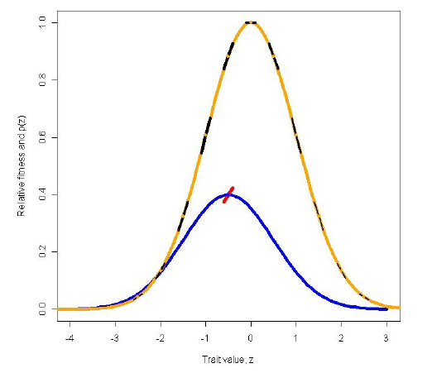

1. The Individual Selection Surface
b. β is the weighted average of the first derivatives
of the ISS
p(z) and w(z)
β
Trait value and mean
Notes:
The directional selection gradient as the weighted average of first derivatives of the ISS. The ISS is the orange curve; the trait distribution before selection, p(z), is shown in blue. First derivatives of the ISS are shown at regular intervals at black, straight line segments. The slopes of those segments correspond to the value of the corresponding first derivatives. The thickness of the black line segments are proportional to their weighting, p(z). The average of all the weighted slopes is the directional selection gradient, β, shown in red.In this illustration, the ISS is a Gaussian function (θ = 0, ω = 1) and p(z) is a normal distribution ( = -0.5, P = 1). Expression in inset from
Lande & Arnold (1983)

Slide 6

1. The Individual Selection Surface
c. Similarly, γ is the weighted average of the second
derivatives of the ISS
p(z) and w(z)
γ
Trait value and mean
Notes:
Lande & Arnold (1983)

Slide 7


2. Approximations to the ISS
Linear & quadratric approximations:
a way to estimate β and γ
linear
quadratic*
* the factor of ½ makes γ a second derivative
Notes:
α is the intercept and ε is the deviation of a particular observation from the regression line (Lande & Arnold 1983)

Slide 8
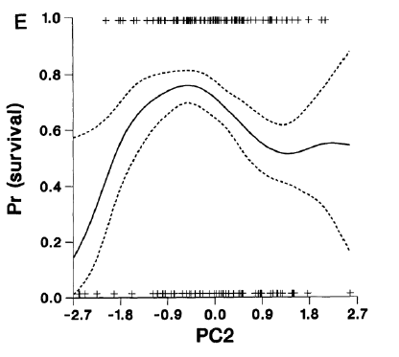
2. Approximations to the ISS
b. Cubic spline approximation,
describes the surface but doesn’t estimate β or γ
Notes:
Overwinter survival of juvenile male song sparrows (n=152) in relation to standardized PC2 (Schluter 1988).

Slide 9



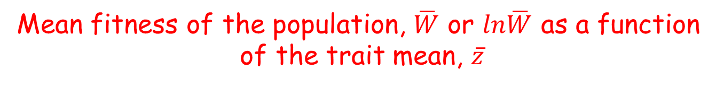
3. The adaptive landscape, AL, the surface on which $\overline{z}$ evolves
Mean fitness of the population, $\overline{W}$ or $ln\overline{W}$ as a function
of the trait mean, $\overline{z}$
a. A window on the AL at the position of the trait mean
Notes:
Lande & Arnold (1983)

Slide 10



3. The adaptive landscape, AL, the surface on which $\overline{z}$ evolves
Mean fitness of the population, $\overline{W}$ or $ln\overline{W}$ as a function
of the trait mean, $\overline{z}$
b. If w(z) is Gaussian, the AL takes a simple form
A normally-distributed
trait before selection
A Gaussian ISS with
optimum θ and width ω
A Gaussian AL with
optimum θ and width ω+P
Notes:
Lande (1979)

Slide 11


3. The adaptive landscape, AL, the surface on which $\overline{z}$ evolves
Mean fitness of the population, $\overline{W}$ or $ln\overline{W}$ as a function
of the trait mean, $\overline{z}$
b. and we can easily solve for first and
second derivatives of the AL
First derivative, β
Second derivative
Notes:
Lande (1979)

Slide 12
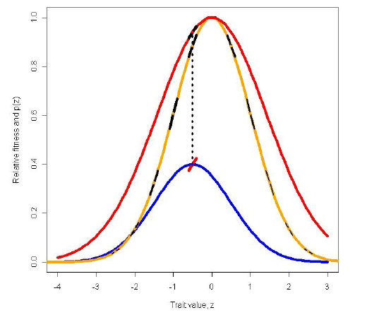
3. The adaptive landscape, AL, the surface on which $\overline{z}$ evolves
Mean fitness of the population, $\overline{W}$ or $ln\overline{W}$ as a function
of the trait mean, $\overline{z}$
b. In the Gaussian case, the AL (red) has the same
optimum as w(z) (orange) but is flatter
Notes:
The directional selection gradient, β, as the first derivative of the AL, evaluated at the trait mean before selection, . The AL is shown as a red Gaussian curve with an optimum θ = -0.5 and width parameter (ω+P) = 2. The directional selection gradient is shown at two sites connected by a dashed vertical line: at the mean of p(z), where it is shown as a red line segment, and at the point of evaluation on the AL, where it is shown as a black line segment. See Lande (1979).

Slide 13
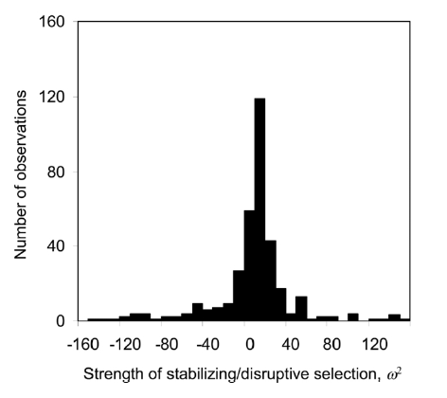

4. Examples and Surveys
a. Estimates of ω
n=355
n=355
ω
Notes:
Estes & Arnold (2007)

Slide 14
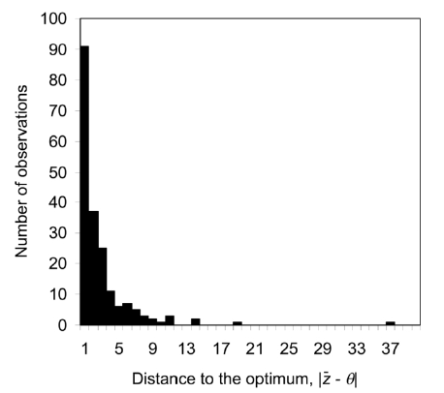

4. Examples and Surveys
b. Estimates of the distance to the optimum
n=197
Notes:
Distance of the phenotypic mean from the intermediate optimum, theta, in natural populations (n =197). Values of , the absolute distance from the phenotypic mean to the optimum in units of phenotypic standard deviations, were calculated from the database of Kingsolver et al. (2001). The first bin shows the number of observationswithin 1 phenotypic standard deviation of the optimum, the second bin shows the number within 2 but ≥1 phenotypic standard deviation from the optimum, and so on. Two values 140 were dropped from the plot. From
Estes & Arnold (2007)

Slide 15
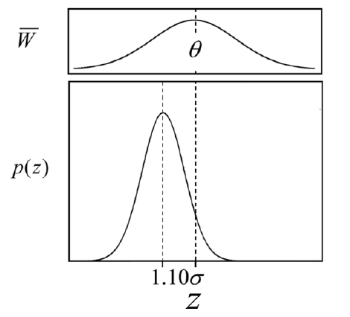
4. Examples and Surveys
c. Relative position and width of the AL,
inferred from the survey
Notes:
Estes & Arnold (2007).

Slide 16
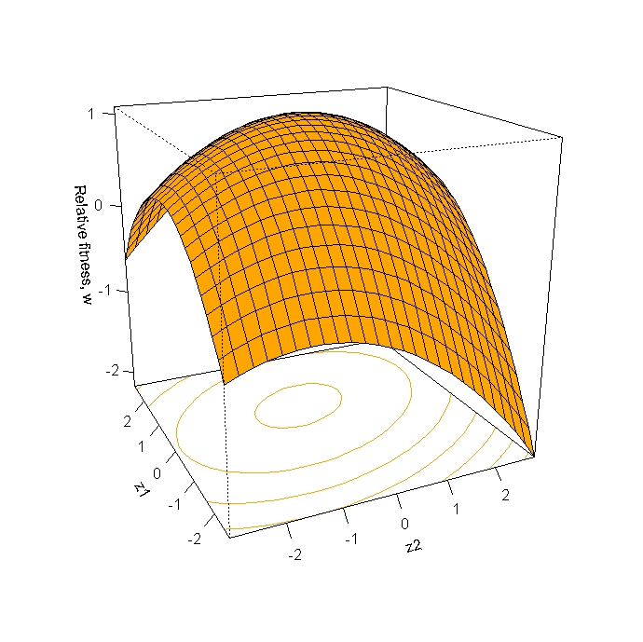
5. The multivariate individual selection surface, ISS
A hypothetical bivariate example
Notes:
Bivariate stabilizing selection represented as a convex selection surface. Fitness corresponds to points on the surface as a function of the values of two traits, z₁ and z₂. A contour representation of the surface is projected onto the z₁ x z₂ plane.

Slide 17
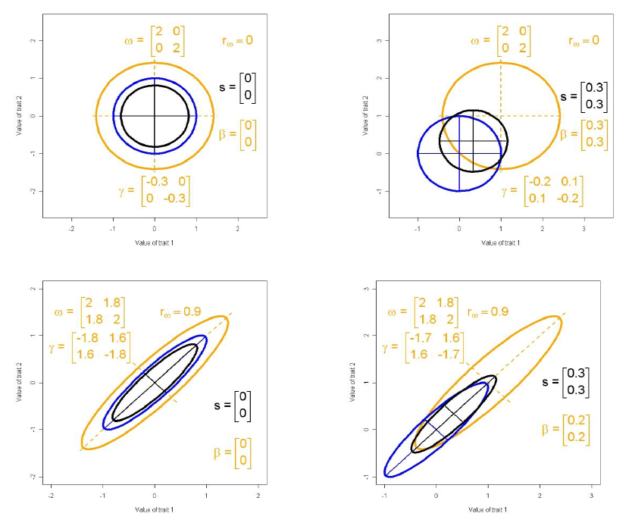
5. The multivariate individual selection surface, ISS
b. Some examples of bivariate ISSs and the
selection they impose
Trait 2
Trait 1
Notes:
Various forms of Gaussian selection and their effects on bivariate trait distribution. Ellipses comparable to 95% confidence ellipses are shown for Gaussian ISSs (orange). Phenotypic trait distributions are bivariate normal before (blue 95% confidence ellipses) and after selection (black 95% confidence ellipses). Bivariate means, variances and covariances, before and after selecton, are given in the caption for Fig. 2.2. Parameters for the ISSs, the same in Lecture 2.2 as here, are: (a) theta = (0, 0); omega= (2, 0; 0, 2); r_{s}=0. (b) theta = (1, 1); omega = (2, 0; 0, 2); r_{s}=0. (c) theta = (0, 0); omega =(2, 1.8; 1.8, 2); r_{s}=0.9. (d) theta = (1, 1);omega = (2, 1.8; 1.8, 2); r_{s}=0.9.

Slide 18


5. The multivariate individual selection surface, ISS
c. Consider a point on the selection surface. The slope at
that point is a vector and curvature is a matrix
First derivatives
Second derivatives
Notes:
Lande & Arnold (1983)

Slide 19
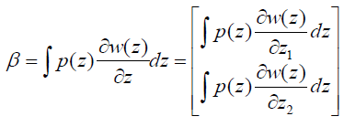
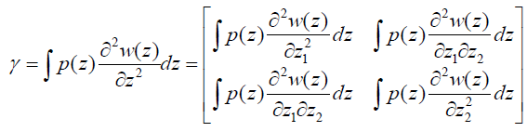
5. The multivariate individual selection surface, ISS
d. If we assume that p(z) is multivariate normal and
the actual ISS is quadratic, then β and γ are, respectively,
the average first and second derivatives of the surface.
Notes:
Lande & Arnold (1983)

Slide 20
6. Approximations to the multivariate ISS
Linear and quadratic approximations, a way to estimate
β and γ
For simplicity, we consider the two-trait case
Linear approximation
Quadratic approximation
Notes:
Lande & Arnold (1983)

Slide 21
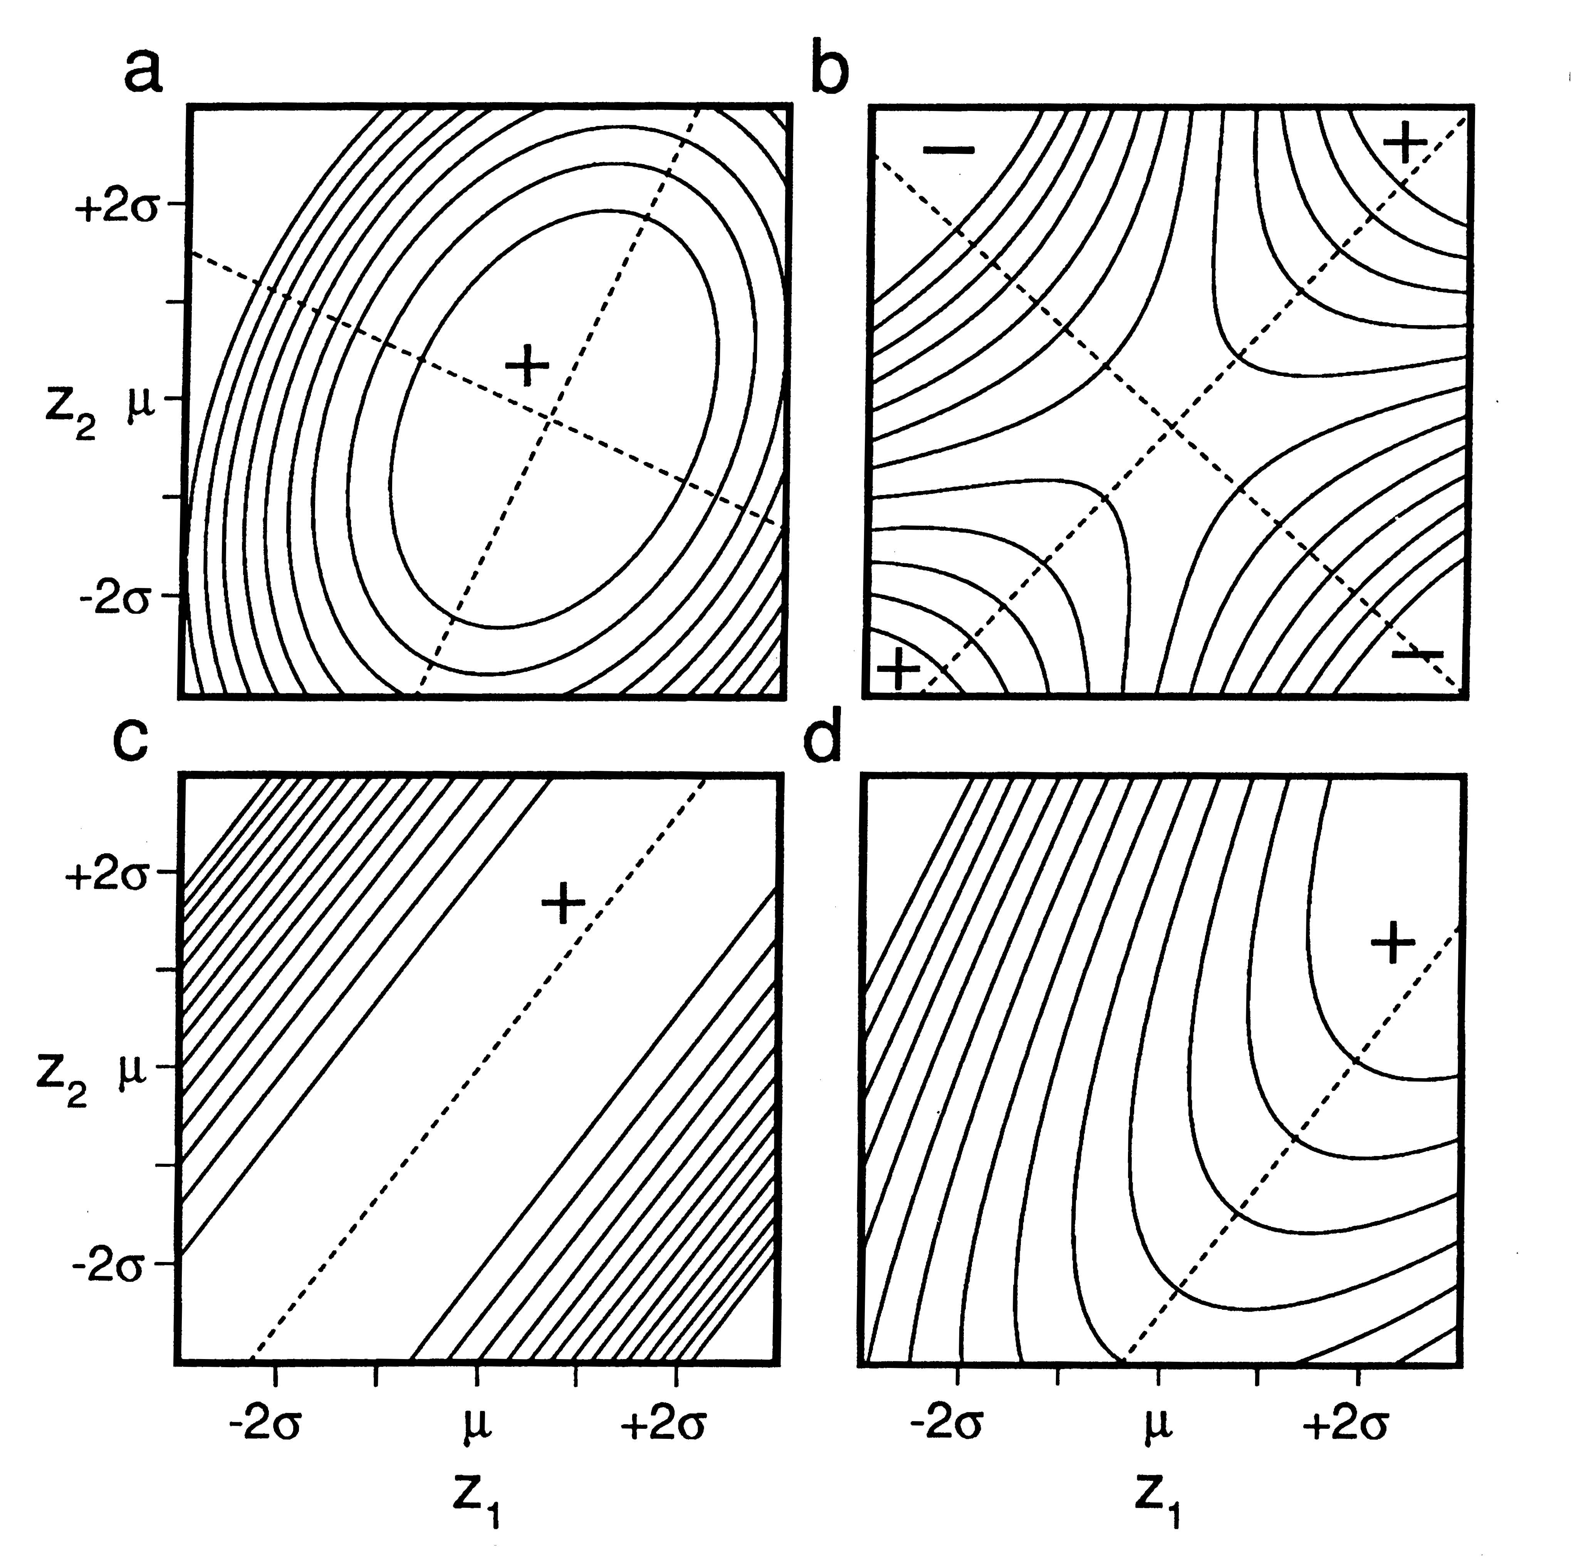
6. Approximations to the multivariate ISS
Linear and quadratic approximations, a way to estimate
β and γ
What can we approximate with a quadratic surface?
Notes:
Despite the simplicity of the quadratic approximation to the ISS (4.3), a large variety of selection possibilities are represented by these functions. In the 2-trait case, for example, quadratic surfaces may be hill (Fig. 4.2a), a saddle (Fig. 4.2b), a nearly level ridge (Fig. 4.2c), a rising ridge (Fig. 4.2d), as well as other possibilities. Fig. 4.2 also illustrates the point that it is generally difficult to visualize the quadratic surface that is specified by even a 2 x 2 matric of γ values. All four surfaces illustrated in Fig. 4.2 have the same value and sign (negative) for their stabilizing selection coefficients, γ₁₁ and γ₂₂. All of the correlational selection coefficients, γ₁₂, have the same sign (positive), but differ in magnitude from surface to surface. The position of the bivariate mean (denoted with an x) varies from surface to surface. The directional selection gradient, β, is the direction of steepest uphill slope from that position, and consequently it varies from surface to surface in Fig. 4.w. If the bivariate mean were located at a stationary point on the surface (the intersection of the two eigenvectors), both of the elements in β would be zero, i.e., there would be no directional selection (Phillips & Arnold (1989).

Slide 22
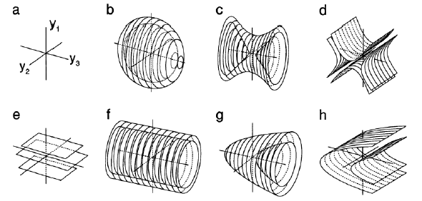
6. Approximations to the multivariate ISS
Linear and quadratic approximations, a way to estimate
β and γ
What can we approximate with a quadratic surface?
Notes:
In the 3-trait case, the variety of ISSs that can be approximated with quadratic surfaces is very large (Phillips & Arnold 1989). Seven varieties are shown in Fig. 4.4, where the canonical axes are denoted y₁, y₂, and y₃, but are not ordered by the size of their eigenvalues. Each of the nested surfaces in each figure represents equal values for relative fitness. Perhaps the easiest 3-trait case to visualize is stabilizing selection on all three axes, shown in Fig. 4.4a. Here the the fitness optimum, θ, a stationary point, is situated at the intersection of the axes. Fitness falls off as concentric spheres about this point. In Fig. 4.4f, the optimum is a line corresponding to y₃, with stabilizing selection on y₁ and y₂, but no selection along the y₃-axis.

Slide 23
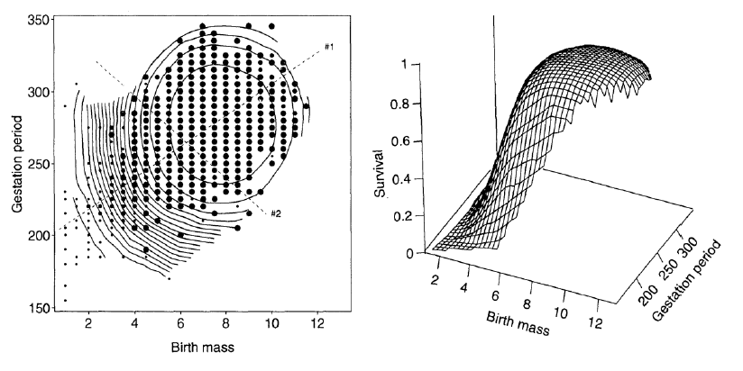
6. Approximations to the multivariate ISS
b. Cubic spline approximation, describes the
surface without estimating β and γ
Notes:
Survival probability of male human infants as a function of birth mass (pounds) and gestation period (days) (from Schluter & Nychka 1994).

Slide 24

7. The multivariate adaptive landscape, AL
The slope and curvature of the AL,
evaluated at the trait mean are related to β and γ
A window on the adaptive landscape
Notes:
Lande & Arnold (1983)

Slide 25




7. The multivariate adaptive landscape, AL
b. If the ISS is multivariate Gaussian, the AL takes a
simple Gaussian form
Gaussian ISS
Gaussian AL

Slide 26
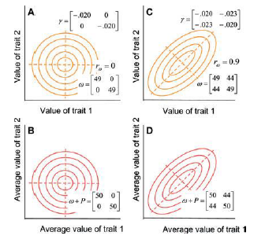
7. The multivariate adaptive landscape, AL
We can characterize the main axes of the ISS and AL by
taking the eigenvectors of the ω - and ω+P matrices
Notes:
Arnold et al. (2008)

Slide 27
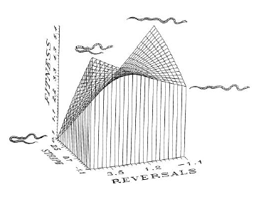
8. Examples and surveys
Bivariate selection on escape behavior and coloration
pattern in a garter snake
Notes:
Brodie (1992)

Slide 28
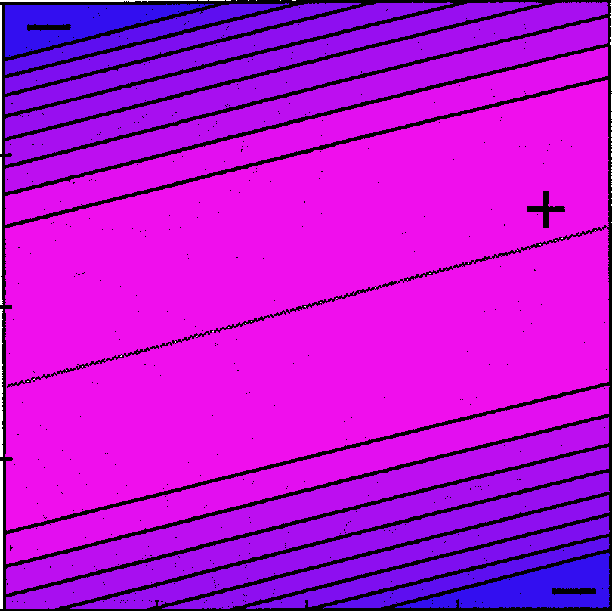
8. Examples and surveys
Growth rate as a function of vertebral numbers (left)
and crawling speed as a function of vertebral numbers
(right) in garter snakes
-2σ
-1σ
TAIL
0
+1σ
+2σ
-2σ
-1σ
0
+1σ
+2σ
TAIL
-2σ
-1σ
0
+1σ
+2σ
-2σ
-1σ
0
+1σ
+2σ
BODY
BODY
Notes:
Arnold (1988), Arnold & Bennett (1984)

Slide 29
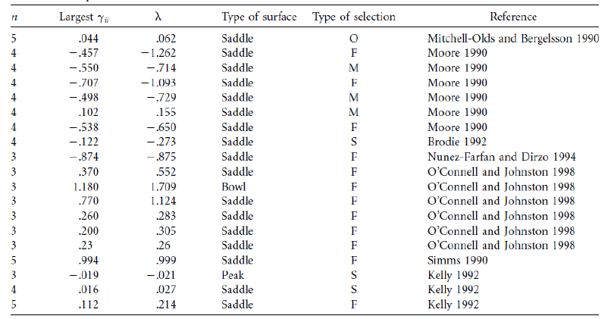
8. Examples and surveys
c. A survey of quadratic approximations to ISSs
shows that saddles are common
Notes:
Blows & Brooks (2003)

Slide 30
What have we learned?
Selection can be described with surfaces.
Some approximations of selection surfaces allow us to estimate key measures of selection (β and γ).
Those key measures in turn tell us about the adaptive landscape.

Slide 31
References
Lande, R. and S. J. Arnold 1983. The measurement of selection on correlated characters. Evolution 37: 1210-1226.
Lande, R. 1979. Quantitative genetic analysis of multivariate evolution, applied to brain: body size allometry. Evolution 33: 402-416.
Schluter, D. 1988. Estimating the form of natural selection on a quantitative trait. Evolution 42: 849-861.
Phillips, P. C. & S. J. Arnold. 1989. Visualizing multivariate selection. Evolution 43: 1209-1222.
Blows, M. W. & R. Brooks. 2003. Measuring nonlinear selection. American Naturalist 162: 815-820.
Estes, E. & S. J. Arnold. 2007. Resolving the paradox of stasis: models with stabilizing selection explain evolutionary divergence on all timescales. American Naturalist 169: 227-244.
Schluter, D. & D. Nychka. 1994. Exploring fitness surfaces. American Naturalist 143: 597-616.
Brodie, E. D. III. 1992. Correlational selection for color pattern and antipredator behavior in the garter snake Thamnophis ordinoides. Evolution 46: 1284-1298.
Arnold, S.J. 1988. Quantitative genetics and selection in natural populations: microevolution of vertebral numbers in the garter snake Thamnophis elegans. Pp. 619-636 IN: B.S. Weir, E.J. Eisen, M.M. Goodman, and G. Namkoong (eds.), Proceedings of the Second International Conference on Quantitative Genetics. Sinauer, Sunderland, MA
Arnold, S.J. and A.F. Bennett. 1988. Behavioural variation in natural populations. V. Morphological correlates of locomotion in the garter snake Thamnophis radix. Biological Journal of the Linnean Society 34: 175-190.
Kingsolver, J. G. et al. 2001. The strength of phenotypic selection in natural populations. American Naturalist 157: 245-261.

