Slide 1
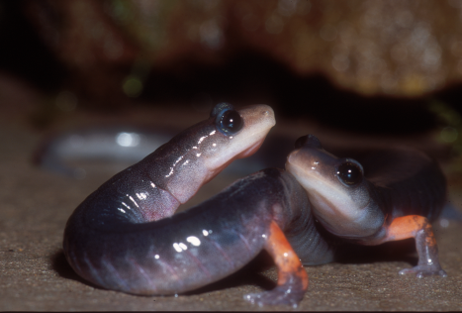
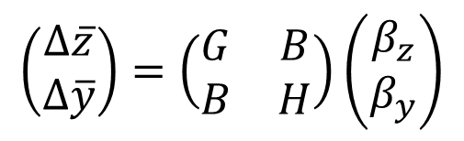
Molecular and phenotypic tangos as models for the evolution of plethodontid courtship pheromones?
$$\left(\begin{matrix}∆\overline{z} \\ ∆\overline{y}\end{matrix}\right)=\left(\begin{matrix}G & B \\ B & H\end{matrix}\right)\left(\begin{matrix}β_{z} \\ β_{y}\end{matrix}\right)$$
Stevan J. Arnold & Lynne D. Houck
Department of Integrative Biology
Oregon State University
Notes:
For more details see: Arnold, S. J. & L. D. Houck. 2016. Can the Fisher-Lande process account for birds of paradise and other sexual radiations. American Naturalist 187:000-000. PDFs of the article are available at the journal website and at ResearchGate .

Slide 2
Background
Male plethodontids produce courtship pheromones in their mental glands.
The pheromones are delivered by scratching or slapping the female during courtship.
Pheromones enhance female sexual receptivity.
The pheromone is a complex cocktail of proteins.
Three unrelated families of proteins contribute to the cocktail.
The evolution of these protein families share a number of characteristics.
What are they?

Slide 3
Evolutionary patterns in courtship pheromone proteins
Incessant, rapid evolution
Driven by drift and positive selection
Gene duplication
Polymorphism within populations can be extensive
How can we account for these patterns?

Slide 4
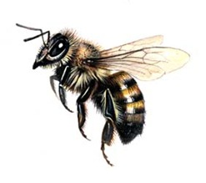


Watts’ tethered bee: a metaphor
Richard Watts

Slide 5
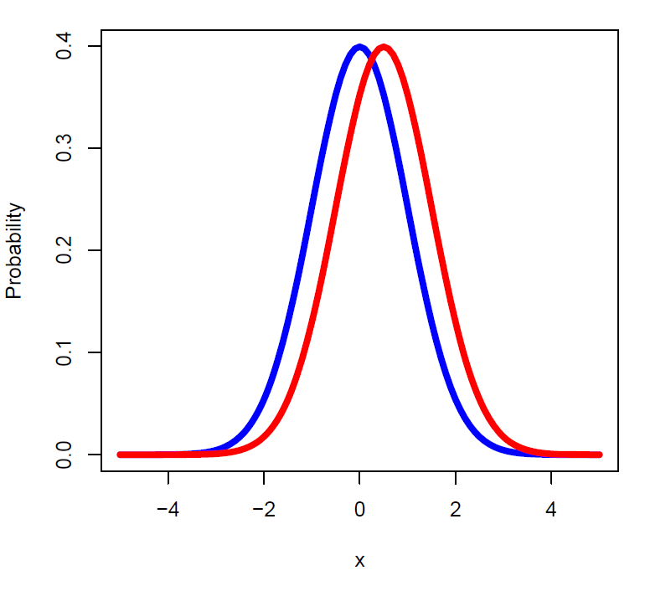




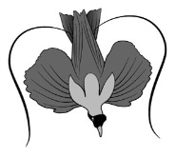

Lande’s model: coevolving within-population distributions of ornaments and preferences
Russell Lande
Notes:
See Lande 1981

Slide 6
From molecules to mating success with a Phenotypic Tango model
fitness
survival
mating success
pheromone
traits
Trait 1
Trait 2
proteins
SPF
PMF
PRF
genes

Slide 7
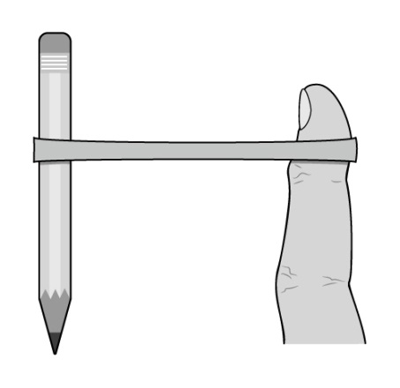
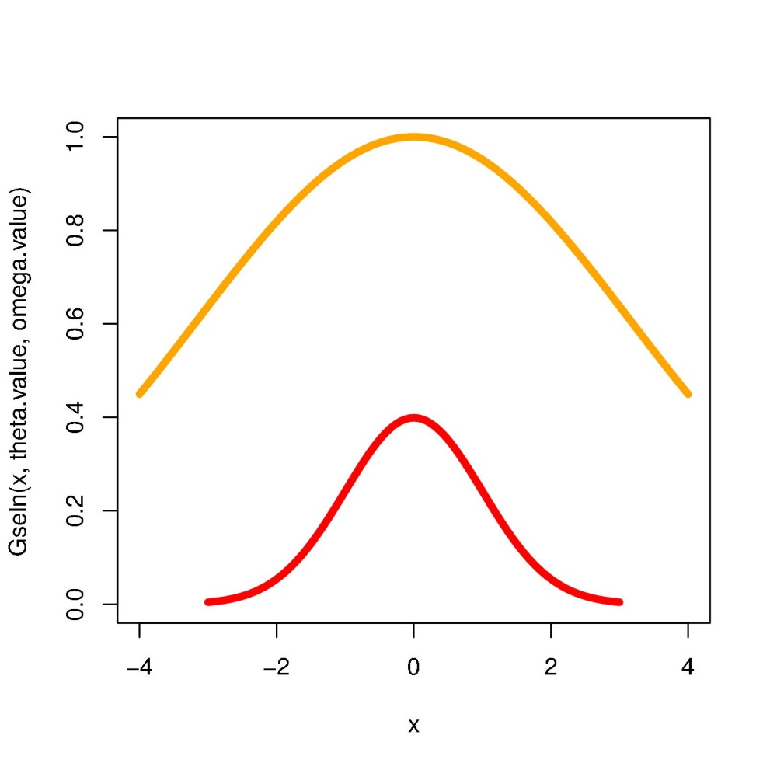
The phenotypic tango:
a model
drift
stabilizing
natural selection
towards an
optimum
is balanced by
drift
Probability, Fitness
receptor trait

Slide 8
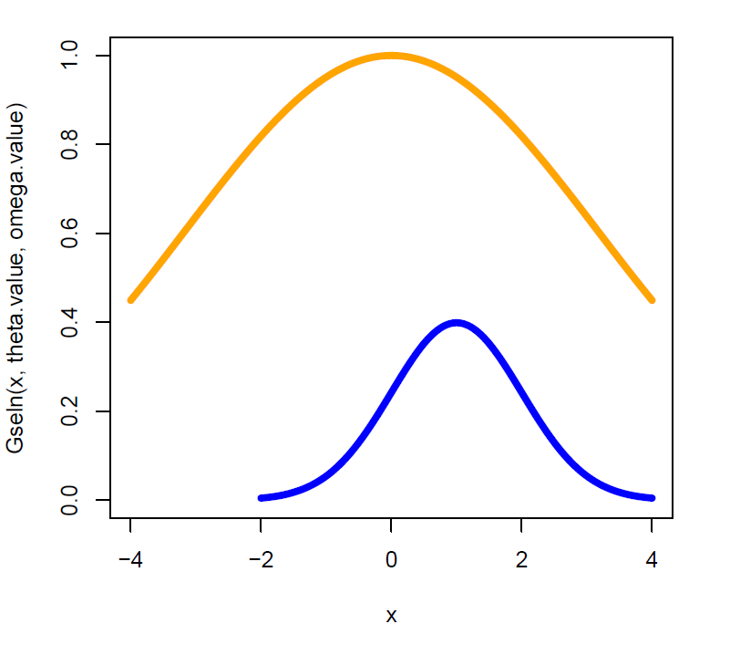



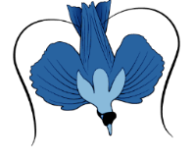

Stabilizing natural selection
towards an intermediate
optimum is
balanced by
opposing
sexual
selection
and drift
sexual
selection
drift
Probability, Fitness
pheromone trait
Notes:
In Lande’s (1981) model, with a single male ornament, at equilibrium natural selection on the ornament balances an opposing force of sexual selection, but the ornament mean is likely to equilibrate at some distance from its natural selection optimum, as in this illustration. The ornament distribution here, shown in blue, has a variance of 1 (P=1). The fitness function describing natural (viability) selection has a width parameter analogous to a variance that is 10*P (ω=10).

Slide 9
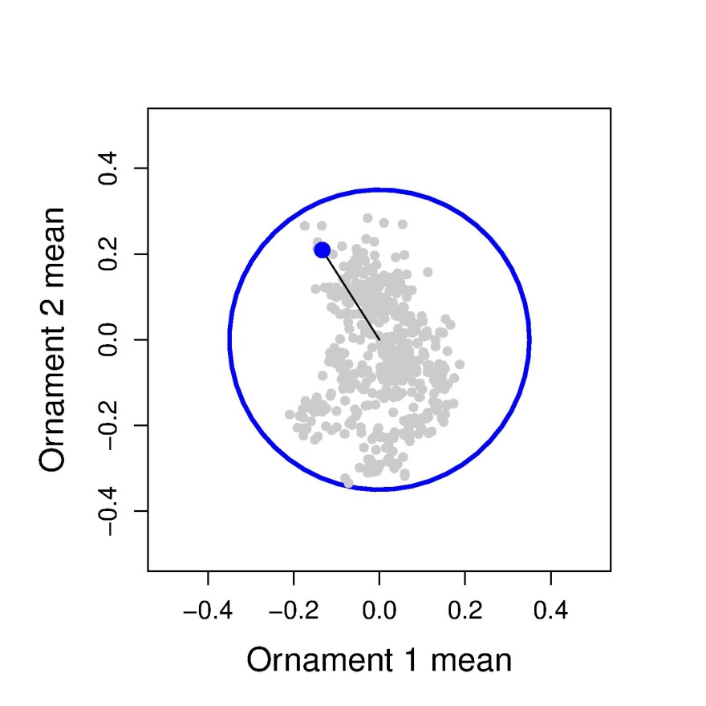
The phenotypic tango: a model pheromone lineage means buzz about their natural selection optimum
animations
Notes:
Need lateral and overhead views of fly flying on tether

Slide 10
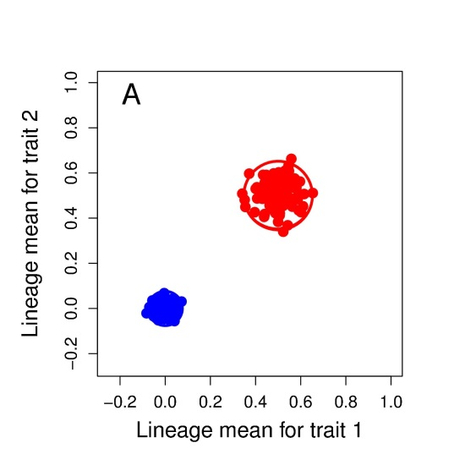
The phenotypic tango: a model no sexual selection – no tango
Notes:
Need lateral and overhead views of fly flying on tether

Slide 11
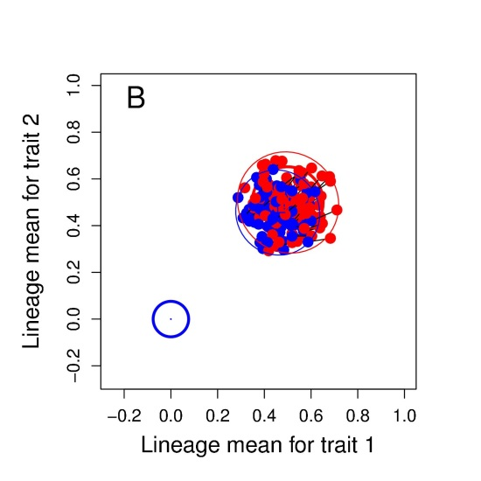
The phenotypic tango: a model with sexual selection, pheromones and receptors tango around the receptor optimum
Notes:
Need lateral and overhead views of fly flying on tether

Slide 12
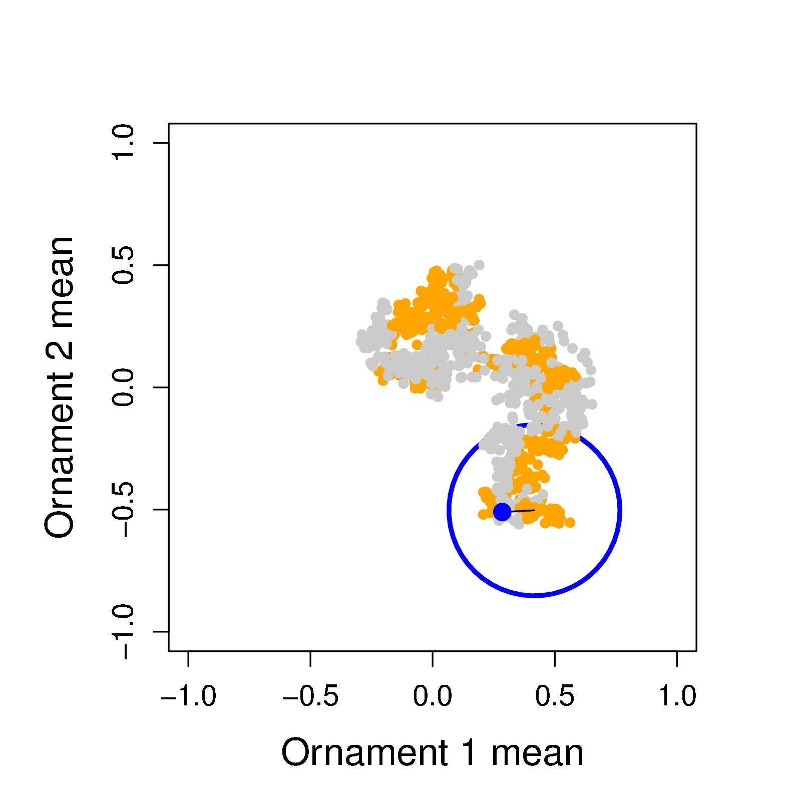

The phenotypic tango: a model if the natural selection optimum moves, pheromone evolution is exaggerated
Notes:
Need lateral and overhead views of fly flying on tether

Slide 13
Conclusions from the model
The evolution of receptors is the key to understanding pheromone evolution
Extraordinary evolution of pheromones, may require very weak selection on receptors or evolutionary movement of the receptor optimum

Slide 14
Where do we stand?
We have a good understanding of the pattern of pheromone evolution
The phenotypic tango model makes qualitative predictions about unmeasured traits
We need a molecular tango model of pheromone and receptor sequences

Slide 15
From molecules to mating success: with a Molecular Tango model
fitness
survival
mating success
pheromone
traits
Trait 1
Trait 2
proteins
SPF
PMF
PRF
genes

Slide 16


























Acknowledgements
L. Houck
S. Tilley
P. Verrell
S. Rollmann
R. Feldhoff
P. Feldhoff
A. Jones
M. Pfrender
C. Palmer
L. Mead
C. Wirsig-
Wiechmann
R. Highton
R. Watts
E. Vacarro
A. Hastings
S. Eddy
F. Laberge
G. Roth
K. Kiemnec-Tyburczy
D. Wilburn
S. Woodley
H. Godwin
R. Gregg
M. McCall

Slide 17
References
Lande, R. 1981. Models of speciation by sexual selection on polygenic traits. Proc. Nat. Acad. Sci. USA 78:3721–3725.
Houck, L.D. & N.L. Reagan. 1990. Male courtship pheromones increase female receptivity in a plethodontid salamander. Animal Behaviour 39:729-734.
Rollmann, S.M., Houck, L.D., & Feldhoff, R.C. 1999. Proteinaceous pheromone affecting female receptivity in a terrestrial salamander. Science 285: 1907‑1909.
Feldhoff, R. C., S. M. Rollmann & L. D. Houck. 1999. Chemical analyses of courtship pheromones in a plethodontid salamander. In: Advances in Chemical Signals in Vertebrates; pp 117‑125; R. E. Johnston, D. Müller‑Schwarze and P. Sorensen (Eds.). Kluwer Academic/Plenum Publishers, New York.
Watts, R.A., C.A. Palmer, R.C. Feldhoff, P.W. Feldhoff, L.D. Houck, A.G. Jones, M.E. Pfrender, S.M. Rollmann & S.J. Arnold. 2004. Stabilizing selection on behavior and morphology masks positive selection on the signal in a salamander pheromone signaling complex. Molecular Biology and Evolution 21:1032-1041.

Slide 18
References, cont.
Palmer, C.A., R. Watts, R. Gregg, M. McCall, L. Houck, R. Highton & S. Arnold. 2005. Lineage-specific differences in evolutionary mode in a salamander courtship pheromone: evidence for a molecular tango. Molec. Biol. Evolution 22:2243-2256.
Houck, L.D., L.S. Mead, R.A. Watts, S.J. Arnold, P.W. Feldhoff & R.C. Feldhoff. 2007. A candidate vertebrate pheromone, SPF, increases female receptivity in a salamander. Pp. 213-221. In: J. Hurst, R. Beynon, and D. Muller-Schwarze, (Eds.), Chemical Signals in Vertebrates 11. Springer, New York.
Palmer, C.A., D.M. Hollis, R.A. Watts, L.D. Houck, M.A. McCall, R.G. Gregg, P.W. Feldhoff, R.C. Feldhoff & S.J. Arnold. 2007. Plethodontid modulating factor, hypervariable salamander courtship pheromone in the three-finger protein superfamily. The FEBS Journal 274:2300-2310.
Houck, L.D., C.A. Palmer, R.A. Watts, S.J. Arnold, P.W. Feldhoff & R.C. Feldhoff. 2007. A new vertebrate courtship pheromone, PMF, affects female receptivity in a terrestrial salamander. Animal Behaviour 73:315-320.
Houck, L.D., R.A. Watts, S.J. Arnold, K.E. Bowen, K.M. Kiemnec, H.A. Godwin, P.W. Feldhoff & R.C. Feldhoff. 2008. A recombinant courtship pheromone affects sexual receptivity in a plethodontid salamander. Chemical Senses 33:623-631.

Slide 19
References, cont.
Palmer, C., A. Picard, R. Watts, L.D. Houck, & S.J. Arnold. 2010. Rapid evolution of Plethodontid Modulating Factor (PMF), a hypervariable salamander courtship pheromone, is driven by positive selection. Jour. Molec. Evol. 70:427-440.
Kiemnec-Tyburczy, K. M., S. K. Woodley, R. A. Watts, S. J. Arnold, & L. D. Houck. 2012. Expression of vomeronasal receptors and related signaling molecules in the nasal cavity of a caudate amphibian (Plethodon shermani). Chemical Senses 37: 335-346.
Wilburn, D.B., K.E. Bowen, R.G. Gregg, J. Cai, P.W. Feldhoff, L.D. Houck, & R.C. Feldhoff. 2012. Proteomic and UTR analyses of a rapidly evolving hypervariable family of vertebrate pheromones. Evolution 66: 2227-2239.
Wilburn, D. B. & W. J. Swanson. 2016. From molecules to mating: rapid evolution and biochemical studies of reproductive proteins. Journal of proteomics 135: 12-25.
Arnold, S. J. & L. D. Houck. 2016. Can the Fisher-Lande process account for birds-of-paradise and other sexual radiations? The American Naturalist 187:717-735.

