Slide 1
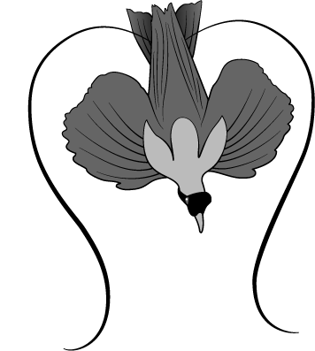
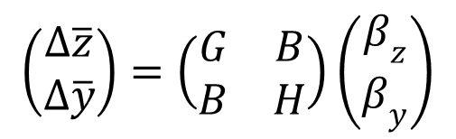
Can the Fisher-Lande Process Account for Birds-of-Paradise and Other Sexual Radiations?
$$\left(\begin{matrix}∆\overline{z} \\ ∆\overline{y}\end{matrix}\right)=\left(\begin{matrix}G & B \\ B & H\end{matrix}\right)\left(\begin{matrix}β_{z} \\ β_{y}\end{matrix}\right)$$
Stevan J. Arnold & Lynne D. Houck
Department of Integrative Biology
Oregon State University
Notes:
For details see: Arnold, S. J. & L. D. Houck. 2016. Can the Fisher-Lande process account for birds of paradise and other sexual radiations? American Naturalist 187:000-000. PDF available at the journal website
http://www.journals.uchicago.edu/doi/10.1086/686258
and at ResearchGate

Slide 2
Argument
Models of the FLP have been successful, but
Their predictions are seldom (never?) tested.
The Phenotypic Tango, a more general version of the model, offers some improvements.
Its predictions can be evaluated with simulations, but
Can the Phenotypic Tango account for actual sexual radiations (e.g., the bird-of-paradise radiation)?
What about popular generic models (BM & OU)? Can they account for the b-o-p radiation? Models useful?
Conclusions
Some directions for the future

Slide 3
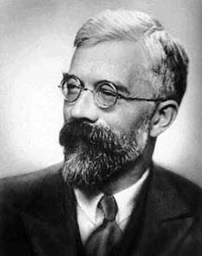
Fisher’s Insight
“The two characteristics affected by such a process, namely plumage development in the male, and sexual preference for such development in the female, must thus advance together … with ever-increasing speed.”
Fisher 1915, 1930
Ronald A. Fisher (1890-1962)
Notes:
Although Fisher famously argued that ornaments and preference means would coevolve in a runaway process, subsequent work has shown that a walk-towards process is also possible and more plausible than the runaway.

Slide 4

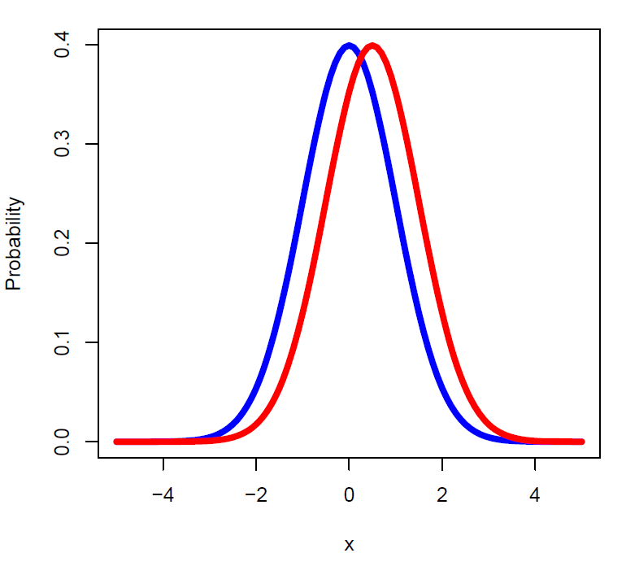


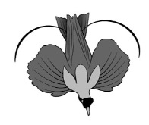
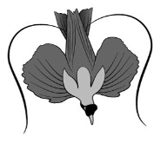
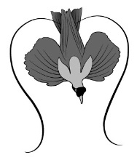
Lande’s model: coevolving within-population distributions of ornaments and preferences
Russell Lande
Notes:
Within-population distributions of ornaments (blue) and preference (red) are normal curves in Lande’s (1981) model. We will use his model for absolute preferences, in which the red curve shows the distribution of the ornaments most preferred by females in the populations. Each female’s preferences are a Gaussian function with an optimum that represents her most preferred mate. Her tendency to mate with a particular male falls off as a Gaussian curve in either direction from that optimum. The distribution of those optima among females is the curve shown in red. In our derivations, programming and figures, we have standardized the variance in both distributions to a value of 1. The means of the two distributions, and hence the distance between them, are free to evolve.

Slide 5
Ingredients of the Fisher-Lande Process
A male ornament affects male survival and – via female preference - mating success,
Female mating preference is based on the ornament but does not affect the survival or fecundity of the female.
Both traits are heritable and – because of assortative mating and sexual selection on males – genetically correlated.

Slide 6

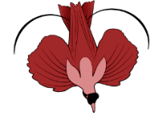




Walk-towards and Runaway Outcomes
WALK-TOWARDS
RUNAWAY
Average preference
Average ornament
Average ornament
Lande 1981
Notes:
In Lande’s (1981) model, with no selection on preferences, the ornament-preference mean evolves towards a stable line of equilibria or away from an unstable line of equilibra. Along both lines, natural and sexual selection on ornaments are perfectly balanced. In the stable (walk-towards) case and with a population of finite size, the bivariate mean will drift along the line. In the model we will consider, parameters are chosen corresponding to the stable case, so the ornament-preference mean evolves towards a single stable point.

Slide 7
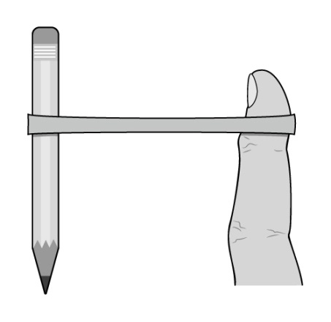
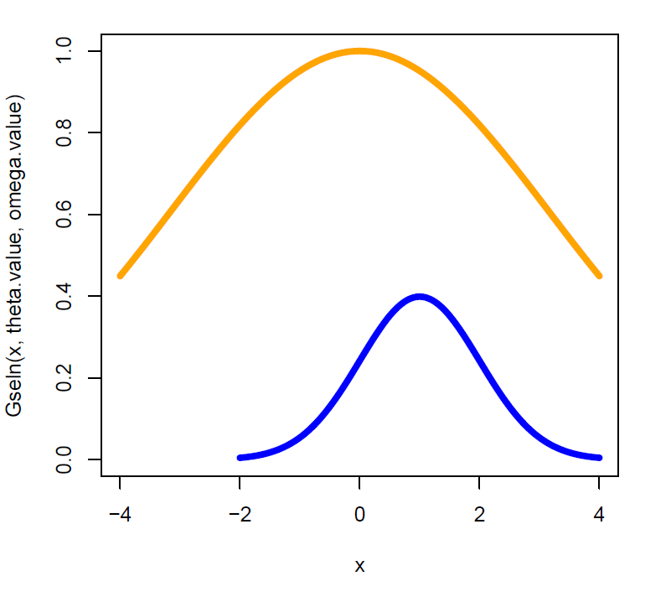

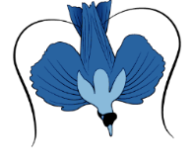
Stabilizing natural selection
towards an intermediate
ornament optimum
balanced by
opposing
sexual
selection
Probability, Fitness
ornament
Notes:
In Lande’s (1981) model, with a single male ornament, at equilibrium natural selection on the ornament balances an opposing force of sexual selection, but the ornament mean is likely to equilibrate at some distance from its natural selection optimum, as in this illustration. The ornament distribution here, shown in blue, has a variance of 1 (P=1). The fitness function describing natural (viability) selection has a width parameter analogous to a variance that is 10*P (ω=10).

Slide 8


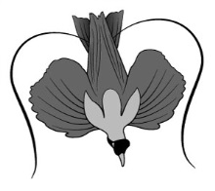



Problem: failure to connect the models with real sexual radiations
$$\left(\begin{matrix}∆\overline{z} \\ ∆\overline{y}\end{matrix}\right)=\left(\begin{matrix}G & B \\ B & H\end{matrix}\right)\left(\begin{matrix}β_{z} \\ β_{y}\end{matrix}\right)$$
nature
models
Notes:
Over three dozen quantitative genetic models for evolution by sexual selection have been derived from Lande’s (1981) model (Mead & Arnold 2004). Surprisingly, these models have seldom been tested using actual data from sexual radiations. The rest of the talk describes how this impasse can be broken. For more details, see Arnold & Houck (2016).

Slide 9

Solution: Birds-of-Paradise, an Iconic Sexual Radiation
Time-calibrated phylogeny
Male display and female choice based upon it
Data on the components of male display
Notes:
In general, to apply our approach, one needs: 1. a time-calibrated phylogeny and 2. data on continuously-varying morphological or behavioral components of male display (i.e., ornaments) for multiple populations or species on the phylogeny.

Slide 10
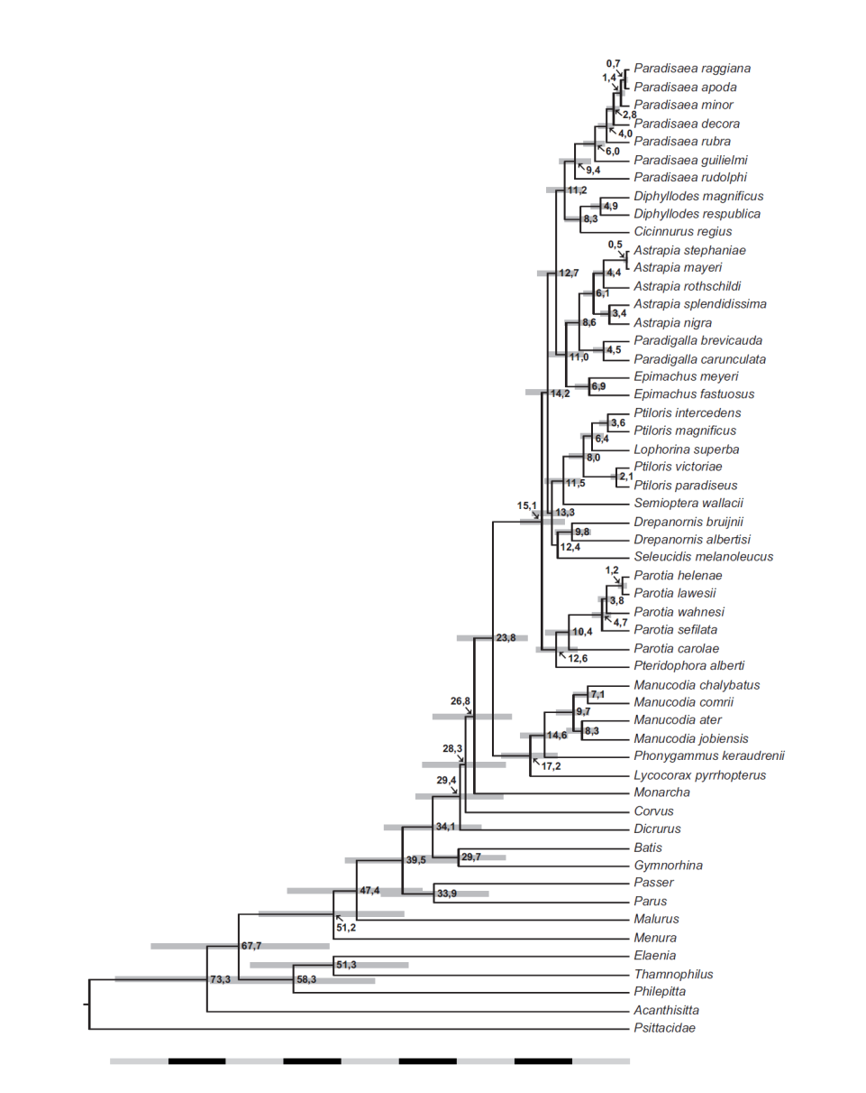
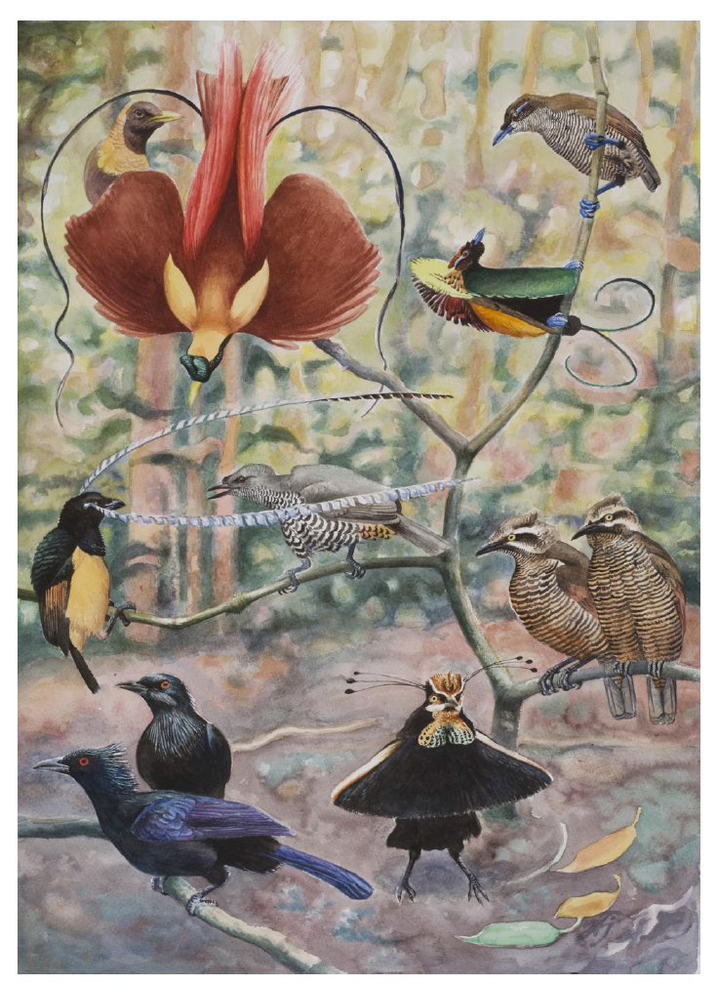

Diversification over 23 million years
Irestedt et al. 2009
Notes:
Birds of paradise have evolved extraordinary diversification in male plumage and behavioral displays over a period of about 23 million years (Irestedt et al. 2009). To view the sexual radiation of birds of paradise through the lens of the phenotypic tango model, we will restrict our attention to 14 populations representing seven species in the genus Paradisaea (see clade at top of tree with a common ancestor at about 9.4 Ma). One exemplar species from this clade, P. apoda, is shown displaying in the next slide and linked video.

Slide 11

Special features of plumage presented during male displays
https://www.facebook.com/Birds.Lovers.1/videos/1003571246388699/
Notes:
Two male birds-of-paradise (Paradisaea apoda) displaying to a female, showing the role of the wings and tail in forming a static shape (after Laman & Scholles 2014). Follow the link to their video of this encounter. We will analyze the evolution of wing and tail size in this genus.

Slide 12
Phenotypic tango: a more general model of the FLP
Two male display traits (ornaments)
Two female preference traits
Selection on female preference
Finite population size
Graphical Conventions
Tail length
Wing length
Notes:
The model of the FLP that we will use is more general than past versions because of the following combination of features: 1. two traits in each sex, 2. stabilizing selection on female preferences, and 3. finite population size. We will illustrate trait evolution in just two dimensions by superimposing ornaments and preferences in the same trait space. We will represent the bivariate distribution of male and female traits with just the positions of the ornament and preference means (blue and red dots). Because we will usually show multiple populations (lineages), we will link the means for each populations with a thin black line. We call the model the Phenotypic Tango because ornament and preference means appear to dance together thru evolutionary time.

Slide 13
Phenotypic tango: a more general model of the FLP
GOOD NEWS! - Model more general than past versions
BAD NEWS! – No analytical solution for model
MORE GOOD NEWS! – Can determine the model’s behavior with simulations
Notes:
Some good and bad news.

Slide 14
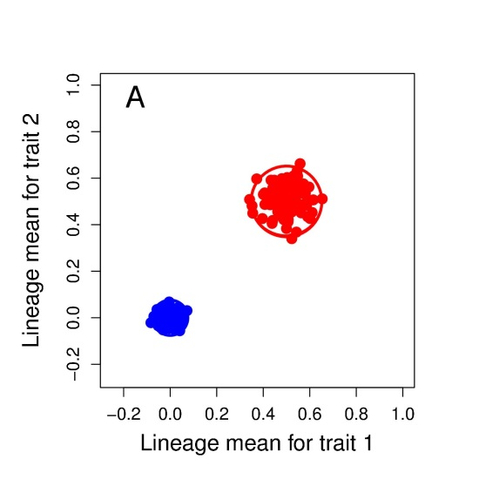
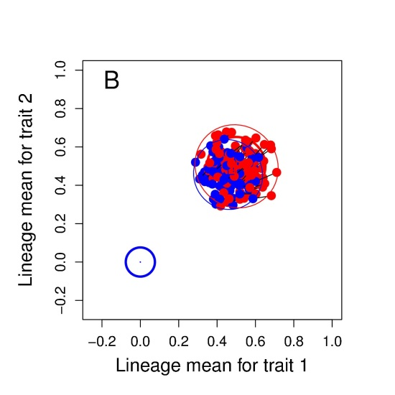
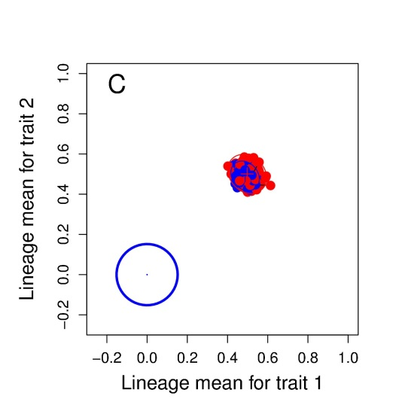
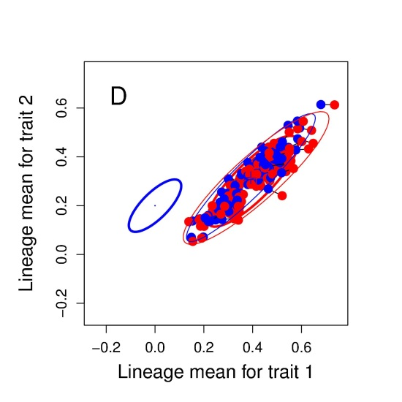
Phenotypic tango: evaluating the model’s behavior with simulations
Notes:
Figure 3: Sexual selection exaggerates the evolution of ornaments and mating preferences, producing a phenotypic tango (illustrated with a set of 100 lineages at generation 500). The 95% confidence ellipses for diversification of ornaments and preferences are shown as heavy blue and red ellipses, respectively. (A) The evolution of the ornaments in the absence of sexual selection (B) The evolution of ornaments and preferences in the presence of sexual selection is a tango. The positions of ornament and preference means for a particular lineage are shown as blue and red dots connected by a black line. (C) When stabilizing selection on ornaments and preferences is reversed (weak on ornaments, strong on preferences), extraordinary evolution of ornaments is eliminated. (D) Correlational natural selection on ornament and preference changes their 95% confidence ellipses from circles to inclined ellipses.

Slide 15
Phenotypic tango: evaluating the model’s behavior with simulations
For animations, see
http://phenotypicevolution.com/?p=221
Notes:
Follow the link to see animations of many of the figures in Arnold & Houck 2016.

Slide 16

Accounting for the Bird-of-Paradise radiation with the Phenotypic Tango model
$$\left(\begin{matrix}∆\overline{z} \\ ∆\overline{y}\end{matrix}\right)=\left(\begin{matrix}G & B \\ B & H\end{matrix}\right)\left(\begin{matrix}β_{z} \\ β_{y}\end{matrix}\right)$$
data
Notes:
Ornament data on a time-calibrated tree allows us to break the impasse. We illustrate tests of the Phenotypic Tango, but the approach we use could be used to test any of the 3 dozen versions of Lande’s model that have been produced in the last 35 years

Slide 17
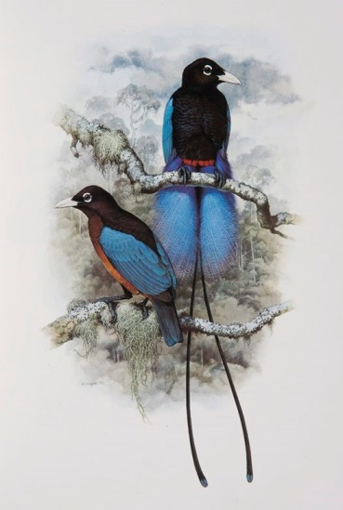
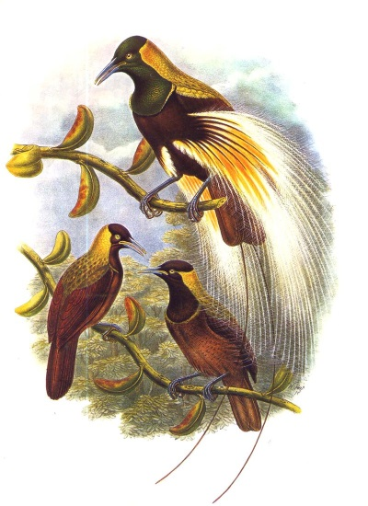
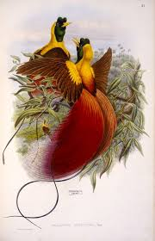
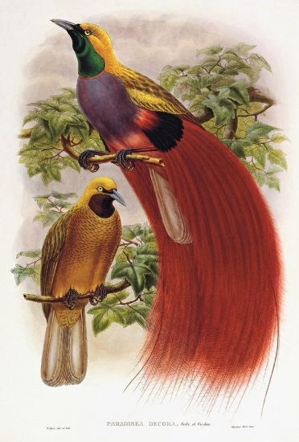
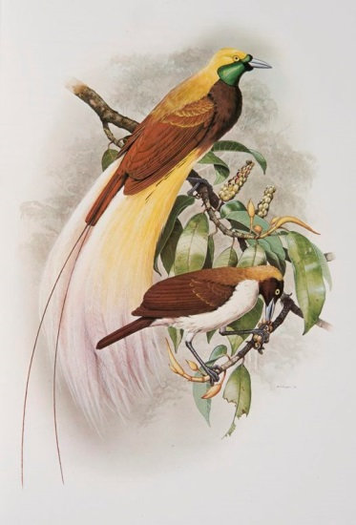
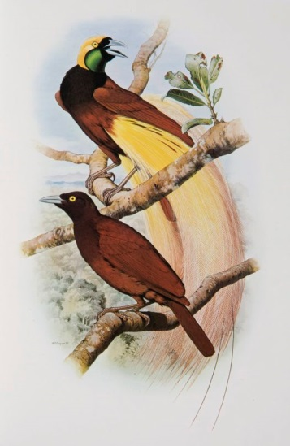
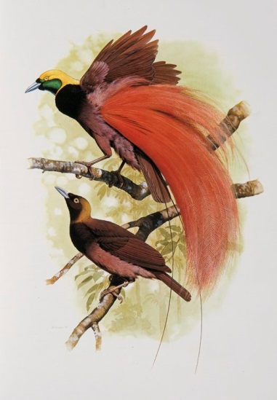
Phenotypic differentiation in the genus Paradisaea over 9 million years
rudolphi
guilielmi
rubra
decora
minor
apoda
raggiana
Notes:
We need data on sexually-selected traits for a set of species that spans an entire radiation. For birds-of-paradise, these requirements can only be satisfied for one genus (Paradisaea), which radiated over a period of 9.4 million years.

Slide 18
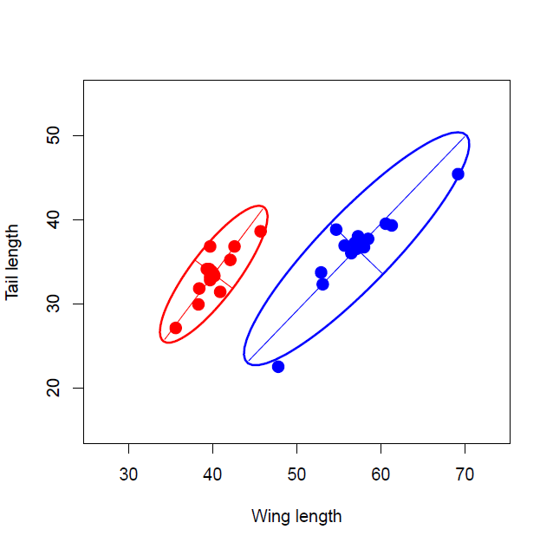
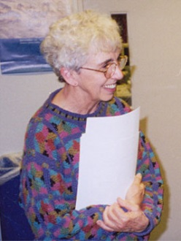
How much evolution? ±10-12 phenotypic standard deviations in 1.8 million generations
males
females
Mary LeCroy
LeCroy 1981
Notes:
Mary LeCroy published data on morphological traits in this genus. Using her data we plot tail length as a function of wing length in 14 populations of birds of paradise, representing 7 species in the genus Paradisaea. The data have been standardized so we can gauge the extent of evolution. Measurements are expressed in units of average within-population standard deviation ($\sqrt{P}$). Female (red dots) and male (blue dots); 95% confidence ellipses and principal components are shown for each sex.

Slide 19

The Phenotypic Tango can account for bivariate patterns in the data
Notes:
Using the Phenotypic Tango model, we can produce male morphological pattern like the one in the preceding slide by invoking correlational selection. Figure 3D. Correlational natural selection on ornament and preference changes their 95% confidence ellipses from circles to inclined ellipses. Notice that mating preferences (unobserved in the bop example in the preceding slide) have displaced the ornament ellipse from position that probably resembled the female plumage optimum to one that mirrors the preference optimum. But wait, notice from the scale that this is a micro-pattern. Can the model produce a full scale (± 12 sd) radiation?

Slide 20
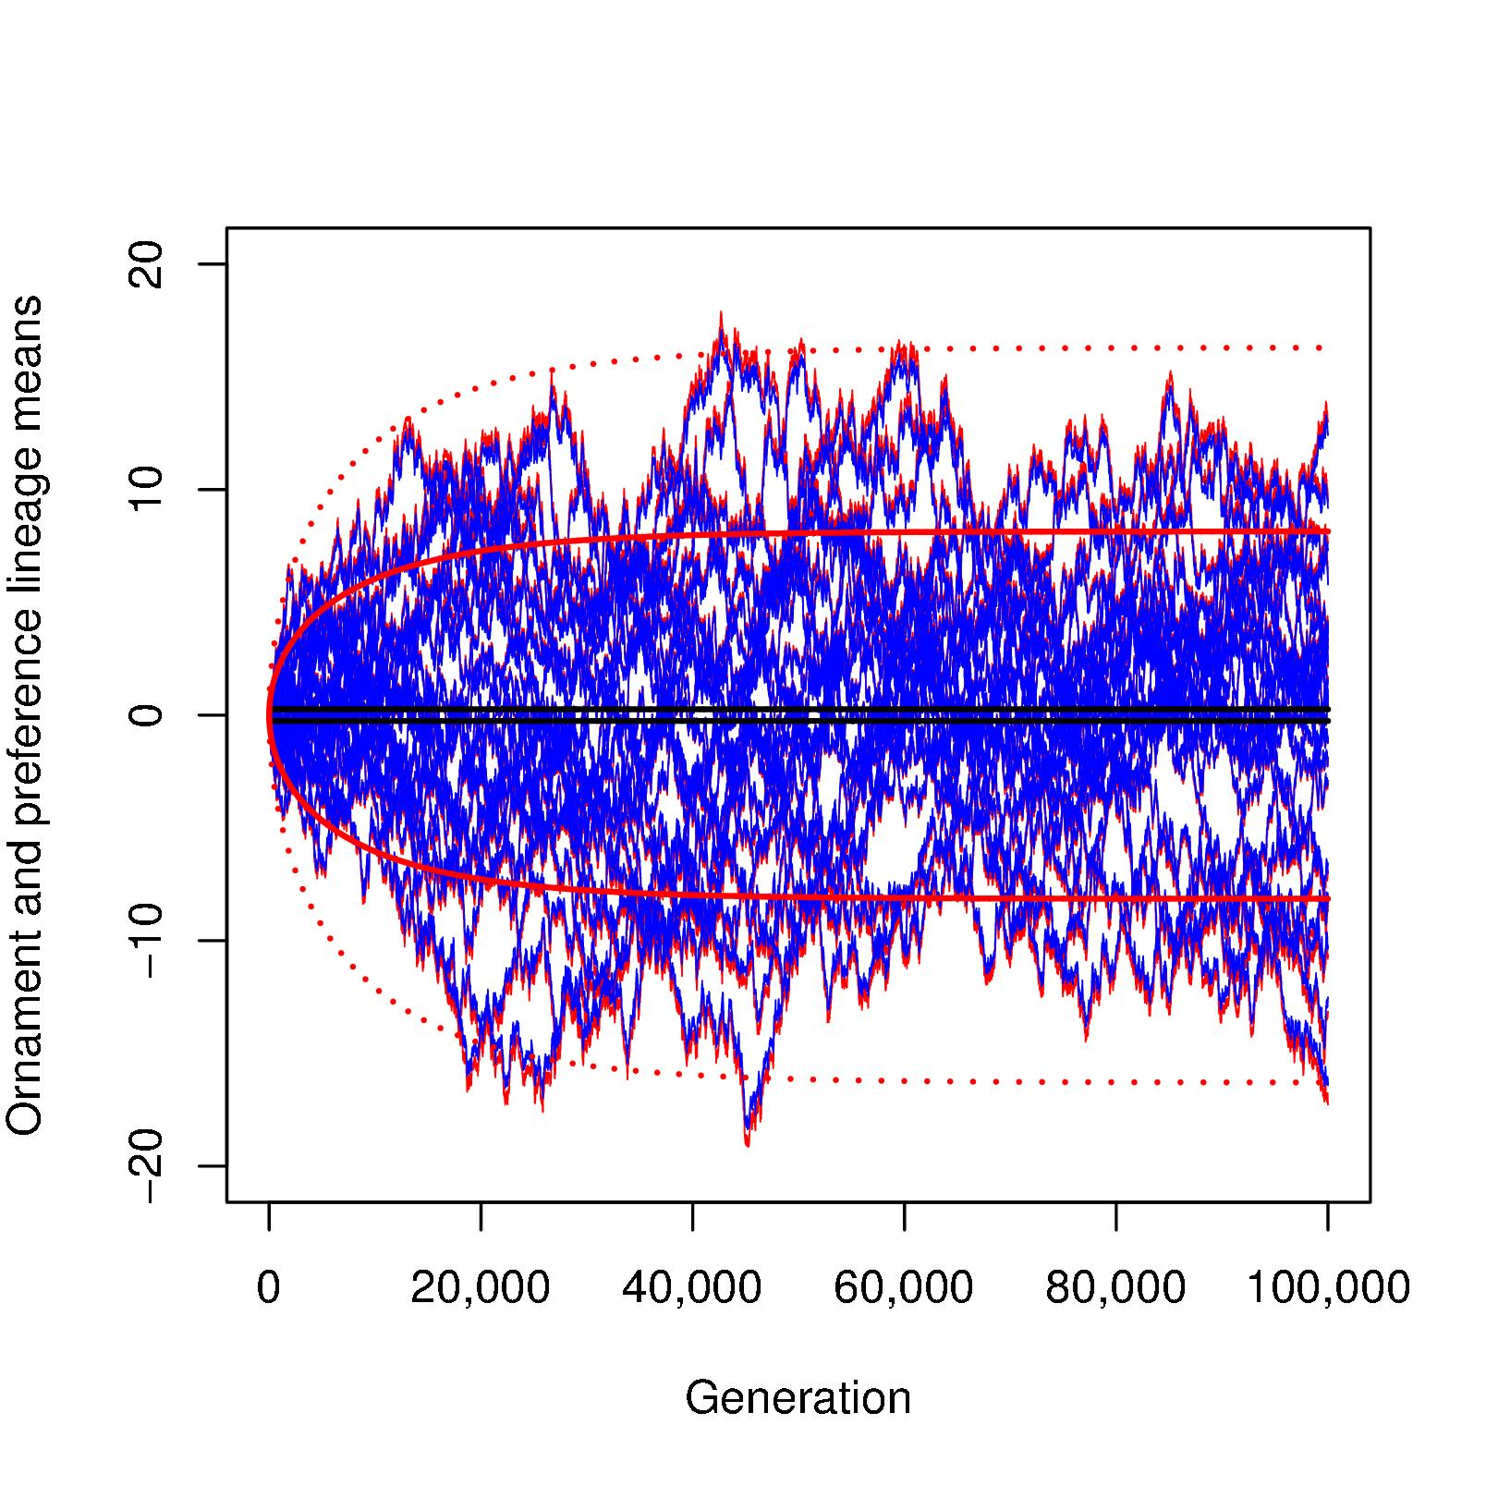
The Phenotypic Tango can account for the observed amount of diversification
if selection on preferences is very weak
ω = 9, ω = 99,999
N_{e} = 1,000
Notes:
Figure 6: Simulated ornament and preference lineage means evolving for 100,000 generations, showing that ornament diversification is predicted by the two times the natural selection confidence limits for preferences (illustrated with 25 lineages evolving for 100,000 generations). Ornament (blue) and preference (red) means are shown in units of within-population standard deviation. Black curves show the expected 99% confidence limits for ornament diversification by natural selection alone. Bold red lines show the expected 99% confidence limits for preference diversification by natural selection alone. Dotted red lines show two times the 99% confidence limits for preferences.

Slide 21
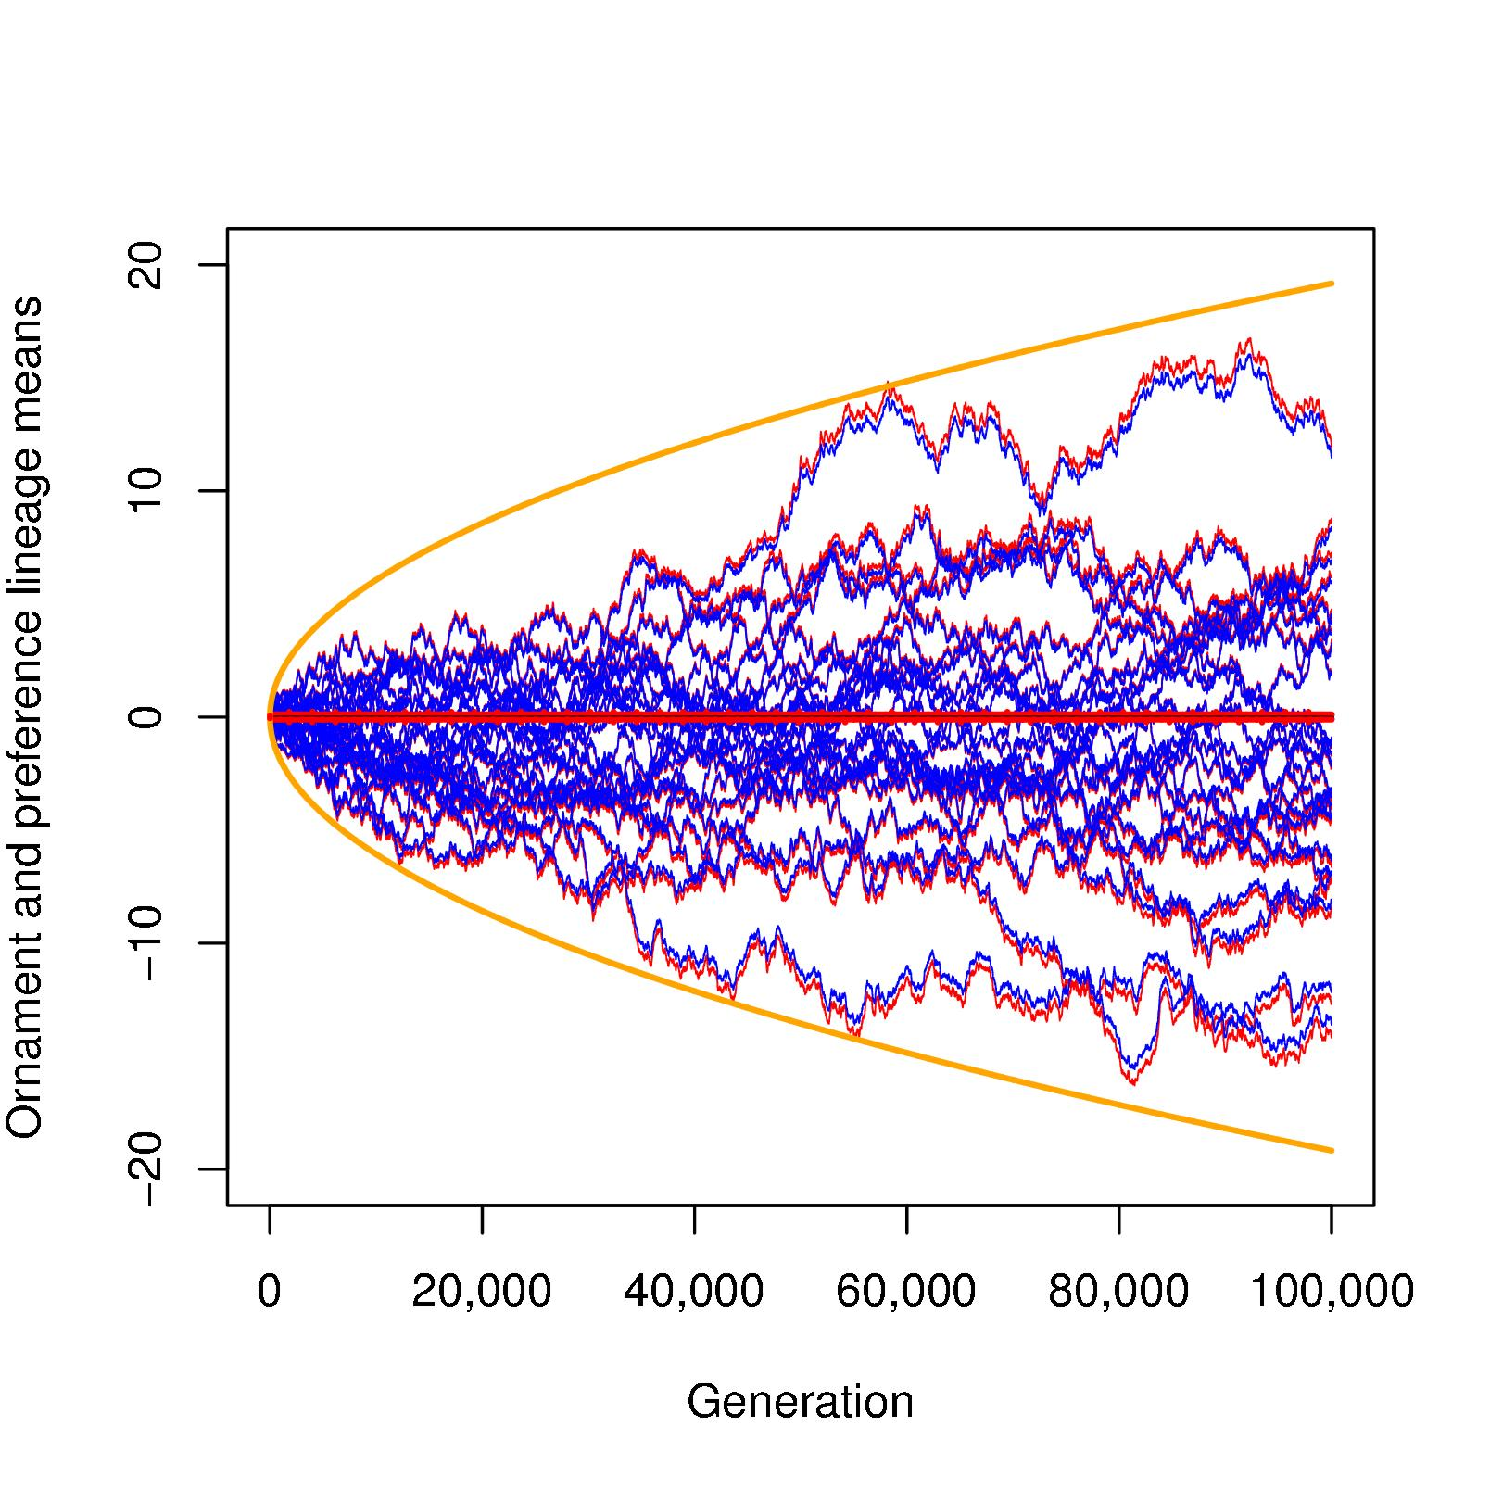
The Phenotypic Tango can account for the observed amount of diversification
if the preference optimum moves by BM
Notes:
Figure 7: Simulated evolution of ornaments and preferences with a moving preference optimum (illustrated with a set of 25 lineages evolving for 100,000 generations). Conventions as in Fig. 6. 95% confidence limits for ornament diversification by natural selection alone are not visible. The orange curve shows the 95% confidence limits for diversification of preference means evolving under a model in which the preference optimum moves by Brownian motion.

Slide 22
Conclusions using the Phenotypic Tango model
Evolving preferences control the evolution of ornaments
Can account for diversification patterns in single and multiple ornaments
To account for the extent of ornament diversification on right timescale, we need to invoke:
  Very weak stabilizing selection on preferences and
  relatively small effective population sizes
  Or move the natural selection optimum at a modest rate

Slide 23
Accounting for the Bird of Paradise radiation with generic models: Brownian motion & Ornstein-Uhlenbeck
GOOD NEWS! – Analytical solutions available.
BAD NEWS! – The parameters we estimate confound inheritance, selection, and pop. size.
GOOD NEWS! – We can account for phylogeny.
GOOD NEWS! – We can use likelihood to compare alternative models
Notes:
More good and bad news.

Slide 24
Accounting for the Bird-of-Paradise radiation with generic models
The contrast between Brownian Motion (BM) and Ornstein-Uhlenbeck (OU) models
Testing model predictions on the Bird-of-Paradise tree with OUwie
Do we need more than one selection regime (poor man’s version of moving optimum) to account for the data?
Can we use this framework to estimate FLP parameters?

Slide 25
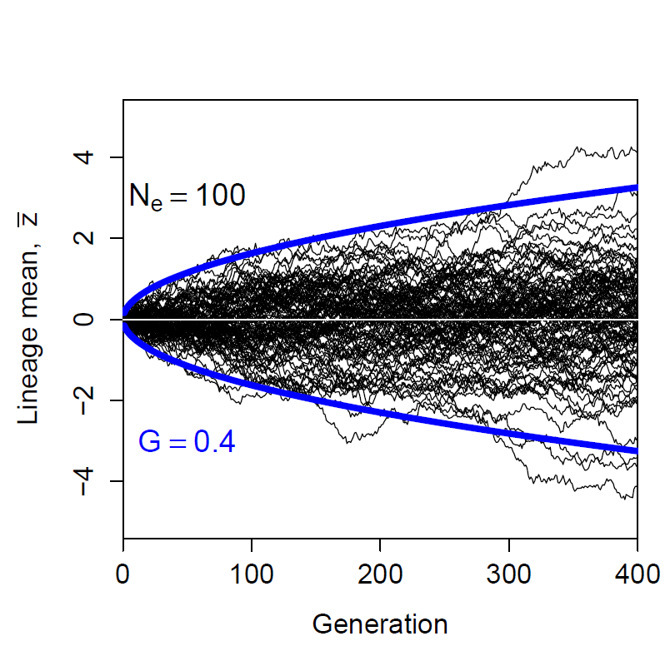
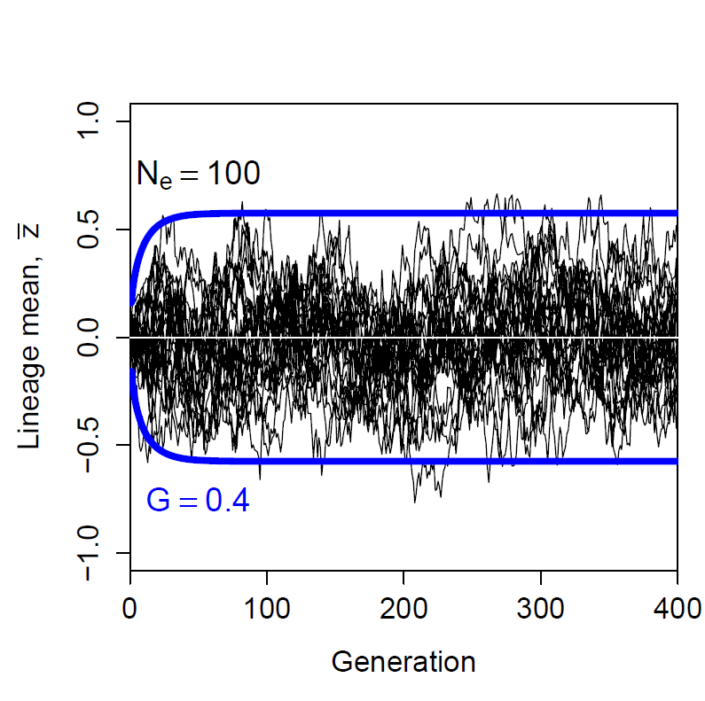
Contrasting model predictions
BM -> ever-expanding evolution
OU -> bounded evolution
Two versions of BM: genetic drift (shown here) or Brownian motion of peak
Notes:
Brownian motion models produce an ever-expanding radiation of trait means. Because the model is cast in generic terms, it covers two underlying interpretations of BM: genetic drift of the trait mean (shown here with effective pop size of 100) or BM of an intermediate optimum. In contrast, OU models without a moving peak produce a bounded radiation of trait means. In the example on the right, stabilizing selection is relatively strong, ω = 9 (see Slide 7 for a diagram).

Slide 26

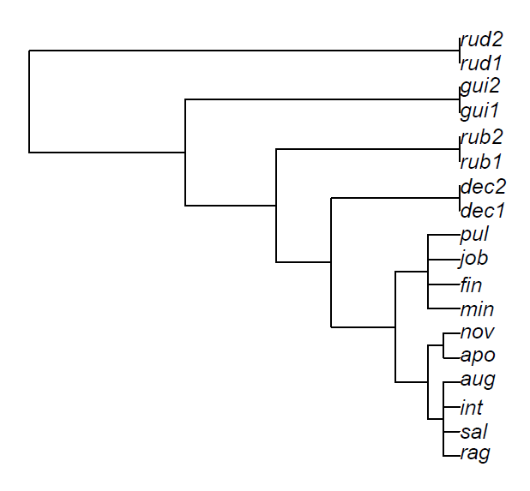
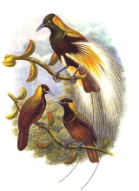


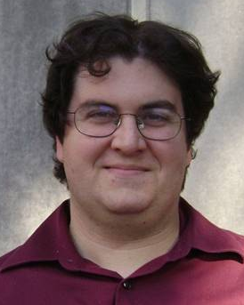


Tree for the genus Paradisaea: two hypothetical selection regimes
9.4 My
6 My
Regime 1
4 My
1.4 My
Regime 2
using OUwie = Beaulieu et al. 2012
Notes:
Using program OUwie, we specify two selection regimes to test the idea that the position of an intermediate optimum changed during the radiation.

Slide 27
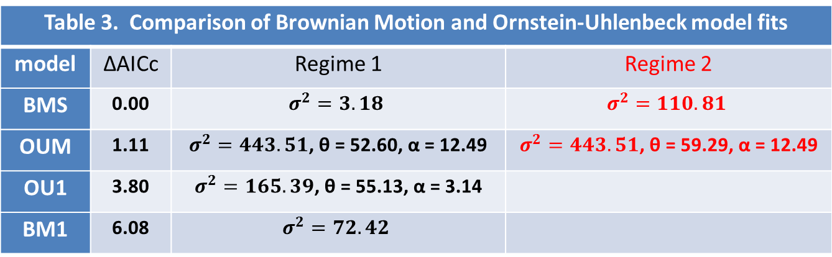
Tests of alternative generic models: using generic BM & OU parameters in OUwie
Table 3. Comparison of Brownian Motion and Ornstein-Uhlenbeck model fits
model | ΔAICc | Regime 1 | Regime 2
BMS | 0.00 | $$σ^{2}=3.18$$ | $$σ^{2}=110.81$$
OUM | 1.11 | $σ^{2}=443.51$, θ = 52.60, α = 12.49 | $σ^{2}=443.51$, θ = 59.29, α = 12.49
OU1 | 3.80 | $σ^{2}=165.39$, θ = 55.13, α = 3.14
BM1 | 6.08 | $$σ^{2}=72.42$$
σ² = stochastic diversification rate = increase in among-lineage
variance in trait means per 200,000 generations
θ = phenotypic optimum
α = restoring force, the rubber band in the OU process
Notes:
BM and OU models with two selection regimes fit the data better than models with one regime. In the case of the best BM model (BMS), the rate of diversification speeds up in the red portion of the tree. In the case of the best OU model (OUM), the position of the optimum changes in the red portion of the tree.

Slide 28
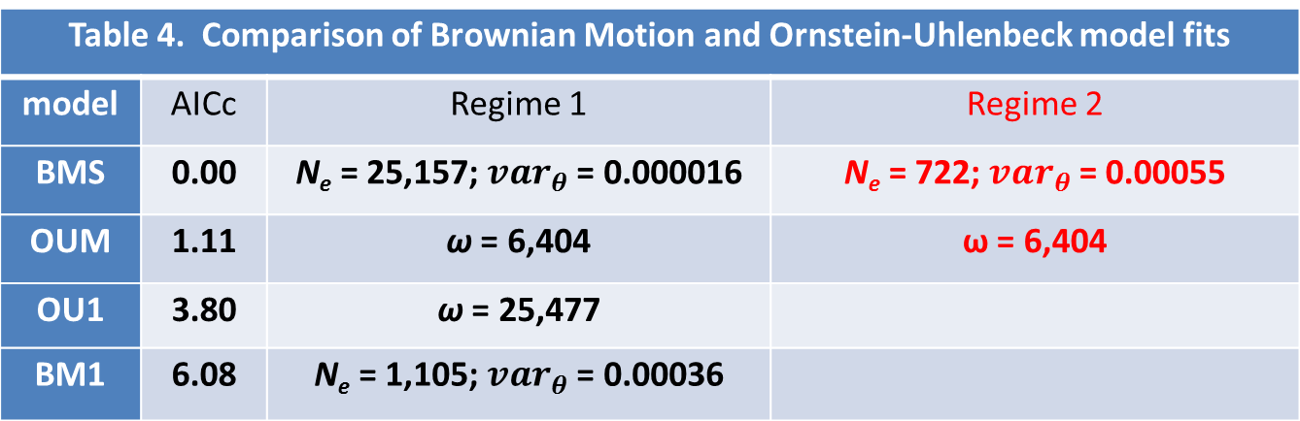
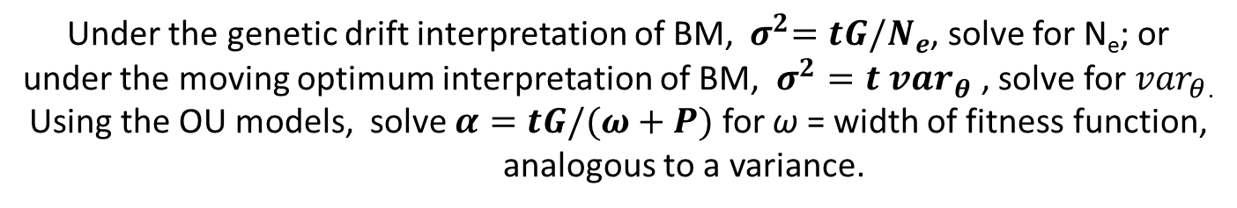
Tests of alternative generic models: using quantitative genetic parameters
Table 4. Comparison of Brownian Motion and Ornstein-Uhlenbeck model fits
model | AICc | Regime 1 | Regime 2
BMS | 0.00 | N_{e} = 25,157; ${var}_{θ}$ = 0.000016 | N_{e} = 722; ${var}_{θ}$ = 0.00055
OUM | 1.11 | ω = 6,404 | ω = 6,404
OU1 | 3.80 | ω = 25,477
BM1 | 6.08 | N_{e} = 1,105; ${var}_{θ}$ = 0.00036
Under the genetic drift interpretation of BM, ${ σ}^{2}=tG/N_{e}$, solve for N_{e}; or under the moving optimum interpretation of BM, $σ^{2}=t {var}_{θ}$ , solve for ${var}_{θ}$.
Using the OU models, solve $α=tG/(ω+P)$ for ω = width of fitness function, analogous to a variance.
Notes:
We can also use OUwie to estimate FLP parameters and distinguish between the two interpretations of BM. Under the genetic drift interpretation of BM, we need to imagine implausibly large Ne in the black region of the tree and implausibly small Ne in the red region. In contrast, under the peak movement interpretation of BM, we estimate a moderate and imaginable rate of peak movement. Turning to OU models, we need to imagine that stabilizing selection on preferences is extremely weak! See next slide.

Slide 29
Visualizing very weak
stabilizing selection
ω = 25,000
ω = 9
Probability, Fitness
var = 1
ornament
Notes:
A weak selection function with ω in the range 6,000 to 25,000 is virtually a flat line!

Slide 30
Conclusion using generic models (OUwie): need moving peaks
Brownian motion of a natural selection optimum for preferences is the best-fitting and most plausible model for the data.
This conclusion is consistent with results using the Phenotypic Tango model.
BM of an intermediate optimum may be a reasonable model for adaptive radiations in general.

Slide 31



The Future
Need solution for Phenotypic Tango model
Need a version of the model that includes peak movement
Need better data and more of it
Need testing framework for model that incorporates prior information and estimates multivariate quantitative genetic parameters
Uyeda & Harmon 2014
Notes:
Photos at bottom show Josef Uyeda and Luke Harmon

Slide 32
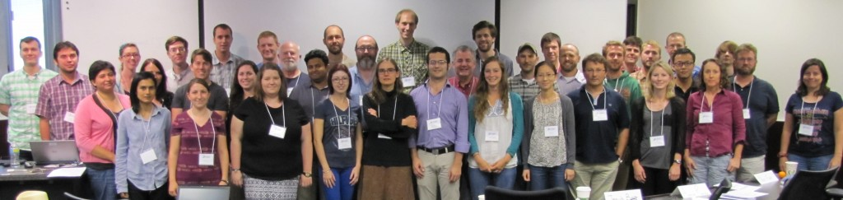


Acknowledgements
NESCent/NIMBioS Course in Evolutionary Quantitative Genetics: Joe Felsenstein = co-organizer; with Patrick Carter, Patrick Phillips, Adam Jones, Trudy Mackay, Marguerite Butler, Emilia Martins, Paul Hohenlohe, Liam Revell, Brian O’Meara, Luke Harmon, Michael Whitlock, Josef Uyeda, Tyler Heather, Matt Pennell = guest instructors.
Illustrations:
Ivan Phillipsen
Notes:
For the 2015 version of this talk (ppt, audiotape, and video) go to the NIMBioS sites:
http://www.nimbios.org/wordpress-training/eqg2/2015/07/23/lecture-6-1-sexual-radiations/
and
https://www.youtube.com/watch?v=o2h8D0rZQrA&list=PLRyq_4VPZ9g8SlS3y4OHy9BmAuK0NdRHe&index=18

Slide 33
References
Arnold, S. J. & L. D. Houck. 2016. Can the Fisher-Lande process account for birds of paradise and other sexual radiations? American Naturalist 187:000-000.
Fisher, R. A. 1930. The genetical theory of natural selection. Clarendon, London.
Lande, R. 1981. Models of speciation by sexual selection on polygenic traits. Proc. Nat. Acad. Sci. USA 78:3721–3725.
LeCroy, M. 1981. The genus Paradisaea - display and evolution. American Museum Novitates 2714: 1-52.
Irestedt, M., K. A. Jønsson, J. Fjeldså, L. Christidis & P. G. P. Ericson. 2009. An unexpectedly long history of sexual selection in birds-of-paradise. BMC Evolutionary Biology 9, No. 235.
Beaulieu, J. M., D.-C. Jhwueng, C. Boettiger, & B. C. O'Meara. 2012. Modeling stabilizing selection: expanding the Ornstein-Uhlenbeck model of adaptive evolution. Evolution 66: 2369-2383.
Uyeda, J. C. & L. K. Harmon. 2014. A novel Bayesian method for inferring and interpreting the dynamics of adaptive landscapes from phylogenetic comparative data. Systematic Biology 63:902–918.

