Slide 1
A Simulation-Based Approach to the Evolution of the G-matrix
Adam G. Jones (Texas A&M Univ.)
Stevan J. Arnold (Oregon State Univ.)
Reinhard Bürger (Univ. Vienna)

Slide 2
Δz = G β
z is a vector of trait means.
β is a vector of directional selection gradients.
G is the genetic variance-covariance matrix.
This equation can be extrapolated to reconstruct the history of selection:
β_{T} = G⁻¹Δz_{T}
It can also be used to predict the future trajectory of the phenotype.
For this application of quantitative genetics theory to be valid, the estimate of G must be representative of G over the time period in question. G must be stable.

Slide 3
Stability of G is an important question
- Empirical comparisons of G between populations within a species usually, but not always, produce similar G-matrices.
Studies at higher taxonomic levels (between species or genera) more often reveal differences among G-matrices.
Analytical theory cannot guarantee G-matrix stability (Turelli, 1988).
Analytical theory also cannot guarantee G-matrix instability, and it gives little indication of how much G will change when it is unstable (and how important these changes may be for evolutionary inferences).

Slide 4
Study Background and Objectives
Stochastic computer models have been used successfully to study several interesting topics in single-trait quantitative genetics (e.g., maintenance of variation, population persistence in a changing environment).
Our objective was to use stochastic computer models to investigate the stability of G over long periods of evolutionary time.
More recent work focuses on the evolution of the mutational architecture, the M-matrix.
Models including epistasis are revealing additional insights into the evolution of G and M.

Slide 5
Model details
Direct Monte Carlo simulation with each gene and individual specified
Two traits affected by 50 pleiotropic loci
Additive inheritance with no dominance or epistasis
Allelic effects drawn from a bivariate normal distribution with means = 0, variances = 0.05, and mutational correlation r_{μ} = 0.0-0.9
Mutation rate = 0.0002 per haploid locus
Environmental effects drawn from a bivariate normal distribution with mean = 0, variances = 1
Gaussian individual selection surface, with a specified amount of correlational selection and ω = 9 or 49
Each simulation run equilibrated for 10,000 (non-overlapping) generations, followed by several thousand of experimental generations

Slide 6
Methods – The Simulation Model (continued)
Population of
N adults
Production of progeny
Monogamy
Mendelian assortment
Mutation, Recombination
Random choice of N
individuals for the next
generation of adults
> N Survivors
B * N Progeny
Gaussian selection
Start with a population of genetically identical adults, and run for 10,000 generations to reach a mutation-selection-drift equilibrium.
Impose the desired model of movement of the optimum.
Calculate G-matrix over the next several thousand generations (repeat 20 times).
We focus on average single-generation changes in G, because we are interested in the effects of model parameters on relative stability of G.

Slide 7
Mutation conventions
Mutational effect on trait 2
Mutational effect on trait 2
Mutational effect on trait 1
Mutational effect on trait 1

Slide 8
Selection conventions
Individual selection surfaces
Value of trait 2
Value of trait 2
Value of trait 1
Value of trait 1

Slide 9
Visualizing the G-matrix
[
]
G =
G₁₁ G₁₂
G₁₂ G₂₂
G₁₁
G₁₂
eigenvalue
eigenvalue
Trait 2 genetic value
G₂₂
Trait 2 genetic value
eigenvector
Trait 1 genetic value
Trait 1 genetic value

Slide 10
φ
We already know that genetic variances can change, and such changes will affect the rate (but not the trajectory) of evolution.
The interesting question in multivariate evolution is whether the trajectory of evolution is constrained by G.
Constraints on the trajectory are imposed by the angle of the leading eigenvector, so we focus on the angle φ.

Slide 11
Stationary Optimum
(selectional correlation = 0, mutational correlation = 0)
φ
0 Generations 2000

Slide 12
Stronger correlational selection produces a more stable G-matrix
(selectional correlation = 0.75, mutational correlation = 0)
φ
0 Generations 2000
ω (trait 1) | ω (trait 2) | r (ω) | r (μ) | Δφ
49 | 49 | 0 | 0 | 9.1
49 | 49 | 0.25 | 0 | 9.2
49 | 49 | 0.50 | 0 | 8.9
49 | 49 | 0.75 | 0 | 7.8
49 | 49 | 0.85 | 0 | 5.4
49 | 49 | 0.90 | 0 | 4.3

Slide 13
A high correlation between mutational effects produces stability
(selectional correlation = 0, mutational correlation = 0.5)
φ
0 Generations 2000
ω (trait 1) | ω (trait 2) | r (ω) | r (μ) | Δφ
49 | 49 | 0 | 0 | 9.9
49 | 49 | 0 | 0.25 | 7.9
49 | 49 | 0 | 0.50 | 3.6
49 | 49 | 0 | 0.75 | 1.5
49 | 49 | 0 | 0.85 | 1.1
49 | 49 | 0 | 0.90 | 0.9

Slide 14
When the selection matrix and mutation matrix are aligned, G can be very stable
selectional correlation = 0.75, mutational correlation = 0.5
φ
0 Generations 2000
selectional correlation = 0.9, mutational correlation = 0.9
φ
0 Generations 2000

Slide 15
Misalignment causes instability
r_{μ}
r_{μ}
r_{μ}
r_{μ}
r_{μ}
Mean per-generation change in angle of the G-matrix
Selectional correlation

Slide 16
A larger population has a more stable G-matrix
ω (trait 1) | ω (trait 2) | r (ω) | r (μ) | N (e) | Δφ
49 | 49 | 0 | 0 | 1366 | 8.8
49 | 49 | 0.5 | 0 | 1366 | 6.2
49 | 49 | 0 | 0.5 | 1366 | 2.7
49 | 49 | 0 | 0 | 2731 | 7.6
49 | 49 | 0.5 | 0 | 2731 | 2.3
49 | 49 | 0 | 0.5 | 2731 | 1.7
Asymmetrical selection intensities or mutational variances produce stability without the need for correlations
ω (trait 1) | ω (trait 2) | r (ω) | r (μ) | α (trait 1) | α (trait 2) | Δφ
49 | 49 | 0 | 0 | 0.05 | 0.05 | 9.9
49 | 49 | 0 | 0 | 0.05 | 0.03 | 7.2
49 | 49 | 0 | 0 | 0.05 | 0.02 | 3.8
49 | 49 | 0 | 0 | 0.05 | 0.01 | 1.9
99 | 99 | 0 | 0 | 0.05 | 0.05 | 9.6
99 | 4 | 0 | 0 | 0.05 | 0.05 | 3.8

Slide 17
Conclusions from a Stationary Optimum
Correlational selection increases G-matrix stability, but not very efficiently unless selection is very strong.
Mutational correlations do an excellent job of maintaining stability, and can produce extreme G-matrix stability.
G-matrices are more stable in large populations, or with asymmetries in trait variances (due to mutation or selection).
Alignment of mutational and selection matrices increases stability.
Given the importance of mutations, we need more data on mutational matrices.
For some suites of characters, the G-matrix is probably very stable over long spans of evolutionary time, while for other it is probably extremely unstable.

Slide 18
What happens when the optimum moves?
Average value of trait 2
Average value of trait 1

Slide 19
In the absence of mutational or selectional correlations, peak movement stabilizes the orientation of the G-matrix

Slide 20
Peak movement along a genetic line of least resistance stabilizes the G-matrix
Average value of trait 2
Average value of trait 2
Average value of trait 1
Average value of trait 1

Slide 21
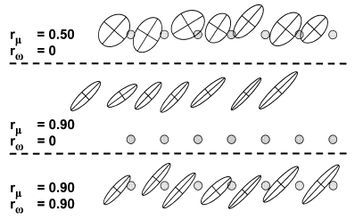
Strong genetic correlations can produce a flying-kite effect
Direction of optimum movement →

Slide 22
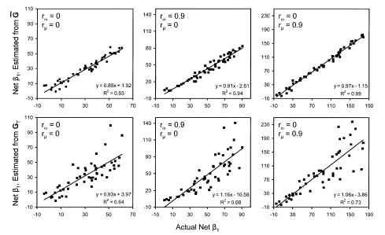
Reconstruction of net-β

Slide 23
More realistic models of movement of the optimum
(a) Episodic
(b) Stochastic
(every 100 generations)
Trait 2 optimum
Trait 1 optimum

Slide 24
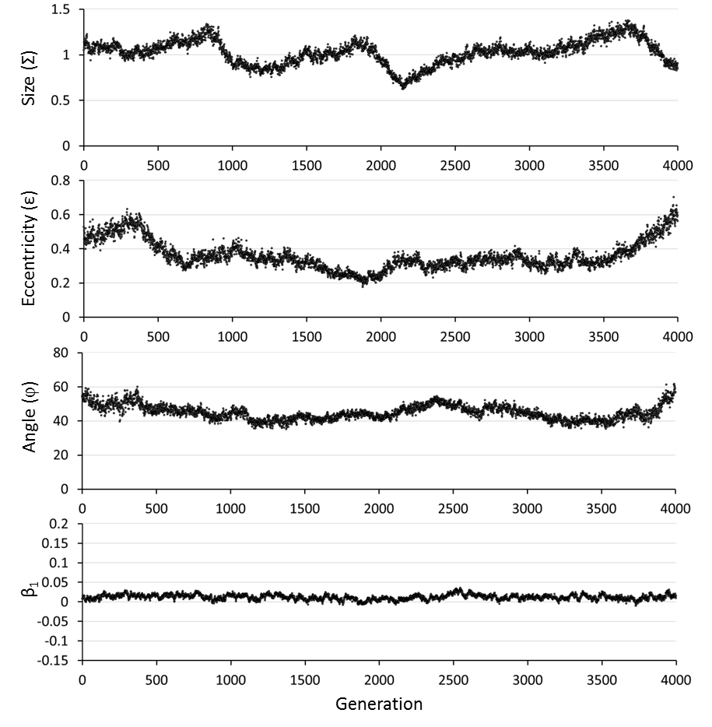
Steadily moving optimum

Slide 25
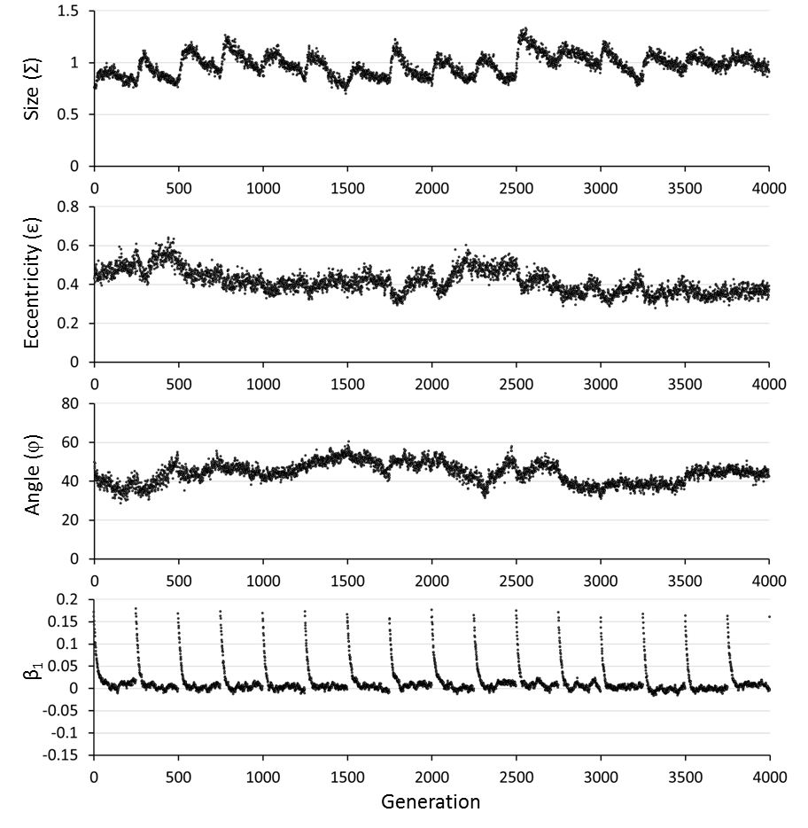
Episodically moving optimum

Slide 26
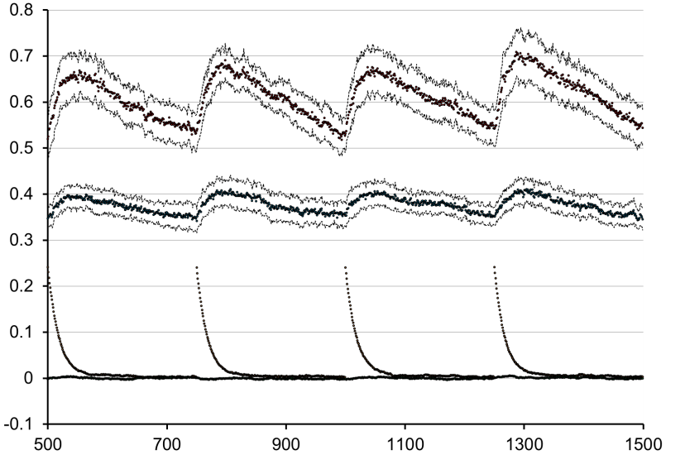
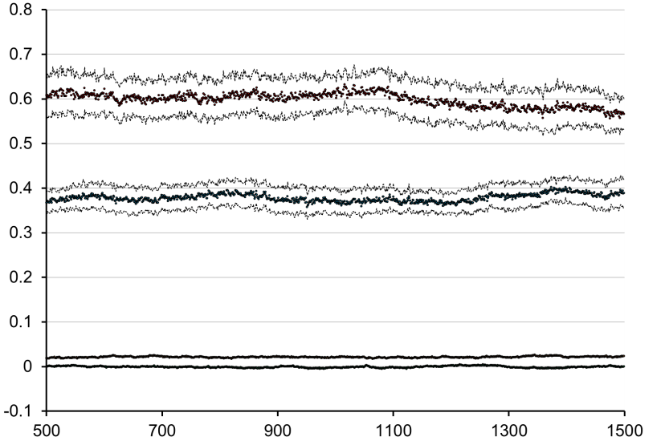
Cyclical changes in the genetic variance in response to episodic movement of the optimum
Episodic, 250 generations
G₁₁
G₂₂
β₁
β₂
Average additive genetic variance (G₁₁ or G₂₂) or selection gradient (β₁ or β₂)
Steady, every generation
G₁₁
G₂₂
β₁
β₂
Generation

Slide 27
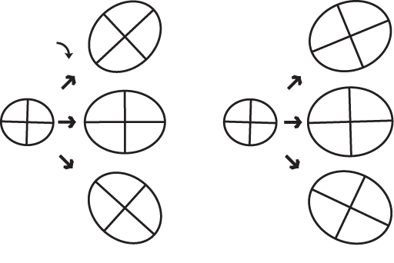
Effects of steady (or episodic) compared to stochastic peak movement
Steady movement, r_{ω}=0, r_{μ}=0
Stochastic, r_{ω}=0, r_{μ}=0, σ_{θ}=0.02
2
Direction of peak movement
Static
optimum
Moving
optimum

Slide 28
Episodic vs. stochastic
Episodic movement = smooth movement
Stochastic movement
Per generation change
in G angle
Degree of correlational selection
Stochastic peak movement destabilizes G under stability-conferring parameter combinations and stabilizes G under destabilizing parameter combinations.

Slide 29
Episodic and stochastic peak movement increase the risk of population extinction

Slide 30
Conclusions
The dynamics of the G-matrix under an episodically or stochastically moving optimum are similar in many ways to those under a smoothly moving optimum.
Strong correlational selection and mutational correlations promote stability.
Movement of the optimum along genetic lines of least resistance promotes stability.
Alignment of mutation, selection and the G-matrix increase stability.
Movement of the bivariate optimum stabilizes the G-matrix by increasing additive genetic variance in the direction the optimum moves.
Both stochastic and episodic models of peak movement increase the risk of population extinction.

Slide 31
Conclusions
Episodic movement of the optimum results in cycles in the additive genetic variance, the eccentricity of the G-matrix, and the per-generation stability of the angle.
Stochastic movement of the optimum tempers stabilizing and destabilizing effects of the direction of peak movement on the G-matrix.
Stochastic movement of the optimum increases additive genetic variance in the population relative to a steadily or episodically moving optimum.
Selection skews the phenotypic distribution in a way that increases lag compared to expectations assuming a Gaussian distribution of breeding values. This phenomenon also results in underestimates of net-β.
Many other interesting questions remain to be addressed with simulation-based models.

Slide 32
Epistasis and the evolution of M
The mutational architecture, summarized by the M-matrix, plays a huge role in generating evolutionary constraints
What evolutionary phenomena shape the mutational architecture?
Epistatic interactions provide a realistic, natural way for the M-matrix to evolve

Slide 33
Epistasis – The Multilinear Model
Our model of epistasis is a multivariate extension of the multilinear model of Hansen and Wagner (2001):
Additive model:
z = a₁ + a₂ + a₃ + …+ e
Multilinear model:
z = a₁ + a₂ + εa₁a₂ + … + e
It’s only slightly more complex for the multivariate case

Slide 34
Epistasis Results
Does epistasis increase genetic variation?
ε variance | r_{ω} | V₁ | V₂ | r_{V} | G₁ | G₂ | r_{G} | % additive
0 | 0 | 0.53 | 0.51 | 0.02 | 0.52 | 0.50 | 0.02 | 100
0.1 | 0 | 0.59 | 0.59 | 0.01 | 0.54 | 0.54 | -0.01 | 92
1.0 | 0 | 0.75 | 0.79 | 0.00 | 0.60 | 0.63 | 0.01 | 80
10.0 | 0 | 0.75 | 0.74 | 0.01 | 0.46 | 0.44 | -0.01 | 61
0 | 0.75 | 0.41 | 0.39 | 0.27 | 0.41 | 0.39 | 0.28 | 100
0.1 | 0.75 | 0.44 | 0.44 | 0.31 | 0.40 | 0.41 | 0.37 | 91
1.0 | 0.75 | 0.45 | 0.44 | 0.28 | 0.36 | 0.35 | 0.37 | 80
10.0 | 0.75 | 0.42 | 0.40 | 0.19 | 0.25 | 0.25 | 0.31 | 61
Generations = 5000, N = 512, ω = 49, μ = 0.0005

Slide 35
Epistasis Results
Does epistasis increase genetic variation?
ε variance | r_{ω} | V₁ | V₂ | r_{V} | G₁ | G₂ | r_{G} | % additive
0 | 0 | 0.53 | 0.51 | 0.02 | 0.52 | 0.50 | 0.02 | 100
0.1 | 0 | 0.59 | 0.59 | 0.01 | 0.54 | 0.54 | -0.01 | 92
1.0 | 0 | 0.75 | 0.79 | 0.00 | 0.60 | 0.63 | 0.01 | 80
10.0 | 0 | 0.75 | 0.74 | 0.01 | 0.46 | 0.44 | -0.01 | 61
0 | 0.75 | 0.41 | 0.39 | 0.27 | 0.41 | 0.39 | 0.28 | 100
0.1 | 0.75 | 0.44 | 0.44 | 0.31 | 0.40 | 0.41 | 0.37 | 91
1.0 | 0.75 | 0.45 | 0.44 | 0.28 | 0.36 | 0.35 | 0.37 | 80
10.0 | 0.75 | 0.42 | 0.40 | 0.19 | 0.25 | 0.25 | 0.31 | 61
Generations = 5000, N = 512, ω = 49, μ = 0.0005

Slide 36
Epistasis Results
Epistasis allows selection to shape the distribution of new mutations
N | r_{ω} | V₁ | V₂ | r_{V} | M₁ | M₂ | r_{μ}
128 | 0 | 0.77 | 0.79 | 0.05 | 0.71 | 0.82 | 0.02
256 | 0 | 0.80 | 0.84 | -0.02 | 0.46 | 0.50 | -0.01
1024 | 0 | 0.70 | 0.70 | 0.00 | 0.17 | 0.16 | -0.01
2048 | 0 | 0.68 | 0.65 | -0.02 | 0.14 | 0.14 | -0.01
128 | 0.90 | 0.33 | 0.32 | 0.41 | 0.43 | 0.42 | 0.08
256 | 0.90 | 0.33 | 0.33 | 0.45 | 0.24 | 0.26 | 0.14
1024 | 0.90 | 0.28 | 0.28 | 0.40 | 0.11 | 0.12 | 0.16
2048 | 0.90 | 0.26 | 0.27 | 0.40 | 0.10 | 0.10 | 0.18
Generations = 5000, ε variance = 1.0, ω = 49, μ = 0.0005

Slide 37
Epistasis Results
Epistasis allows selection to shape the distribution of new mutations
N | r_{ω} | V₁ | V₂ | r_{V} | M₁ | M₂ | r_{μ}
128 | 0 | 0.77 | 0.79 | 0.05 | 0.71 | 0.82 | 0.02
256 | 0 | 0.80 | 0.84 | -0.02 | 0.46 | 0.50 | -0.01
1024 | 0 | 0.70 | 0.70 | 0.00 | 0.17 | 0.16 | -0.01
2048 | 0 | 0.68 | 0.65 | -0.02 | 0.14 | 0.14 | -0.01
128 | 0.90 | 0.33 | 0.32 | 0.41 | 0.43 | 0.42 | 0.08
256 | 0.90 | 0.33 | 0.33 | 0.45 | 0.24 | 0.26 | 0.14
1024 | 0.90 | 0.28 | 0.28 | 0.40 | 0.11 | 0.12 | 0.16
2048 | 0.90 | 0.26 | 0.27 | 0.40 | 0.10 | 0.10 | 0.18
Generations = 5000, ε variance = 1.0, ω = 49, μ = 0.0005

Slide 38
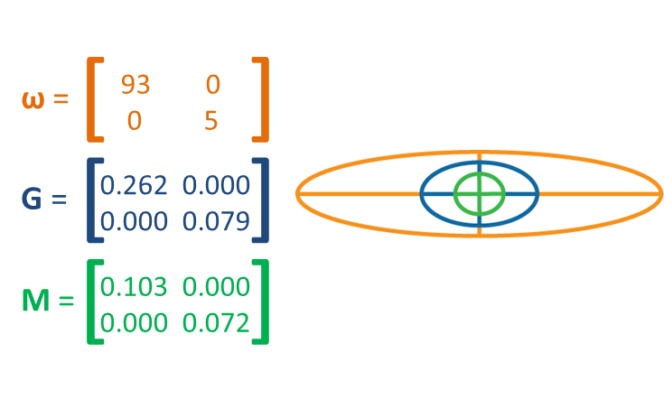

Slide 39
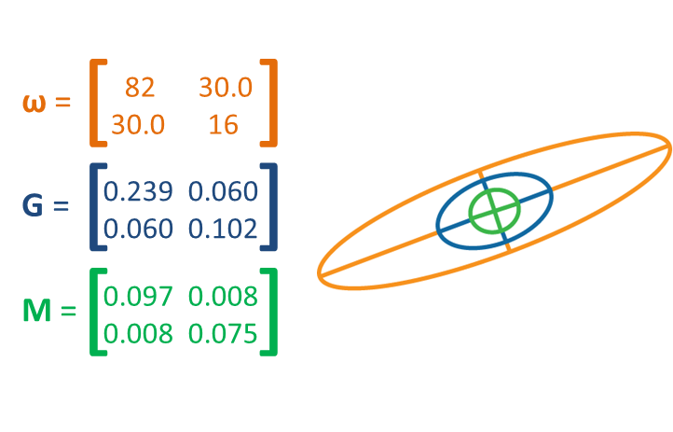

Slide 40
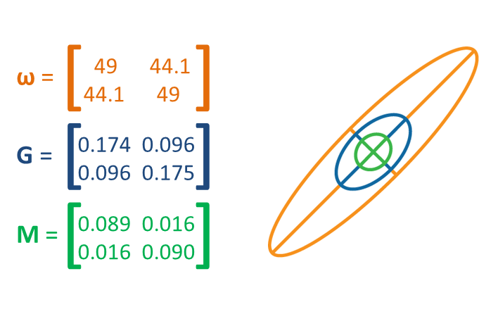

Slide 41
Conclusions from the Model
Epistasis allows natural selection to shape the mutational architecture of traits.
Smaller populations evolve larger mutational variances.
Smaller populations harbor more genetic variance than larger populations in this model.
Triple alignment: the selection surface, G-matrix, and M-matrix evolve to be in nearly perfect alignment.

Slide 42
Implications
High apparent additive genetic variation doesn’t necessarily imply that the underlying genetic architecture involves only independent, additive loci (much of the additive genetic variance can arise from epistatic terms).
Mutational variances and covariances can be shaped by selection when epistasis enters the picture.
For traits affected by large numbers of genes there could be hundreds or thousands of epistatic interactions, which may be difficult to diagnose in genome-wide association studies or QTL mapping studies.
The mutational architecture, which we like to think of as separate from natural selection, could itself be a product of historical patterns of selection.

Slide 43
Using the Simulation Program
A fully factorial approach is prohibitively time consuming, because the model has too many parameters
Think in terms of experimental design, with controls and treatments
Start with a core set of parameters and vary one or two parameters at a time
The default values provide a reasonable starting place (but possibly remove stochasticity, use a stationary optimum, and increase curvature of the selection surface by setting ω to 9 instead of 49)

Slide 44
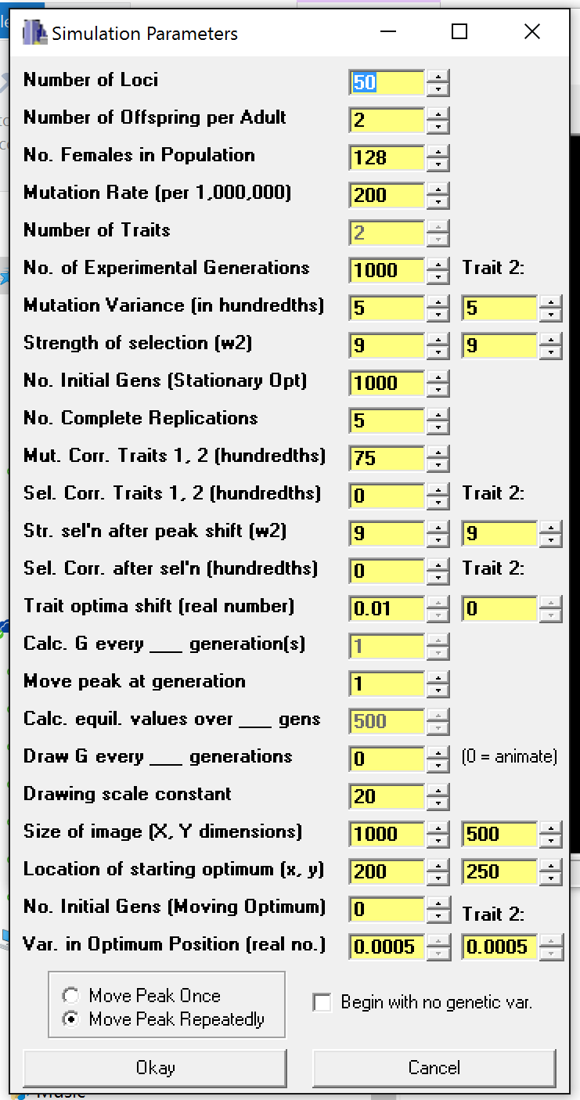
If you make the number of loci too small, the program will probably crash because you won’t maintain any genetic variance
Each female has 2x this number of offspring
The sex ratio is equal and you’re changing the number of females
This mutation rate is 0.0002 – too small will result in no variance
Mutational variances for traits 1 and 2 (5 means 0.05)
Smaller values result in a steeper selection surface
How many simulation runs under these parameter values? Not the number of generations, which are set separately.
Mutational correlation – very important – can be between -100 and 100
Selectional correlation – set both values, generally to the same number
How far does the optimum move for trait 1 and trait 2?
What generation (Move Peak Once) or how often (Move Peak Repeatedly) does the optimum move?
These parameters set the graphical window’s properties – experiment
If you want some generations of a moving optimum, with no data collected, set them here
Stochasticity in the position of the optimum – set this to zero for starters
Once – the bivariate optimum moves once at generation “Move peak at generation” by “Trait Optima Shift Units”. Repeatedly – the peak moves every “Move peak at generation” generations by the “Trait Optima Shift”.

Slide 45
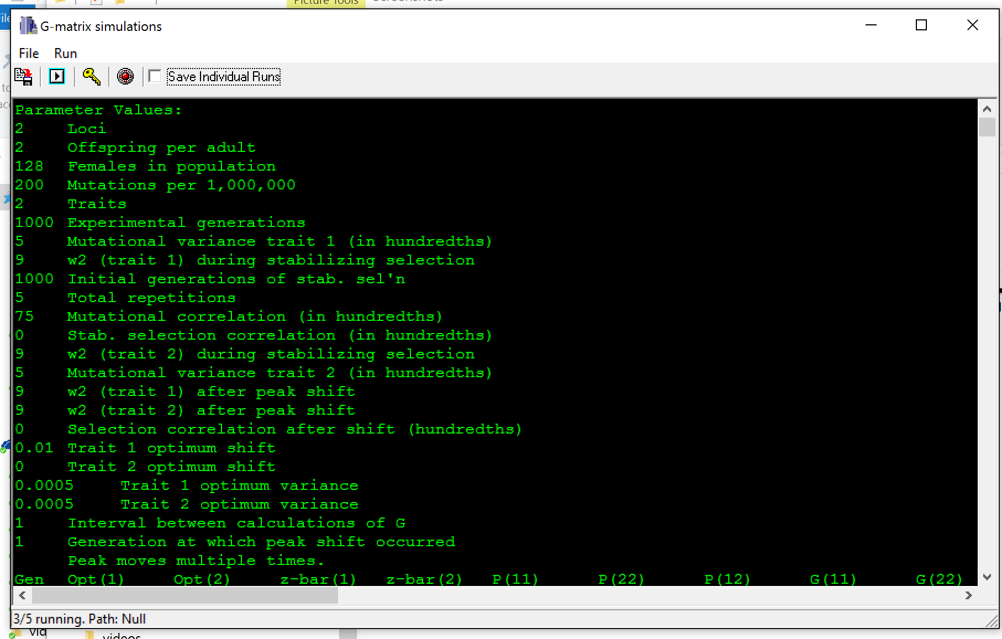
Save the contents of the text window
Check this box to have the program save each run in a separate “.csv” file – uncheck and recheck the box to change filename
Run the simulation
Set parameters

Slide 46
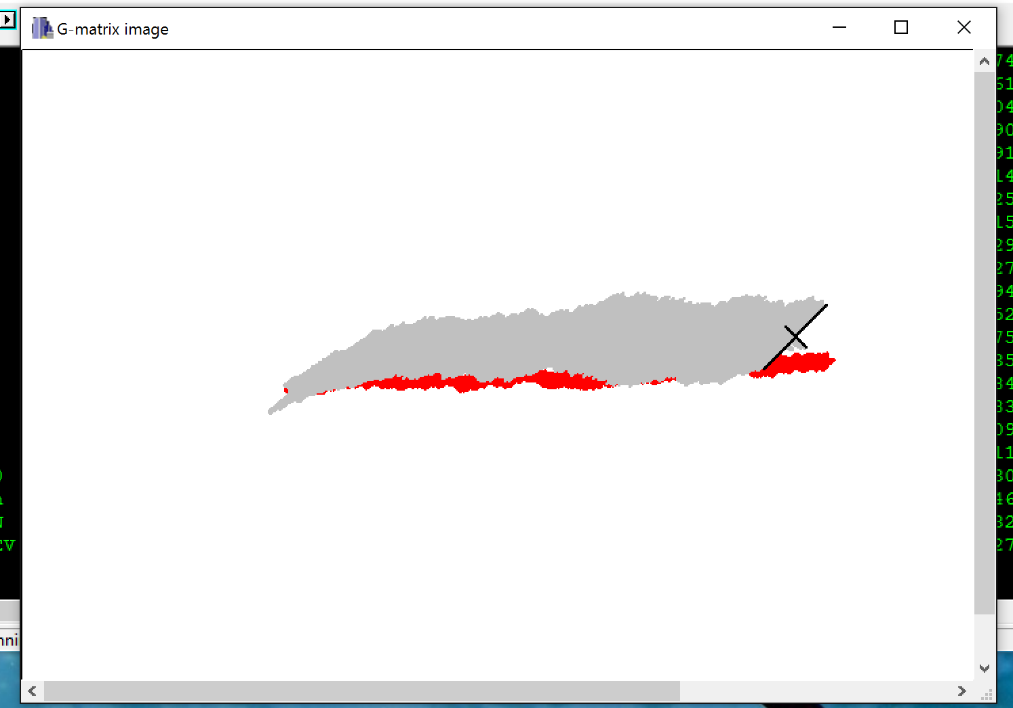

Slide 47
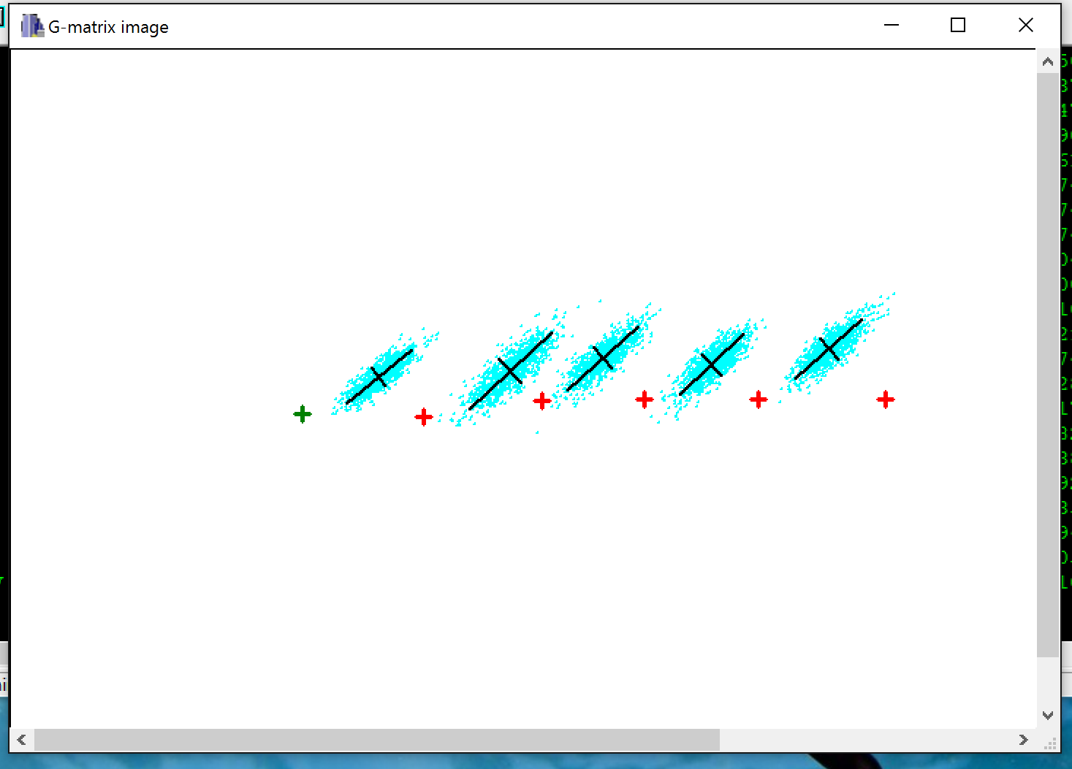

Slide 48
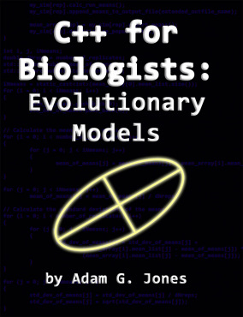
Additional Resources
Tutorial on programming these sorts of models in C++:
  Free pdf at https://pipefishguysite.wordpress.com/jones-lab-publications/
  Hard copy from Amazon
Command-line version of the program and source code:
  https://github.com/JonesLabIdaho/GmatrixCommandLine

