Slide 1
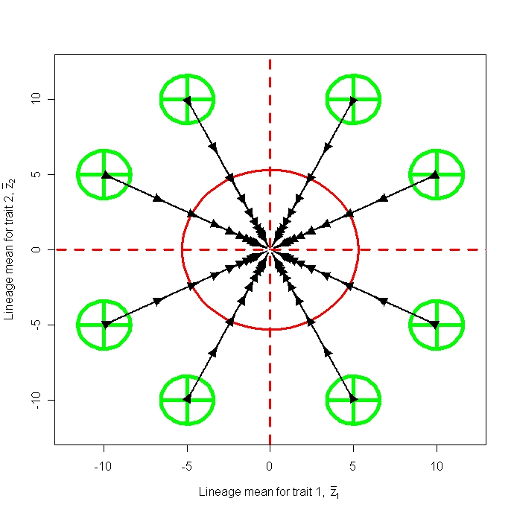
2.3 Evolution on a Surface
Stevan J. Arnold
Department of Integrative Biology
Oregon State University

Slide 2
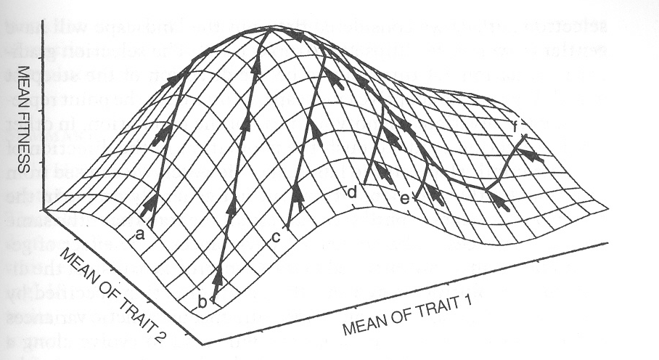
Evolution of the trait mean on an adaptive landscape: more than a metaphor
Notes:
The idea of an adaptive landscape is based on Sewall Wright’s (1931) depiction of a surface upon which gene frequencies evolve. In the case of quantitative traits, the adaptive landscape (AL) is a surface that describes mean fitness in the population as a function of average trait values (Lande 1976, 1979). The AL is a useful device to model trait evolution, as we shall see in this lecture. We can glimpse the AL of natural populations by estimating two coefficients of selection, β and γ.

Slide 3
Thesis
Models for adaptive radiation can be constructed with quantitative genetic parameters.
The use of quantitative genetic parameters allows us to cross-check with the empirical literature on inheritance, selection, and population size.
Stabilizing selection and peak movement appear to be necessary but may not be sufficient to account for evolution in deep time.

Slide 4
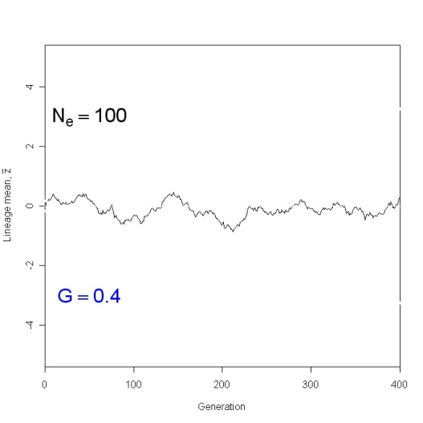
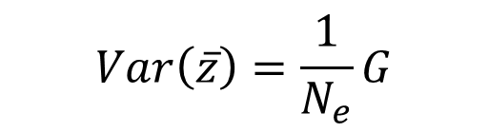
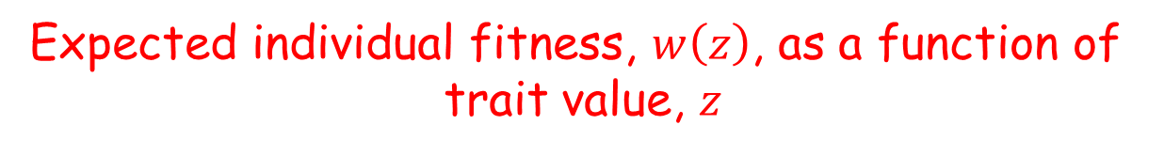
1. Evolution without selection, genetic drift
Sampling N_{e} individuals from a normal distribution
of breeding values
$$Var\left(\overline{z}\right)=\frac{1}{N_{e}}G$$
Projecting the distribution of breeding values
into the future
Var$\left({\overline{z}}_{t}\right)=\frac{1}{N_{e}}Gt$
Lineage mean
Generation
Notes:
Imagine a base population in which breeding values are normally distributed with a mean and a variance G. Suppose we establish replicate populations, each of size N_{e} , from this base population. The variance among those replicates in mean breeding value will be (1/Ne)G (Lande 1976). Genetic drift causes the phenotypic mean of a lineage to undergo a random walk. In this simulation of genetic drift, the lineage mean is shown in units of within-population phenotypic standard deviation. At generation the variance among replicate lineage means is (1/Ne)G t.

Slide 5
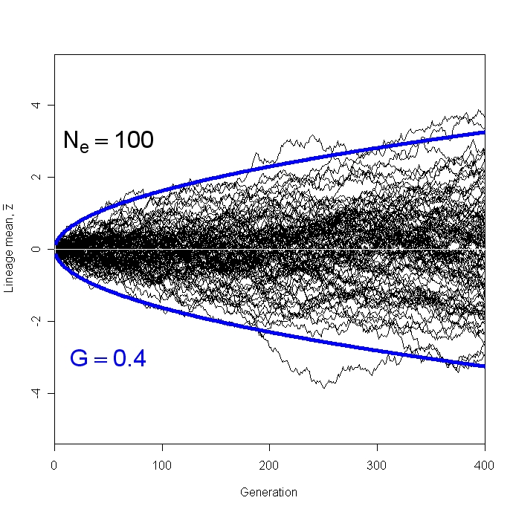

1. Evolution without selection, genetic drift
c. Many replicate populations evolving by drift
Var$\left({\overline{z}}_{t}\right)=\frac{1}{N_{e}}Gt$
Animation 1
Lineage mean
Generation
Notes:
The random walks of 100 replicates lineages are shown for Ne=100 and a genetic variance of 0.4. The theoretical 99% confidence limits for the mean of lineage means are shown in blue.

Slide 6




2. Univariate evolution about a stationary peak
a. Tendency to evolve uphill on the adaptive landscape
$$∆\ln{\overline{W}≅ ∆{\overline{z}}^{T}G^{−1}∆\overline{z}}≥0$$
b. Stochastic dynamics with a single Gaussian, stationary peak
The Ornstein-Uhlenbeck, OU, process
Per generation change in mean
Variance among replicate
lineages in trait mean
Notes:
a. These two expressions encapsulate Lande’s (1979) argument that, in the absence of frequency-dependent selection, evolution tends to proceed uphill on the adaptive landscape. (b). According to the OU-process, each generation the trait mean drifts by an amount equivalent to a draw from a normal distribution with mean zero and variance G/N_{e} and is pulled back towards the optimum with a force, β, that is proportional to the deviation from the optimum (Lande 1976).

Slide 7
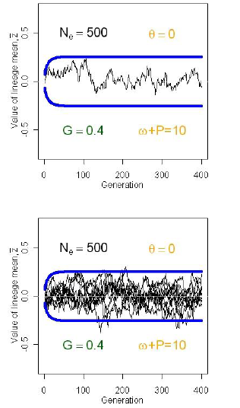
2. Univariate evolution about a stationary peak
b. Stochastic dynamics with a single, stationary peak
Lineage mean
Animation 2
Lineage mean
Generation
Notes:
An example of a lineage drifting about its optimum is shown in the upper panel. Each time the trait mean drifts away from the optimum, it is pulled back, so - as a long term average - the mean resides at the optimum. An ensemble of 10 replicate populations, buzzing about identical optima are shown in the lower panel. The outer limits of their paths are accurately described by the 99% confidence limits (shown in blue), given by the limiting variance among means. The animation show the same two panels for different combinations of parameters.

Slide 8

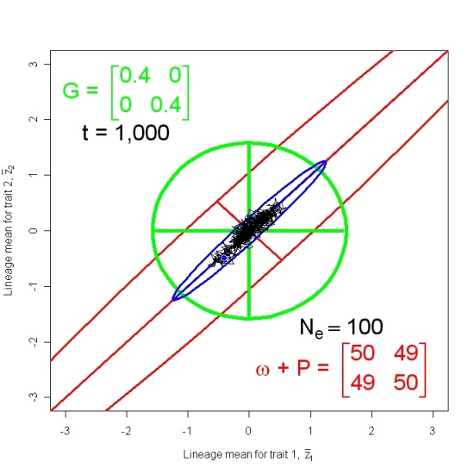
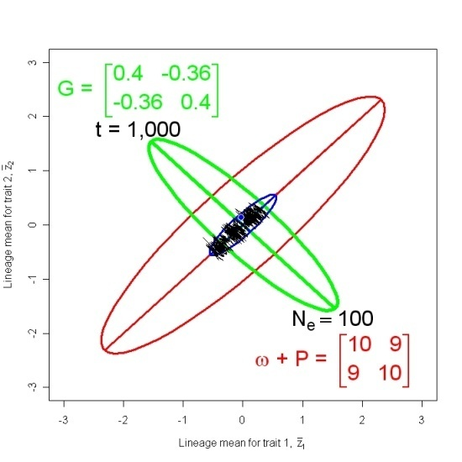
3. Bivariate evolution about a stationary peak
Replicate responses to a single Gaussian, stationary peak
The adaptive landscape trumps the G-matrix
Animation 5
Animation 6
Lineage mean for trait 2
Lineage mean for trait 1
Lineage mean for trait 1
Notes:
At generation t, the lineage means are multinormally distributed about a mean vector of zeros with a variance-covariance matrix given by the expression shown at the top (Hansen & Martins 1997). The role of the adaptive landscape in shaping the results of drift-selection balance is also shown in two simulations. The 95% confidence ellipse for genetic values is shown in green and represents the G-matrix. The adaptive landscape is bivariate stabilizing in both cases and is represented by its 25% confidence ellipse in red. Such a low level ellipse must be employed because, the limits of the 95% ellipse would be far outside the scale limits of the figure. The limiting pattern for dispersion of lineage means is represented by its 95% confidence ellipse in blue.

Slide 9
3. Bivariate evolution about a stationary peak
Stochastic response to a single Gaussian, stationary peak
The adaptive landscape trumps the G-matrix
Lineage mean for trait 2
The heartbreak of OU: to account for data, requires
small N_{e} or
very weak stabilizing selection (large ω)
Lineage mean for trait 1
Lineage mean for trait 1

Slide 10
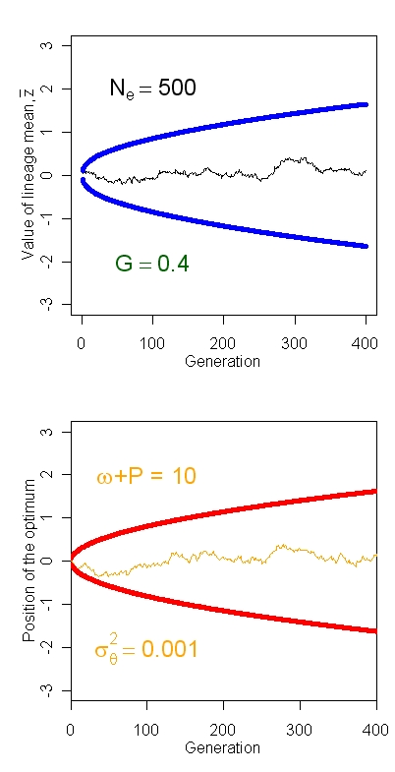
4. Evolution when the peak moves
a. Brownian motion of a Gaussian adaptive peak
The optimum, θ, undergoes
Brownian motion
The lineage mean chases
the optimum
Notes:
By Brownian motion of the optimum we mean that the current position of the optimum deviates from its position in the preceeding time interval by random variable, ε_{θ} , which is a draw from a normal distribution with a mean of zero and variance of σ_{θ}² . The evolution of the lineage mean is composed of three contributions: the movement of the optimum, the response of the mean to that movement, and random drift of the mean. The panel on the left shows the path of the optimum, θ, through time. The 99% confidence limits of the optimum are shown with red lines. In the panel on the right, a single lineage mean closely tracks the moving optimum of its AL.

Slide 11
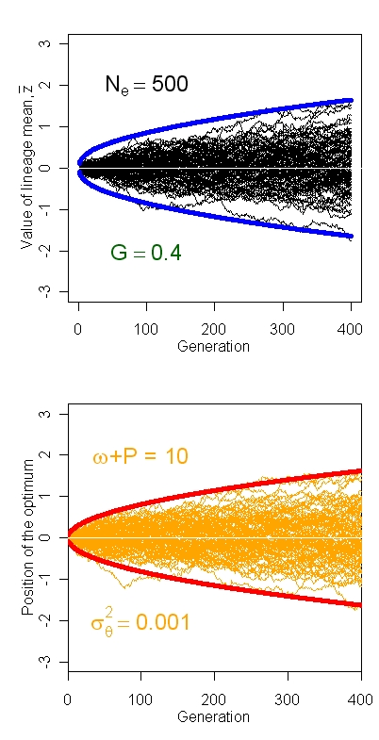
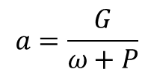
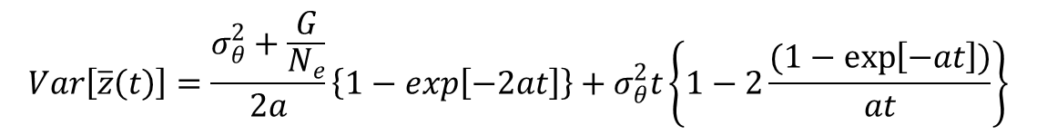
4. Evolution when the peak moves
a. Brownian motion of a Gaussian adaptive peak
Replicate lineages respond to replicate peak movement
$$Var\left[\overline{z}\left(t\right)\right]=\frac{σ_{θ}^{2}+\frac{G}{N_{e}}}{2a}\left\{1−exp\left[−2at\right]\right\}+σ_{θ}^{2}t\left\{1−2\frac{(1−\exp\left[−at\right])}{at}\right\}$$
$$a=\frac{G}{ω+P}$$
Notes:
The expression for the variance among lineage means reflects the contributions of the three processes already listed (Hansen et al. 2008). In the panel on the right, 100 replicate lineages track the moving optima of their ALs.

Slide 12
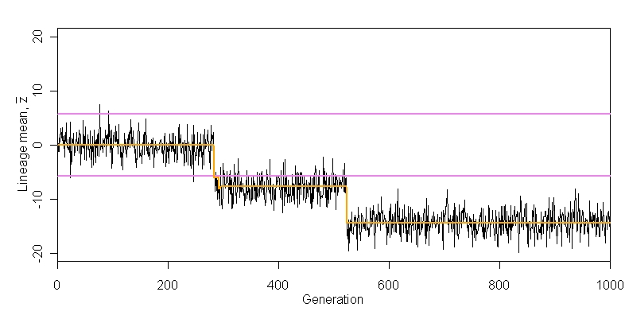
4. Evolution when the peak moves
b. Multiple burst model of peak movement
The optimum, θ, moves in rare bursts, governed by a Poisson
process, but is otherwise stationary
The lineage mean instantaneously tracks bursts in the optimum,
but otherwise evolves according
to a white noise process
Lineage mean
θ
θ
Generation
Notes:
Simulation of the multiple burst model of Uyeda et al. (2011). The orange line shows the position of the optimum. Parameter values are Sigma squared sub p =5, Sigma squared sub d =37 , and lambda=0.005 . The average waiting time for a displacement of the optimum is 200 generations. The 99% confidence limits for a normal distribution with mean zero and variance are shown in violet. In this example, three displacements (at about 290, 300, 520 generations) move the lineage mean in the same direction, but that will not be the case in most runs.

Slide 13
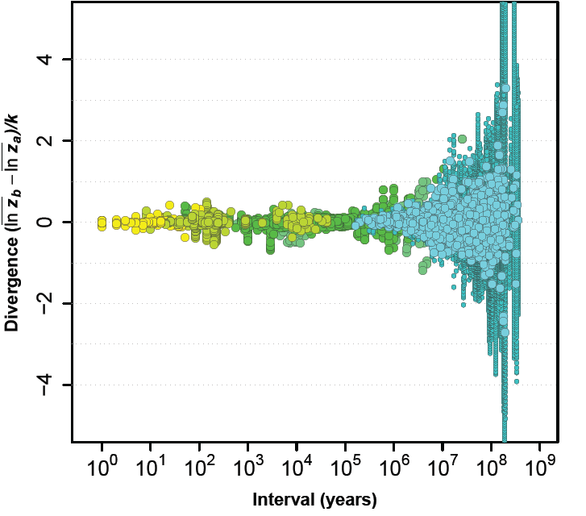
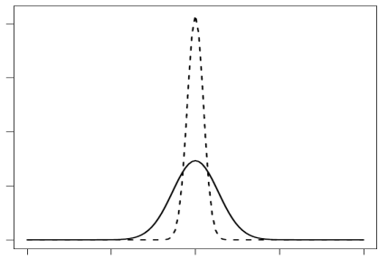
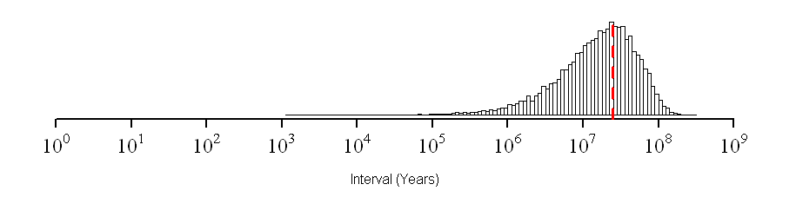
5. Challenging the models with data
A
White noise distribution
(dashed)
B
Burst size
distribution
(solid)
Divergence
Probability
Animation 7
Burst timing distribution
(mean time between
bursts = 25 my)
C
Probability
Interval (years)
Notes:
This slides summarizes what we learn from the maximum likelihood estimates of parameters for the best-fitting multiple-burst model. Consider first the normal distribution of white noise deviations from zero on the y-axis, the initial position of the optimum. The best estimate of the standard deviation of this distribution (shown with a dashed line on the upper left) is abut 0.10. In contrast, the normal distribution of burst sizes (shown with a solid line) has a standard deviation of 0.27, about three times larger. Turning finally to the distribution of burst waiting times (bottom right), we see that on a log scale the distribution is skewed towards ‘short’ waiting times, but the mean time is 25 million years and bursts are very uncommon in intervals shorter than 1 million years. In other words, evolutionary bursts that might carry the lineage out of an adaptive zones are very rare. Furthermore, the large divergence values observed in some fossil time series and more commonly in comparative data would require a succession of several to many bursts (From Arnold 2014, based on Uyeda et al. 2011). Animation 7 shows a series of fits to a subset of the data (see Estes & Arnold 2007) with different versions of genetic drift.

Slide 14
What have we learned?
Quantitative genetic models can be used to model adaptive radiations.
Models in which an adaptive peak is stationary can not account for the scope of actual adaptive radiations.
Bounded evolution is a prevalent mode of evolution on all timescales.
Sudden departures from bounded evolution are rare but may account for the invasion of new adaptive zones.

Slide 15
References
Lande, R. 1976. Natural selection and random genetic drift in phenotypic evolution. Evolution 30:314-334.
Lande, R. 1979. Quantitative genetic analysis of multivariate evolution, applied to brain: body size allometry. Evolution 33: 402-416.
Lande, R. 1980. Sexual dimorphism, sexual selection, and adaptation in polygenic characters. Evolution 34: 292-305.
Hansen, T. F., and E. P. Martins. 1996. Translating between microevolutionary process and macroevolutionary patterns: the correlation structure of interspecific data. Evolution 50: 1404-1417.
Hansen, T. F., J. Pienaar, and S. H. Orzack. 2008. A comparative method for studying adaptation to a randomly evolving environment. Evolution 62:1965-1977.
Estes, E. & S. J. Arnold. 2007. Resolving the paradox of stasis: models with stabilizing selection explain evolutionary divergence on all timescales. American Naturalist 169: 227-244.
Uyeda, J. C., T. F. Hansen, S. J. Arnold, and J. Pienaar. 2011. The million-year wait for macroevolutionary bursts. Proceedings of the National Academy of Sciences U.S.A. 108:15908-15913.
Arnold, S. J. 2014. Phenotypic evolution, the ongoing synthesis. American Naturalist 183: 729-746.

